Slide 1
CFD Simulation
Heat Sink with Folded Fins

Slide 2
Scope of Work
To predict the Temperature distribution on the heat sink using CFD analysis with 6061-T6 material .
Assumptions
Flow is considered to be Steady-state, Incompressible.
Blower is not considered in the model and the flow rate of 55 CFM is considered at the inlet.
Deliverables
Velocity & Temperature Distribution in the heat sink Model.

Slide 3
Inputs
CAD Data of the Model.
Wattages of the IGBT.
Boundary Conditions
Inlet Flow Rate 55 CFM
Inlet Air Temperature : 70⁰C
Material considered for Heat sink is 6061-T6
Tools Used
Mesh Generation -ICEM CFD.
Solver - FLUENT 14.0

Slide 4
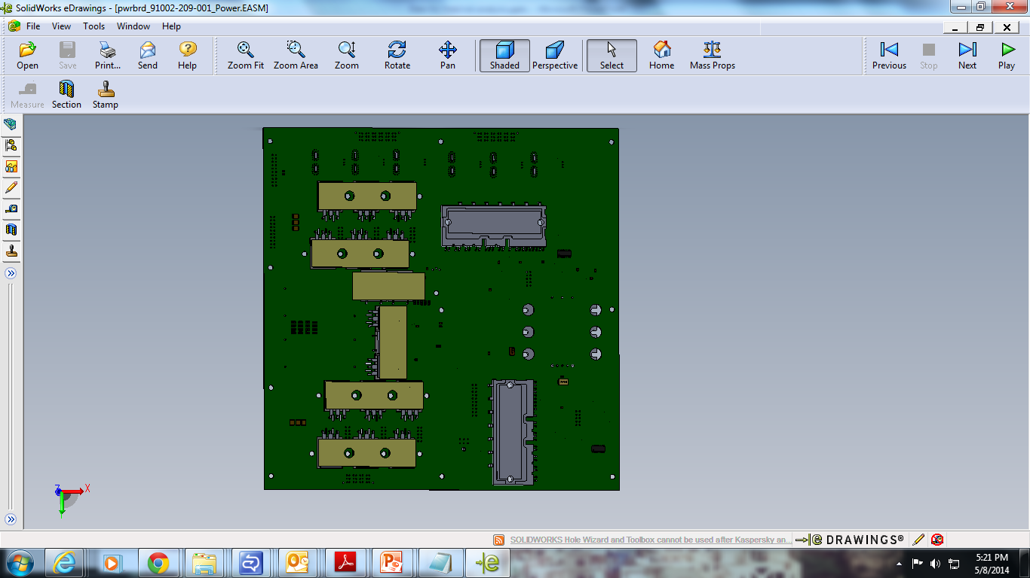
VFMD Details-Power Board Components Power Dissipation
45 watts
3 watts
45 watts
30watts
20watts(Component in other side)
30 watts
45 watts
45 watts
45 watts

Slide 5
Inlet Air Flow Rate is 55 CFM

Slide 6
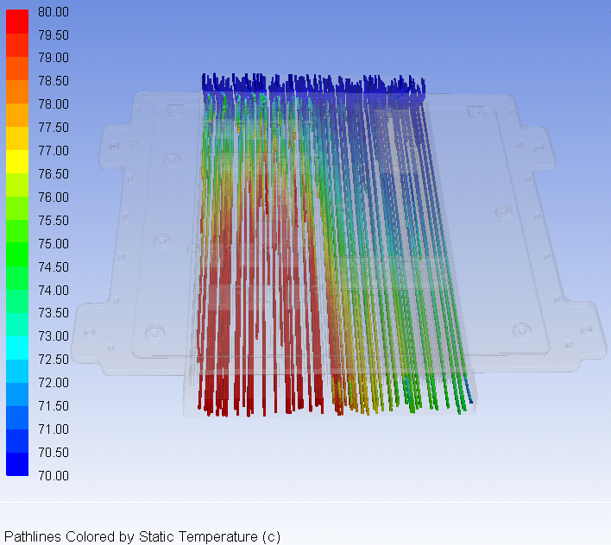
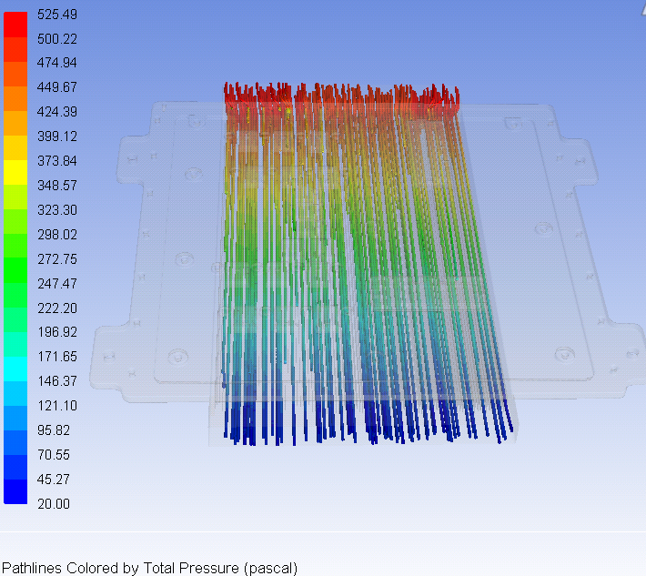
Temperature & Pressure Distribution
Total Pressure Drop is 466 Pa

Slide 7
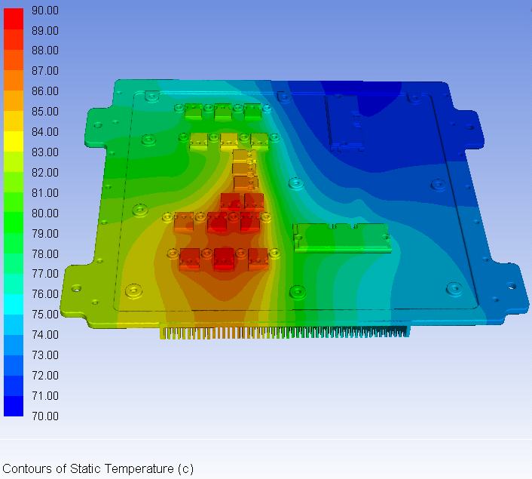
Temperature Distribution on Heat Sink
Maximum Temperature on the IGBTs are less than 100⁰C

