Slide 1
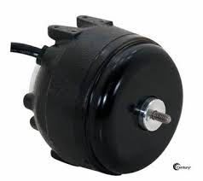
Motor - Reverse Engineering & Development
Motor used for HVAC systems (always-on)
Phase-1: Reverse Engineering, Manufacturing documentation, Testing, Costing
Phase-2: Design & development - Electronics/Software/Electrical/Mechanical, certification
Phase-1:
Reverse Engineering and generation of manufacturing documents
Measurements & Performance Testing, Material testing, BoM Costing
Phase-2:
Electronics/Software/Electrical/Mechanical Design, Prototype/EV/DV manufacturing/Testing
Validation and certification (UL, ATEX)
Phase-1: Met customer targets on schedule, BoM costing, Test reports and manufacturing documents
Phase-2: Preliminary Design in progress
Enhanced Design (Wireless capability, Size optimization), Analysis
Advanced control algorithms, Protection mechanism, Meeting BoM cost target, Test rigs
Validation and certification plans ready, EOL tester support only
Industry Context
Business Objective
Solution Approach
Illustrative purpose only
Business Impact

