Slide 1


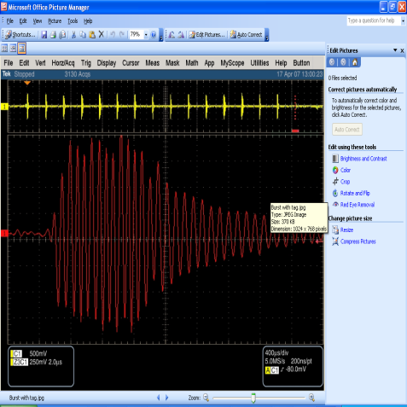
Electronic Article Surveillance System
Scope
Design and Development of Hardware and Firmware for Electronic Article Surveillance System
Environment
TI DSP TMS320LF2407A processor
Code Composer studio and XDS-510 ICE
ORCAD schematic capture, Cadence Allegro and PSPICE
Highlights
A single point solution for complete product development from concept evolving to final product delivery
Unique Transmitter and Receiver design using RF resonance principle
Development of algorithm for detection of the passive LC tag
Synchronization with mains supply to avoid false alarms in case of multiple antennas in operation
Reduction of BOM cost by 40% and passed Australian Emission Test Standards

