Slide 1

ECAD capabilities
Design capabilities:
Multilayer PCB design (1-16 layers), Buried and Blind vias,
High speed boards (Ex: PCI/PCIe, cPCI, DDR,…)
Power Boards with different materials like thermal clad, multilayer PCB along with Thermal Pad
High Density SMT/Through-hole designs, Controlled Impedance board design, Insulation classes
Design of PCMCIA, Backplanes and Motherboard
EMI / EMC design considerations
Thermal Management
High Voltage design (up to 2500 Volts)
DFM / DFT / DFA services
Mechanical constraints
ECAD-MCAD collaboration
IPC standards – 2221 / 2222 for Design
Layout compliance for UL, CE certification
Library Development:
Symbols and Footprints having high pin count (>1000 pins), through-hole/ Fine pitch components
Creating complex Housing connector designs
Design as per IPC-7351 & IPC-7351A/B land pattern standards
Creating Footprint from Gerber, DXF and Drawing files.
Creating checklist and process document as per the client requirements.
ECAD design services:
Complete PCB Layout design solutions for digital, analog, mixed signal and RF boards
New PCB Layout Design & Redesign Projects
Translating the designs from one EDA tool to another
Re-engineering designs for component obsolescence
PCB Reverse Engg & Legacy design translations
Redesigning boards to reduce cost
Library development
Schematics creation & Updates
SI / Thermal analysis
Bill of Material (BOM) Generation
Fabrication files for FAB house.

Slide 2







E-CAD Tool, Competency & Business Overview
Circuit Schematic capture
“Orcad” (Cadence)
“Design View” (Mentor Graphics)
“Allegro Design entry HDL” (ConceptHDL)(Cadence)
“Design Architect” (Mentor Graphics Boardstation)
“DXDesigner “(Mentor Graphics)
Altium
PCB Layout Design
Allegro PCB designer (Cadence)
PADS Professional (Mentor Graphics)
Xpedition PCB Suite (Mentor Graphics)
Altium (PCAD)
CADSTAR (Zuken)
Boardstation (Mentor Graphics)
SI Analysis
Allegro SI (SigXplore)(Cadence)
Thermal Analysis
Hyperlynx Thermal (Betasoft)(Mentor Graphics)
CAM tools
CAM350
GCPreview
Viewmate
Team
Average Experience :
6 to 7 years
Qualification :
Engineering Graduates or Engineering Diploma-holders
Domains:
Consumer
Industrial
Automotive
Aerospace
Semiconductor Equipments
Customer snapshot
Enabled US appliance major to Restructure its libraries over 800+ Components – Valor test passed
Assisting US major with PCB process enhancement
Leading/Managing/ Training the PCB COE team
Sustained engagement with a Semiconductor Major
Sustained engagement with a Auto Major
Reference layouts/designs for a Japanese Chip Maker
Reference layouts/designs for European Aerospace customer.

Slide 3
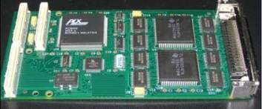
Hardware Engineering for PCI Mezzanine Card Design
Business Needs
Designing of Electronics
8 Channel PMC Serial Card
ROHS Compliance (90% of Components used are ROHS Compliant. Remaining can be replaced directly once it is ready as per manufacturer schedule)
Cost Reduction
I/O’s Compatible with existing system
Design Cycle
Schematics Capture & PCB Design
PCB Manufacturing & Assembly
Integration with VME System, Functional & Final Testing
Product Release Process
Outputs
Study of PCI, PMC and CMC standards
Schematic Entry
PCB Layout
Integration & Final Testing
Design Release for Production
Tools Used
PCAD

Slide 4
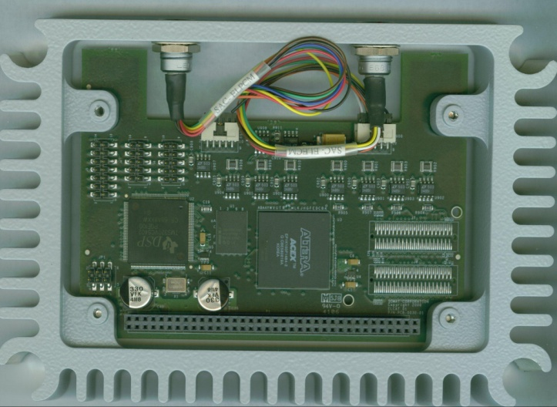
Design of PCM-ECM Expansion Module
Scope
Design of Powertrain Control Module and Engine Control Modules
Design of circuit Schematics and PCB Layout
Selection of components including IP67 connectors
Re-design of enclosure
Solution
TI DSP TMS320VC5402 for data processing and analysis
Altera FPGA EP1K100FC484 for interface and data acquisition
Mentor Graphics – Design View for Schematics
Cadence – Allegro for PCB Layout
AutoCAD for Enclosure Design
Benefits
Rugged Data Acquisition System with IP67 protection for Automotive application.
Designed for field testing in harsh environments.
Communication with other DAQ modules on ISA bus.

