Slide 1
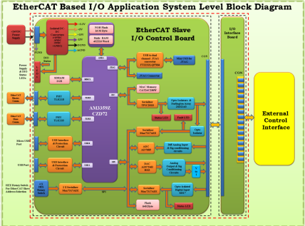
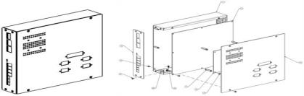
Case Study - EtherCAT Based Input / Output Slave Controller
Business Needs
Design and Development of Hardware & Firmware for a EtherCAT Input / output Slave Controller used Machine control applications
Project Scope
Preparations of Product Specifications , HW / FW Design Documents
Design & Development of Hardware & Firmware for a EtherCAT Input / output Slave Controller
Hardware Design: BOM, Components Procurements, Schematic Design, PCB Layout, Enclosure Design & Manufacturing, Testing & Validation with TwinCAT Master
Firmware Design : Development of Drivers, application logic, IO control and Communication
Business Benefits
End to End Product Development
Scalable DIO and AIO configuration
Easy Integration with any EtherCAT Master
Fast Cycle / Response Time
Deterministic Real Time Performance and Control
Material Type : CRS 18GA, 1.193mm Thickness
Finish : Zinc Plate As per ASTM B 633. TYPE III. TRIVALENT CHROMATE/RoHS, Color Type CLEAR

