Slide 1
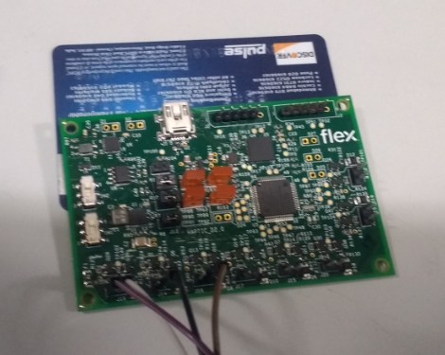
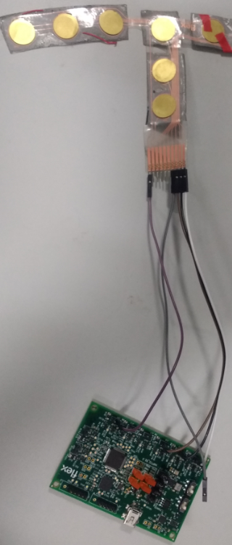
Haptic touch sense Technology-Piezo Haptic Sensor
Business Needs
Design and Development of Hardware & Firmware for a Haptic Sensor used in Automotive application
Design the product in credit card size.
Project Scope
Preparations of Product Specifications , HW / FW Design Documents
Design & Development of Hardware & Firmware for a Haptic sensor
Hardware Design: BOM, Components Procurements, Schematic Design, PCB Layout, & Testing
Firmware Design : Development of Sensing logic, and Vibration
Business Benefits
End to End Product Development
Easy configurable voltage range from 100V to 500V for different vibrations
Configurable for 8 sensors
Single Piezo for both functions, sensing and vibration.
Low cost solution

