Slide 1
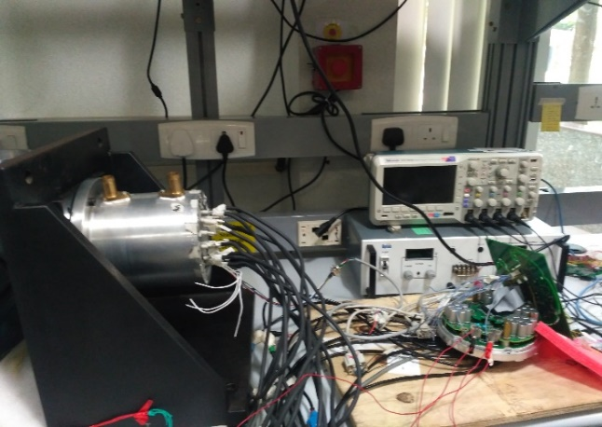
48V Systems - Power Inverter (Motor Control ECU)
Our Understanding
Experience
Strength
Solutions / offerings
Integrated Power Inverter (Motor Control ECU)
High Performance Motor Control Algorithm
Model Based Development
Liquid Cooled Thermal Management
Safety Compliance – ISO 26262
EMI / EMC Compliance
No of Resources
20+ Resources
2+ SMEs
Partner Eco System
Hardware Fabrication and Components Assembly
EMI / EMC Testing
Design and Development of Power Inverter (Motor Control ECU) for
48V Mild Electric Vehicle
Functional Safety – ISO 26262 Compliance
AutoSAR Compliant Architecture
Validation and Testing – Dyno Testing
Challenges
High Efficiency
Safety and Reliability
Thermal Management
Compact Design
Case Study
Design and Development of an Integrated Motor Control Unit for Interior Permanent Magnet Synchronous Motor for Mild Hybrid Electric Vehicle

Slide 2
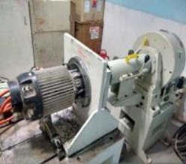
Case Study 1: 48V Power Inverter (Motor Control ECU) for HEV (1/6)
For European Tier-1
48V 18kW 65Nm IPMSM for Mild HEV
Objective:
Design and Development of an Integrated Motor Control Unit for Interior Permanent Magnet Synchronous Motor for Hybrid Electric Vehicle
ENG2
ENG10
ENG4
ENG9
ENG5
ENG8
ENG5
ENG7
Scope:
End to End Product Development Include
System Level Design
Software Design and Development:
Hardware Design and Development
Testing: Software, Hardware, System and Dyno Testing
AutoSAR Compliance
Functional Safety Compliance : ISO 26262 – ASIL-C
ENG6
ENG6
Thermal Model
Features:
Motor Control Algorithm: Sensored Vector Control : FOC
Inverter: Two Level Voltage Source Inverter: Full Bridge SiC based MOSFET
PWM Topology: Space Vector PWM
Model Based Development
Regenerative Braking Capability
Fault Management: Over Voltage, Over Current and Over Temperature etc.
Diagnostics and Network Management
Liquid Cooled Thermal Management
Dyno Testing
Integrated ECU
High Level Specifications:
System Voltage: 48V
Motor Capacity: 18 kW, 65 Nm, 18,000 RPM
Motor Type: IPMSM
Motor Position
Control Processor
Phase cut off circuit
Motor
Phase cutoff Final
CAN
CP Heart beat
PWM Initial
Motor Driver
PWM Enable
HW Protection Logic
SPI
MP Heart beat
PWM Final
Monitor Processor
Phase cutoff
Initial
Driver Diagnostics
Phase current
Phase voltage
Motor, board temperature
Motor position
Safety Architecture

Slide 3
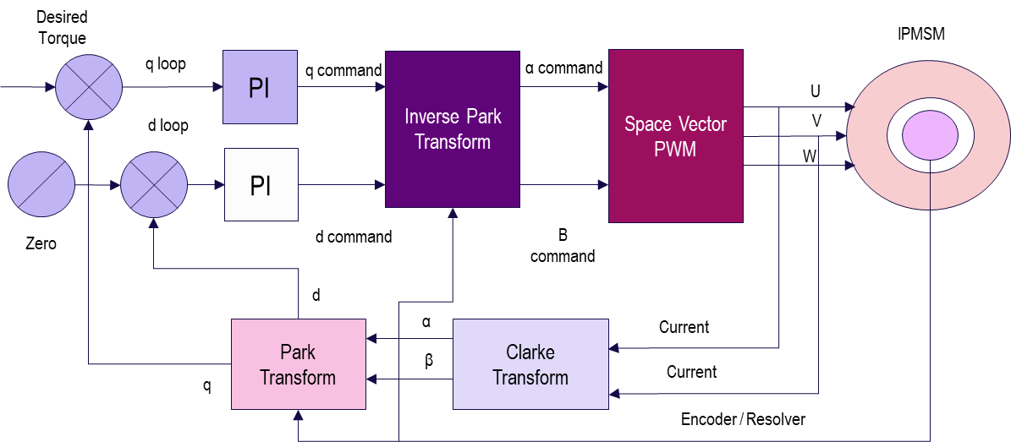
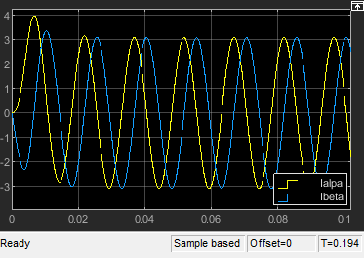
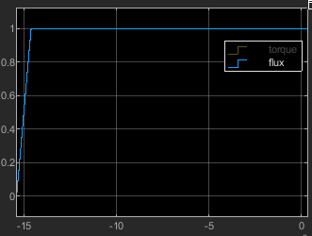
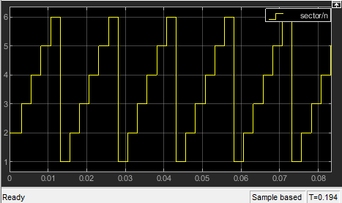
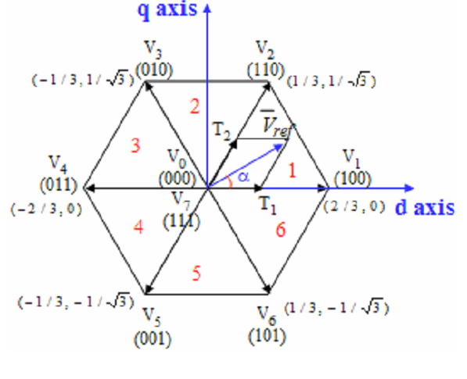
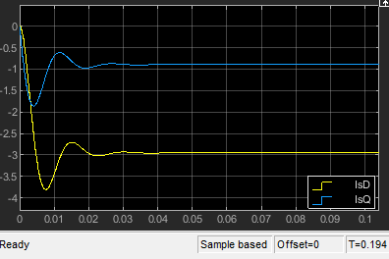
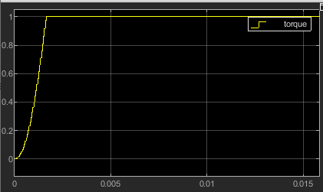
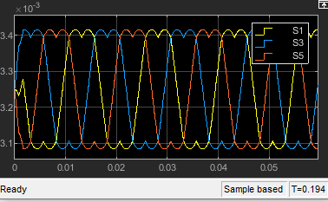
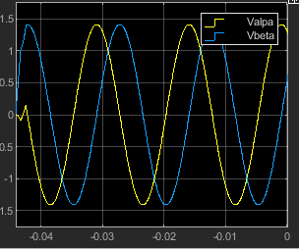
Case Study 1: Motor Control Algorithm Development Flow – Model Based Development (2/6)
FOC
Requirement Analysis
Design
Development
Testing
Evaluation
MBD : Mat lab / Simulink / State flow
Auto code Generation: Target link
SVPWM
Clark Transform
Flux Response
Sector
Park Transform
Vu, Vv, Vw
Torque Response
Space Vector & Sectors
Inverse Park

Slide 4
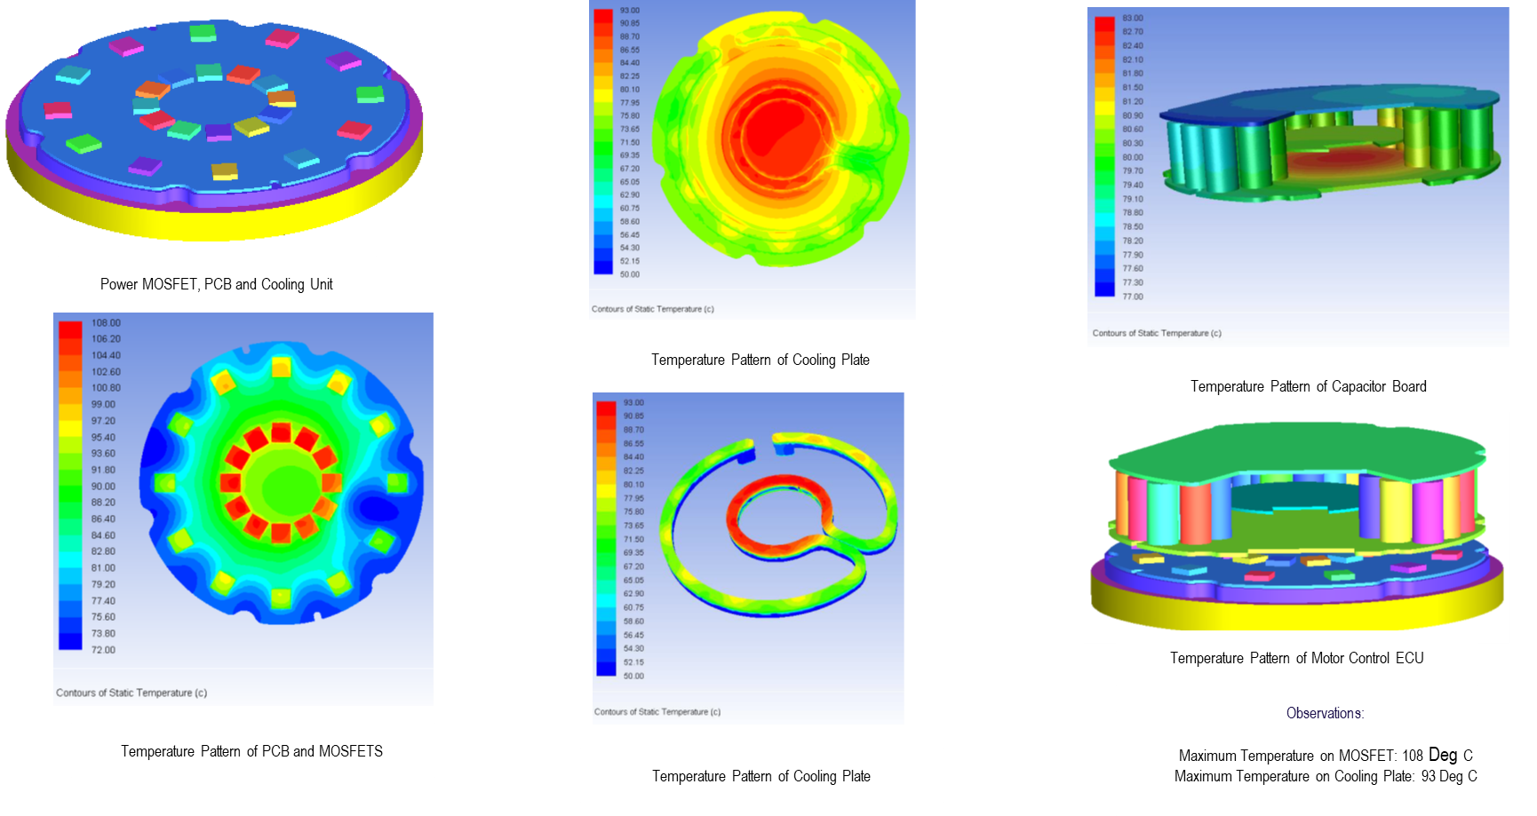
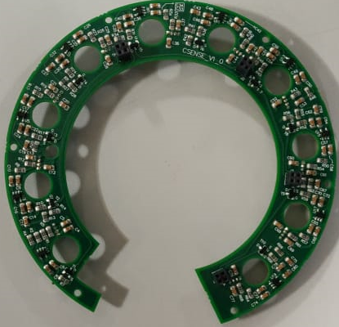
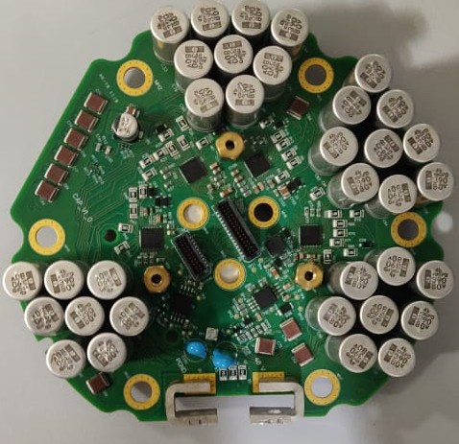
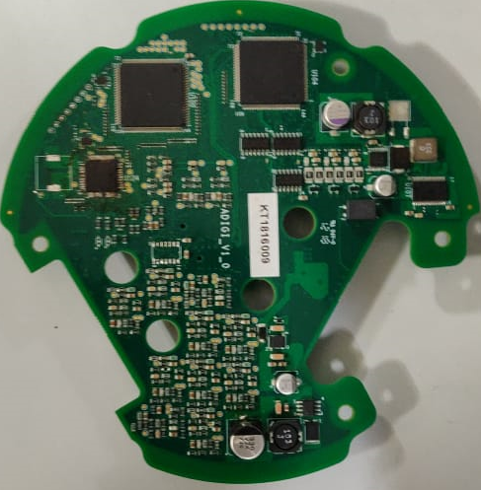
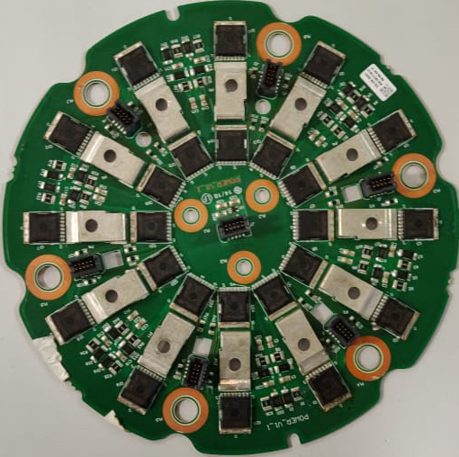
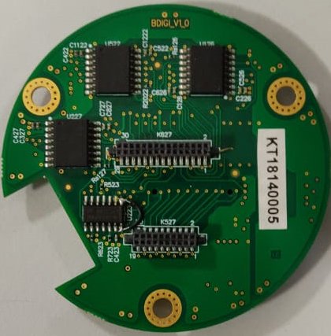
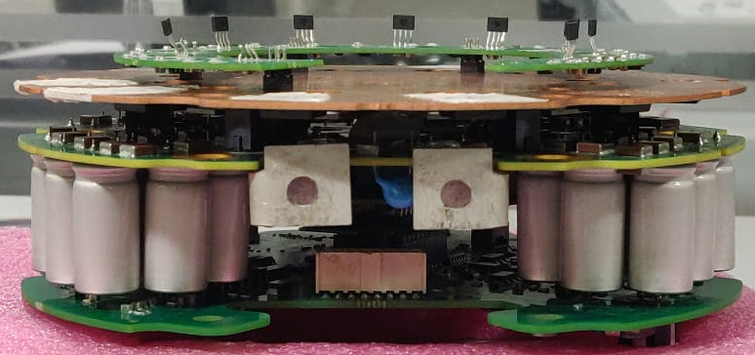
Case Study 1: Hardware Development Workflow & Thermal Management of Power Inverter (3/6)
Hardware Development Workflow
Thermal Management of Power
Define Architecture
Select Key Components
Schematic Design
PCB Layout
Assemble, Test & Debug
EMI/EMC Conformance Test
Hardware Design Tools:
Mentor Graphics,OrCAD,Simetrix, pSpice
Liquid Cooling based Thermal Management of Power Inverter had been done to study the temperature in MOSFET junctions and to control the liquid flow rate accordingly
Inputs for the modelling
- 3D Geometry of the model
- Boundary Conditions like inlet mass flow rates and Power
dissipation of MOSFETS
Thermal Modelling and Simulations were performed with the given Ambient conditions, MOSFET junction temperature and flow rate
SW Tools used :
Meshing & analysis: ICEM CFD & Fluent
Current Sensor
Capacitor
Main Controller
Power
Isolation
Motor Controller ECU

