Slide 1


48V MILD HYBRID EDS
ECU Development
2018

Slide 2
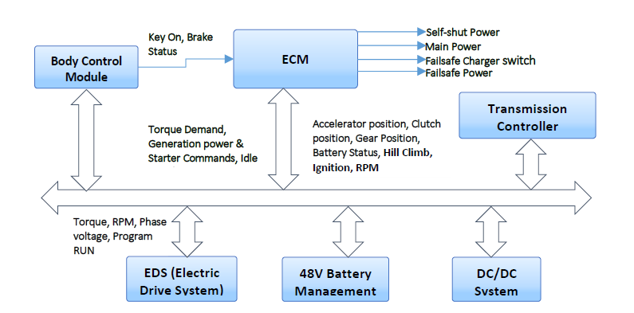
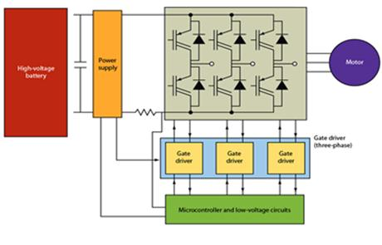
EDS Controller – Project Overview
Objective:
48V mild hybrid system Motor controller design
Scope:
48 Volt mild hybrid control design (HW and SW).
Motor Traction control.
Regenerative charging
Start/Stop control
Hardware Development
Application SW Development
Platform SW Development
ISO26262 Compliant Functional Safety – ASIL C
Copyright © 2017 Tech Mahindra. All rights reserved.
2

Slide 3
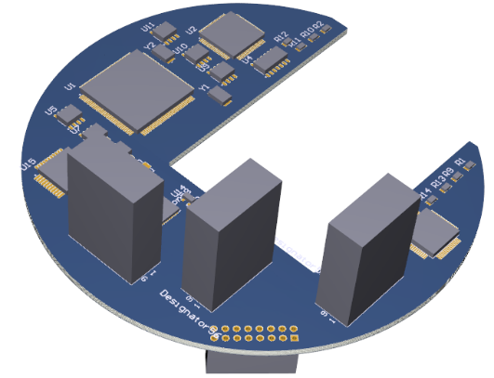
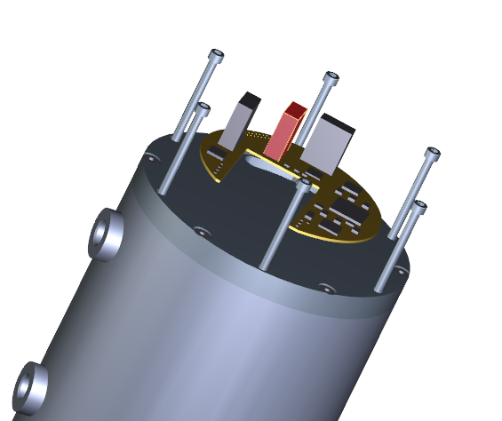
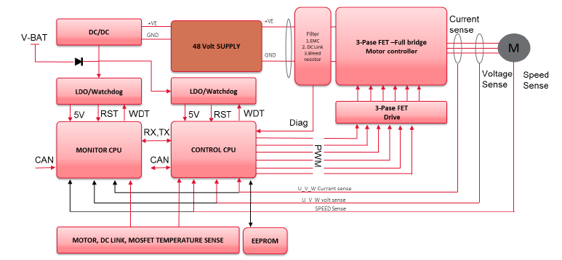
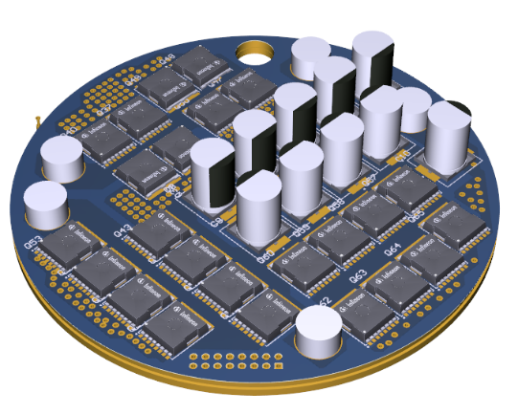
EDS Controller – HW Development Overview
HW Overview
Two CPU system Architecture
3 Phase Mosfet motor Driver for Inverting DC-AC
60Nm /18KW/21000RPM PMSM closed loop control by FOC.
Torque control and Regenerative control
Start /Stop functionality
Mechanical 3D Model Development
PCB Placement, Routing and Gerber Release
Traction motor is overheat protection
Mosfet high temperatures protection
Smoothing condenser high temperatures protection control

Slide 4
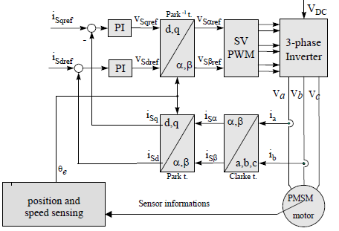
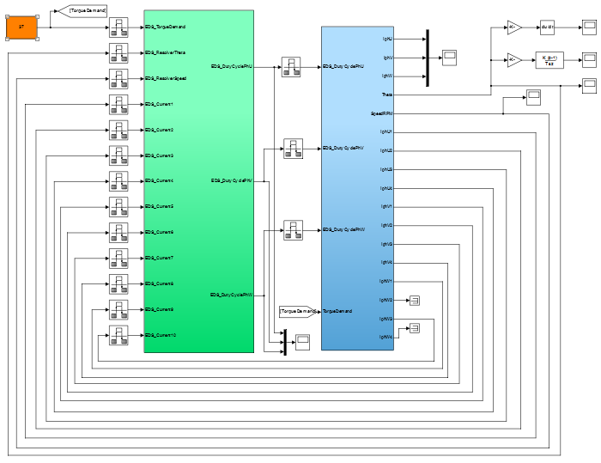
EDS Controller – SW Development Overview
SW Overview
Field Oriented Control of PMSM Motor
Functionalities – Torque-Boost, Generator Control, Start-Stop
Model Based Design for Application Software Development
Field Oriented Control (FOC) of 3 Phase Multicoiled- PMSM Motor using PI control of Torque component of current (Iq) and Flux component of current (Id)
Space Vector Pulse Width Modulation (SVPWM) used for 3 phase inverter
Field Weaking Control
Plant Model Development – Inverter Model, DQ Modeling, PMSM Motor Model, Load Model, Multi Coil
Model In Loop (MIL), AutoCode Generation & Software In Loop (SIL)
ISR Based Motor Control – Sampling Period 50 uS (20Khz)
ISO26262 Compliant Monitor Processor Software Development
Tools MATLAB-Simulink and TargetLink
Platform SW is developed using ARCCORE AutoSar Stacks
BSW Stack Configuration, CDD Configuration, MCAL Configuration
RTE Configuration
Tools - EB-Tresos for MCAL, HighTec Compilers

Slide 5
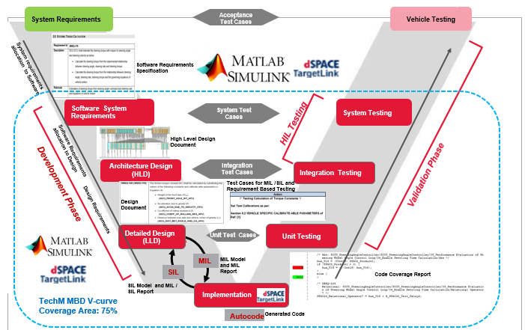
EDS SW Development – Model Based Design
Requirements Specifications
EDS System Requirements
Software Requirements Specifications
Hardware Requirements Specifications
High Level Design
Modelling and Simulation
Algorithm and logic definition
Simulink model development
MIL testing
Auto coding and SIL testing
Data dictionary development
Auto coding
SIL testing
Integration testing
Support for Integration testing
EDS Parameter tuning
Maintenance
Bug fixes
Calibration change
Fine tuning the application
Model Based Design – Application SW Development

Slide 6
EDS Controller – Challenges
Challenges
Constraints on ECU size, dimensions – Divided into 5 PCBs – Current Sensor, Power Board, Cap Board, Digital Boards
Driver Circuits for Multi-Coil (3 phase divided into 12 coils) – PCB Lay-outing, Synchronism for driving MOSFETs
ADC Sampling for all 12 coils
FOC based control for Multi-Coil based PMSM Motor
Functional Safety using Monitor Processor – To be sync with Control Processor
Copyright © 2017 Tech Mahindra. All rights reserved.
6

