Slide 1
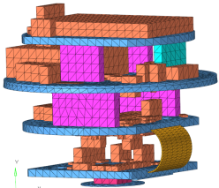
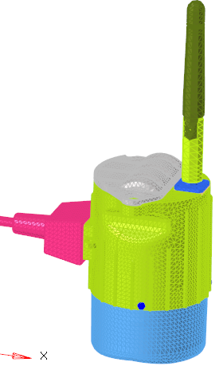
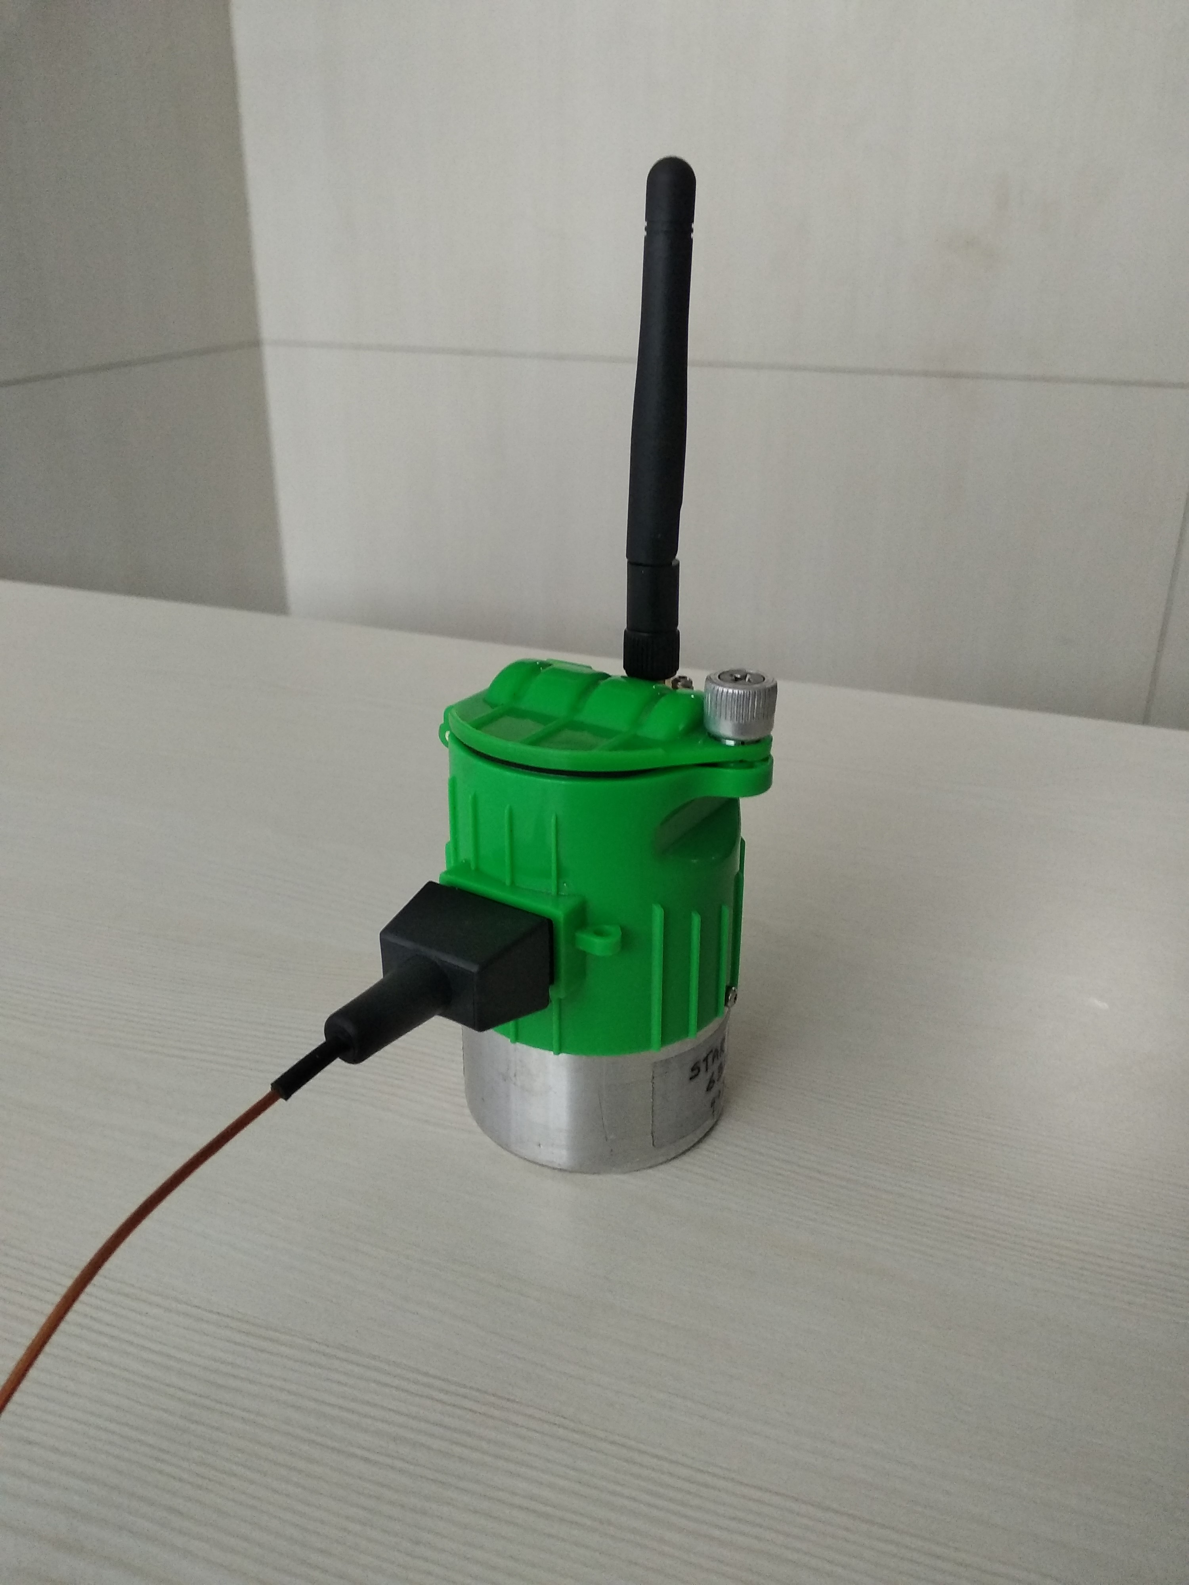



Wireless Vibration sensor
Scope
To design and Proto development of Vibration and temperature sensor with wireless communication.
Input
Design and development of vibration sensor till 8 KHz bandwidth.
Wireless communication to Gateway -IEEE 802.15.4 compliant 2.4GHz radio.
Sensor to meet IP55 protection rating.
Approach
Requirements & Design
Analysis (FEA)
Development
System testing
Pre compliance
Compliance certification
Requirements Analysis.
Critical component selection.
Schematic and layout design
FW design
Mechanical enclosure design
FEA Analysis
Proto development (HW and Mechanical)
FW development
Functional testing
Vibration testing till 4K frequency input frequencies.
Temperature range testing
RF range testing
Pre compliance testing.
Compliance testing and certification for EMI/EMC,FCC,CE and IP55.
Challenges
Component availability as per specification
Cost effective solution , Small size
Longer battery life (With 4kilobytes of data/Transaction)
Transmission range: 100m

