Slide 1
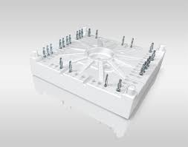
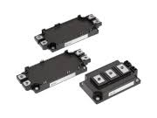
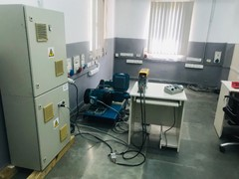
Obsolescence Management – Power Devices & others
Scope:
Complete Ownership of product obsolescence activities for components in VFDs:
Requirement analysis based on PCN / EoL notification from suppliers
Component usage in products, BoM affected by change
Assess impact on UL file
Search alternate components, generate technical comparison and propose commercial strategy
Procure samples, validate and generate test reports
Raise ECN and update design documents (BoM, schematics, layouts, etc)
CIB modules and IGBTs:
Characteristic comparison
Gate resistance assessment
Power Loss calculation and assess changes required in product
Procure samples and validate
Switching characteristics
Temperature rise test
Overload behavior
BoM, schematic and PCB layout update
Regenerative test set-up in PE lab

