Slide 1
P404 – Project brief

Slide 2
Business Problem
Customer's requirement was to
Optimize the baseline prototype design to a leaner, cost effective and a production intent design in a record time of just eight months.
Customer's expectations were to
Integrate the motor and the controller
To reduce the assembly form factor
To improve the safety and reliability by avoiding the high current cables running between the controller and the Motor
Design of a cost effective product that requires minimum after-market support.

Slide 3
Solution
MSAT provided the following solution
An integrated 17KW / 120 Nm integrated ECU-Motor, production intent design with
Integrated packaging design,
Controller power layout design
Effective thermal dissipation design
Cleaned up the baseline design to optimize it to a lean circuit.
Re-designed the PCB layout for better thermal management, signal integrity, balanced impedance paths for critical signals etc.
Run all the requisite design analysis like CFD, FEA, Thermal, reliability analysis, FMEA etc., at the source to make the product design more robust and to increase the overall reliability of the product.
The key differentiator of this program was
An integrated motor controller design is being tried out for the first time on a non-passenger vehicle (i.e. on a Light electric truck, Laden Wt: 2 ton, Unladen Wt: 1.4 ton).

Slide 4
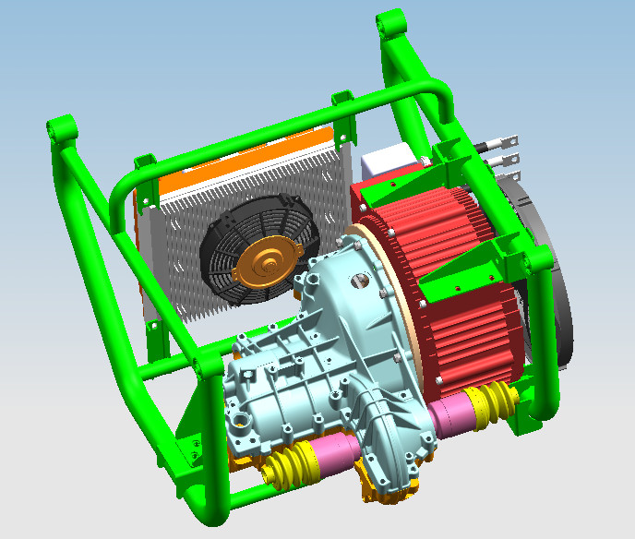
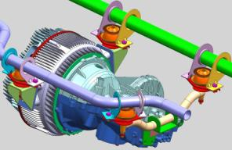
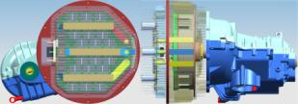
Project Brief
Baseline Design
New Design
Vehicle Front
Vehicle
Up
Vehicle RHS
Separate Motor & Controller
Rotor mounts toward clutch side
Proto vehicle available for testing
Motor & controller assy. Mount on tubular structure (Cradle)
Integrated Motor & Controller
Stator mounts towards clutch side
Motor mounted direct on vehicle chassis
Compact design
Better Manufacturability

Slide 5
Business Benefits
The following are the value creation out of the program
Integrated packaging has reduced the vehicle assembly form factor by around 30%
Improved Safety, Reliability and manufacturability.
Cost effective and optimized solution resulting in less manufacturing TACT, assembly and test time, thereby increasing the productivity.
Faster time to market. The design has been rolled out within eight months.

Slide 6
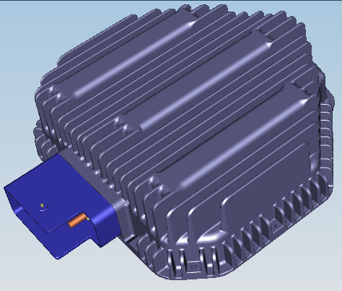
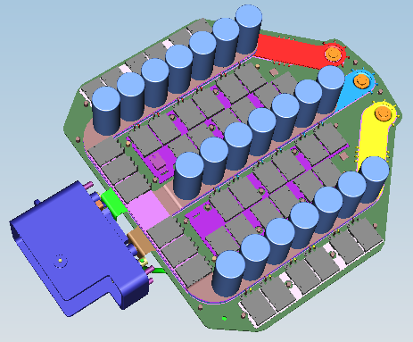
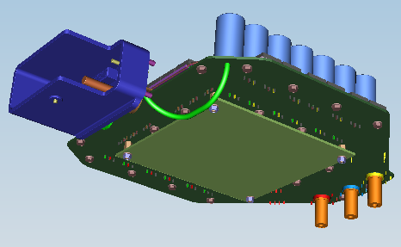
Integrated design
The Integrated motor –controller design have only two PCBs
Integrated Logic Board
Integrated Power Board
Controller casing with heatsink
IPB with bus bars, MOSFETs and capacitors
Integrated logic board stacked to IPB

