Slide 1
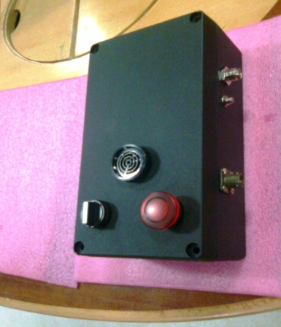
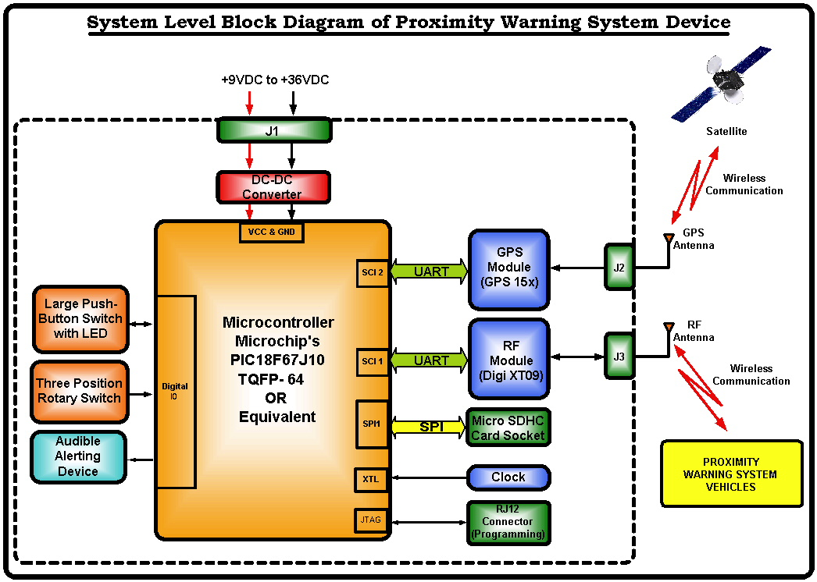
Design and Development of Proximity Warning
System
Objective
Design and Development of Hardware and Firmware for Proximity Warning System for Rail Road Repair Equipment using RF and GPS modules
Environment
CCS C Compiler, ICD for Debugging
ORCAD schematic capture. Cadence Allegro, PSPICE and SI Analysis tools
AutoCAD/SolidWorkd for Enclosure Design
Highlights
End to End Product Development
GPS and RF modules for location identification and wireless communication
Configurable distance limit to indicate nearby vehicles
Rugged IP65 Enclosure – Die Cast Aluminum to meet harsh environments
FAT 32 file system for data logging
Implementation of Message communication with complex signature
Configurable distance thresholds for Audio and Visual alarms

Slide 2

Project Details
Scope:
Design and Development of Hardware and Firmware for Proximity Warning System for Rail Road Repair Equipment using RF and GPS modules
Critical Specs
Input supply : +9VDC to +36VDC
Solution :
End to End Product Development
GPS and RF modules for location identification and wireless communication
Configurable distance limit to indicate nearby vehicles
Rugged IP65 Enclosure – Die Cast Aluminum to meet harsh environments
FAT 32 file system for data logging
Implementation of Message communication with complex signature
Configurable distance thresholds for Audio and Visual alarms
Tools:
CCS C Compiler, ICD for Debugging
ORCAD Schematic capture. Cadence Allegro PCB Layout , PSPICE and SI Analysis tools
AutoCAD / Solid Work for Enclosure Design
Standards :
EMI/EMC - IEC 61000-4.3/2/6

Slide 3
System Level Block Diagram

