Slide 1
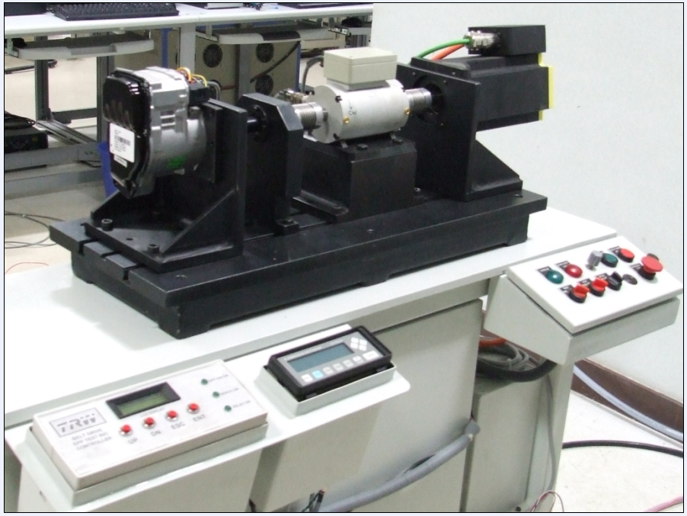
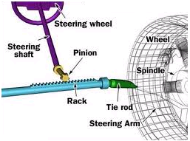
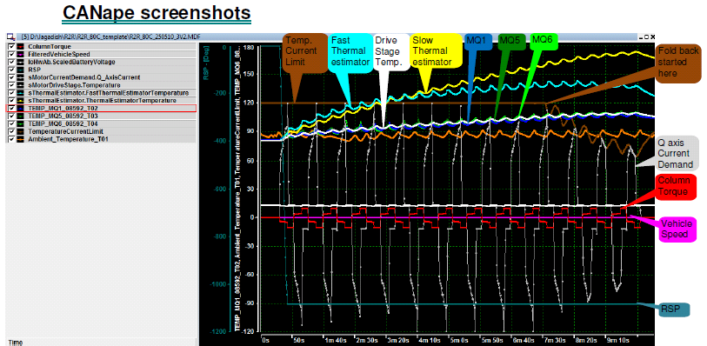
Power Steering test rig
Rack to Rack test involves running the DUT in simulated vehicle environment where vehicle speed, Engine speed, Steering wheel angle and torque fed to DUT in controlled ambient temperature. This test mainly simulates the parking scenario where Driver steers vehicle extreme ends on both left and right directions. During running these profiles ECU performance is recorded as shown below.
Tester
Recorded test results.
These results gives insights of DUT performance – Electrical, Thermal. Also givers system behavior details during this test profile.

