Slide 1
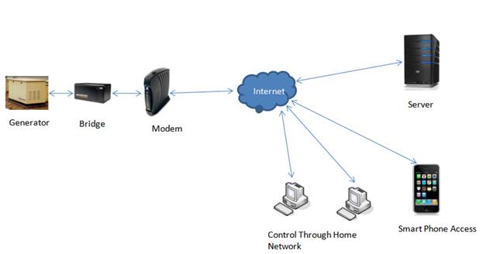
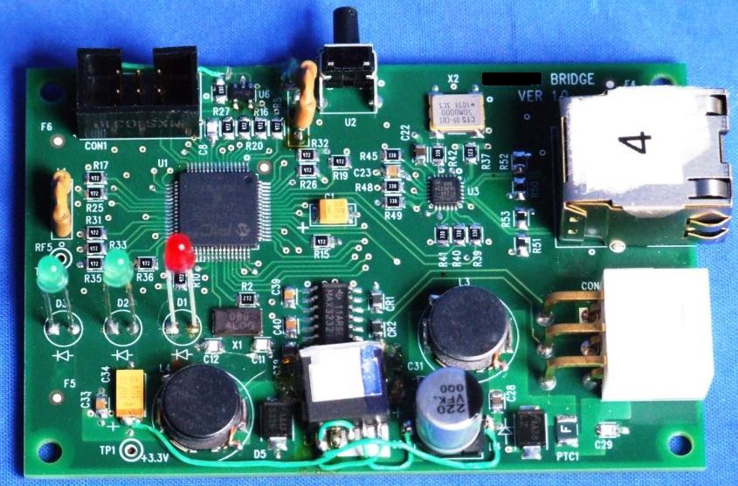
Remote Monitoring System
Remote Monitoring of the Power generators thru Internet
Design bridge hardware a to extract required parameters from generator and transfer to server through Ethernet (Internet) using Modem / Routers.
Develop server application with GUI for data analysis, Alert generation and notification to different user levels.
Highlights
Scope
Remote monitoring and control of Generator thru Internet.
Bridge to interface the generator to outside world. Automatic configuration of the Bridge. No User configuration required.
Cost effective, as no Static IP/domain is required
Health of the generator shown in graphical and tabular format
Schedule (Generator) maintenance activities through the tool itself
Schedule periodic exercise for generator.
Remote start / stop of the Generator.
Communication of Alerts to Smart phones (dealer and end-user) through email/SMS.
End User
Ability to view the status of generator anytime, anywhere
Improved Generator life and performance due to periodic Exercise
Faster service response from dealer
Convenience of ordering maintenance items online
Manufacturer
Ability to view the entire population of connected products to gather marketing data and product trends
Incremental revenue per unit through subscription
Increased trouble shooting ability for Manufacturer’s tech support
Better end-user satisfaction
Provides ability to “push” software updates & advertisements.
Key Benefits
.NET 2.0, Sql Server 2005
IIS Web Server, Apache Web Server, Device Drivers,
Client Server Applications Netbeans, Requisite Pro, Eclipse
C, C++, Java, Swing, AWT, HTML, DHTML
Project Environment

Slide 2
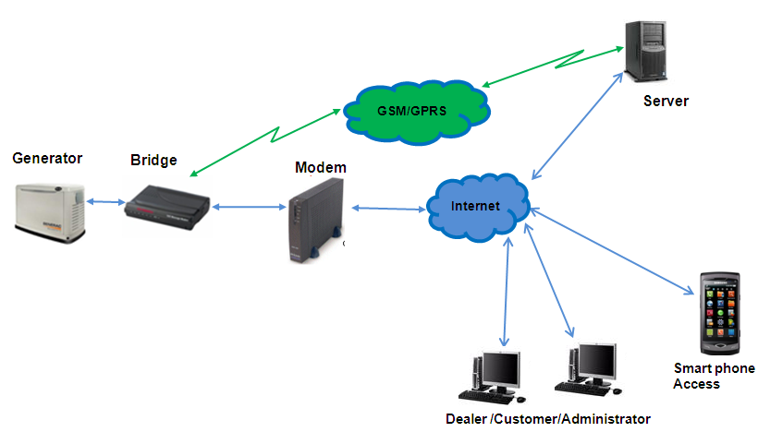
Remote Monitoring System
Remote Monitoring of the Power generators thru Internet
Design bridge hardware a to extract required parameters from generator and transfer to server through Ethernet (Internet) using Modem / Routers and thru GSM/GPRS
Develop server application with GUI for data analysis, Alert generation and notification to different user levels.
Highlights
Scope
Remote monitoring and control of Generator even where wired network infrastructure is not available.
Dashboard shows the health of the generator (Engine RPM, Battery voltage, Generator voltage, Engine status, etc.) in graphical or tabular format
Display of Fault status like, Low battery, High coolant temperature, RPM Sensor fault, etc.
Monitor Fuel level and usage
Monitor additional Digital inputs
Report Generation covers DG Run hours, Alarm status, EB Fail hours, etc.
Map display –useful for Administrator and users with multiple Gensets
OTA Firmware upgrade
End User
Ability to view the status of generator anytime, anywhere
Improved Generator life and performance due to periodic Exercise
Faster service response from dealer
Convenience of ordering maintenance items online
Manufacturer
Ability to view the entire population of connected products to gather marketing data and product trends
Incremental revenue per unit through subscription
Increased trouble shooting ability for Manufacturer’s tech support
Better end-user satisfaction
Provides ability to “push” software updates & advertisements.
Key Benefits
.NET 2.0, Sql Server 2005
IIS Web Server, Apache Web Server, Device Drivers,
Client Server Applications Netbeans, Requisite Pro, Eclipse
C, C++, Java, Swing, AWT, HTML, DHTML
Project Environment

