Slide 1
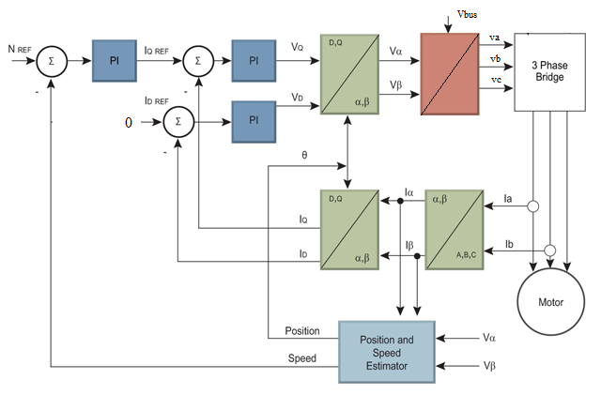
Hybrid Electric Vehicle Motor Controller ECU : Case Reference
Industry Context
The proliferation of the Hybrid & Electric Vehicle is dependent on the performance of an electric motor and power electronics components
Business Objective
Advanced motor controller algorithms to meet vehicle level requirements
Highly efficient inverters / converters to generate quality power supplies
Powerful hardware to support sophisticated algorithms
Model based software development life cycle
Solution / Approach
High Performance Torque Control Scheme
High Torque & speed control capabilities
Highly efficient power converters
Regenerative braking capabilities
IS0 26262 compliance
AUTOSAR compliance
Business Impact
Successfully developed and tested for different vehicle operating conditions
Scalable Architecture
Advanced control algorithms
Design and development of highly efficient power converters
Value Addition
SVPWM, Ant Windup Scheme and Field Weakening Control

