Slide 1


Presentation to Carrier

Slide 2
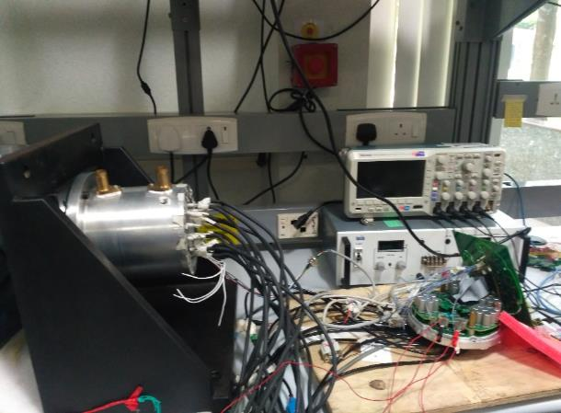
Mild Hybrid Drive Controller 1/3
The proliferation of the Hybrid & Electric Vehicle is dependent on the performance of an electric motor and power electronics components
Advanced motor controller algorithms to meet vehicle level requirements
Highly efficient inverters / converters to generate quality power supplies
Powerful hardware to support sophisticated algorithms
Model based software development life cycle
High Performance Torque Control Scheme
High Torque & speed control capabilities
Highly efficient power converters
Regenerative braking capabilities
IS0 26262 compliance
AUTOSAR compliance
Successfully developed and tested for different vehicle operating conditions
Scalable Architecture
Advanced control algorithms
Design and development of highly efficient power converters
Industry Context
Business Objective
Solution Approach
Business Impact

Slide 3
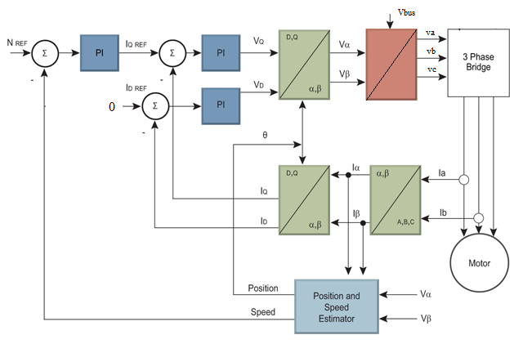



Mild Hybrid Drive Controller 2/3
Requirement Analysis
Design
Development
Testing
Evaluation
Field Oriented Control
Value Addition
SVPWM, Ant Windup Scheme and Field Weakening Control

Slide 4
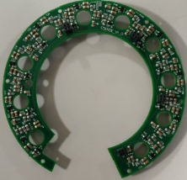
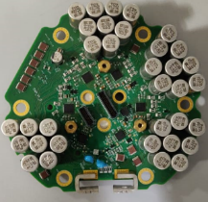
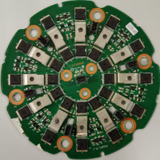
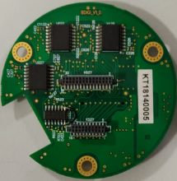
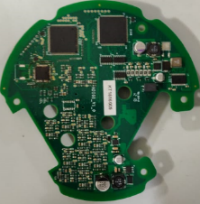
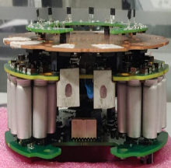
Mild Hybrid Drive Controller 3/3
Define Architecture
Select Key Components
Schematic Design
PCB Layout
Assemble, Test & Debug
EMI/EMC Conformance Test
Current Sensor
Capacitor
Power
Isolation
Hardware Design Tools:
Mentor Graphics,OrCAD,Simetrix, pSpice
Main Controller
Motor Controller ECU

Slide 5





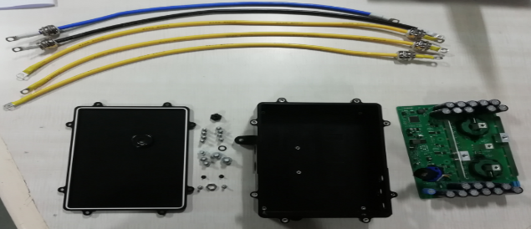
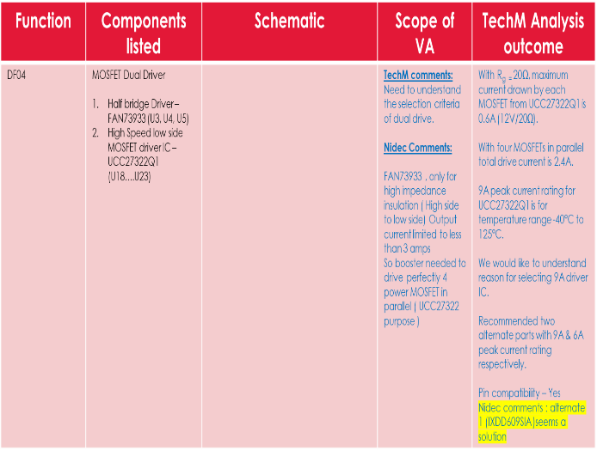
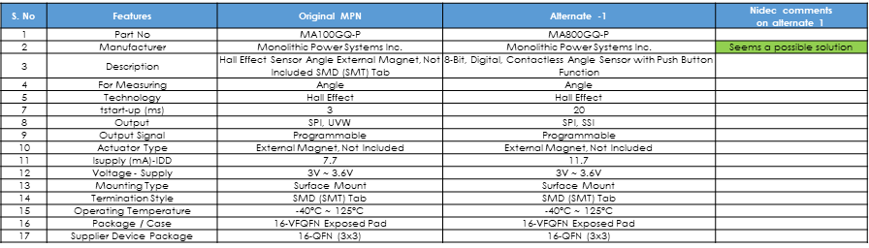
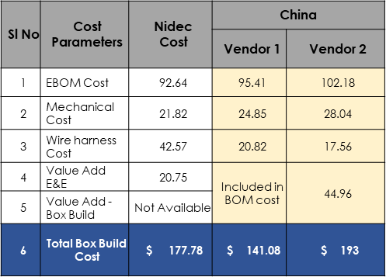
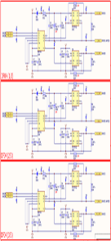
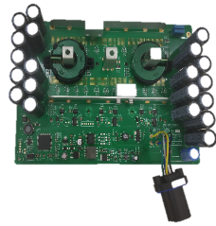
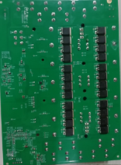
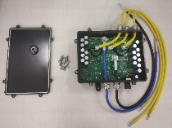
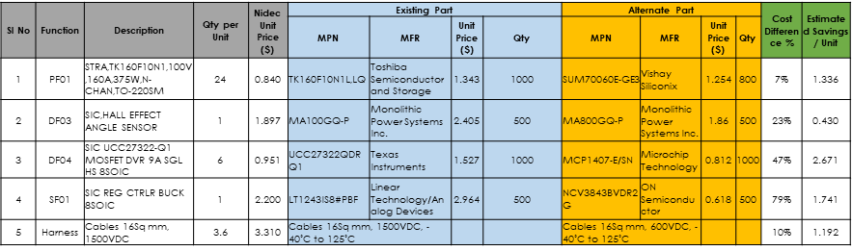
Project Execution Approach 2/2
Input Study
Design Review
Idea Generation
Identification of Low cost FFF alternates
Low Cost Alternate vendor Identification
Product Study
Understanding the functionality
Teardown
Study the schematic
Identify areas for Cost optimization
Schematic Analysis
Identify high cost components in BOM
Brainstorming on idea generation
Check the feasibility for implementation
Shortlist the ideas
Datasheet study
Prepare Comparison Sheets w.r.t. existing parts specs
Float RFQ to supplier
Verify cost competitiveness
Identify vendors for Mech parts & EMS in China\India
Float RFQ
Quote analysis
Quote Finalization
Teardown
Schematic Analysis
Low cost FFF alternates Specifications Comparison
Vendor Quote Comparison

Slide 6
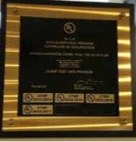
Power Electronics Lab (Pune)
Area – Approx. 2600 sq. ft.
Max power of AC drives that can be tested – 45kW
Drive voltage rating test capability (Mains Supply 415V, Others through high current rating Auto transformer) – 1110V, 240V, 415V, 575V, 690V
Tests Performed
EMC
Functional
Heat Run
Product certification
Destructive tests with 5kA short circuit capacity (5kA at 415V, 240V, 575V, 4.5kA at 690V)
Component evaluation
Circuit operation
Abnormal conditions testing
Mechanical testing
Certification under UL CTDP (Client Test Data Program)
Maintaining high level of safety
Motor room with number of rigs – 22kW AC, 11kW AC, 4kW AC, 10.4kW servo, 6kW Servo, 2.5kW Servo)
Thermal Chamber for heat run up to 50°C actual ambient

Slide 7
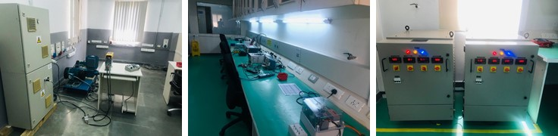
Power Electronics Lab (Hyderabad)
Functional evaluation of drives up to 7.5kW
AC drives, DC drives and Servo drives
Regenerative test set-up for loading drives
Environmental chamber for testing under temperature variation of:
-40⁰C to 120⁰C and RH of 20% to 95%
Source Capability:
380VAC to 600VAC, 3-phase; Current: 30A
180VAC to 280VAC, 3-phase; Current: 40A
Capability to enhance source capacity to 250A

Slide 8
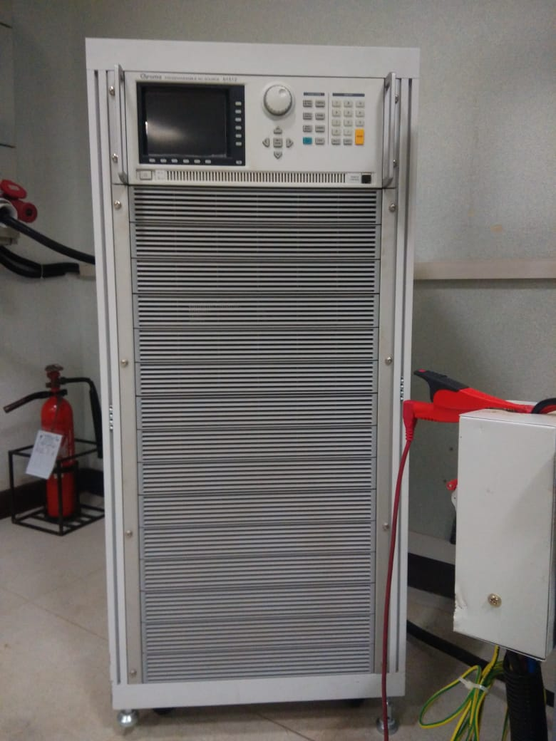
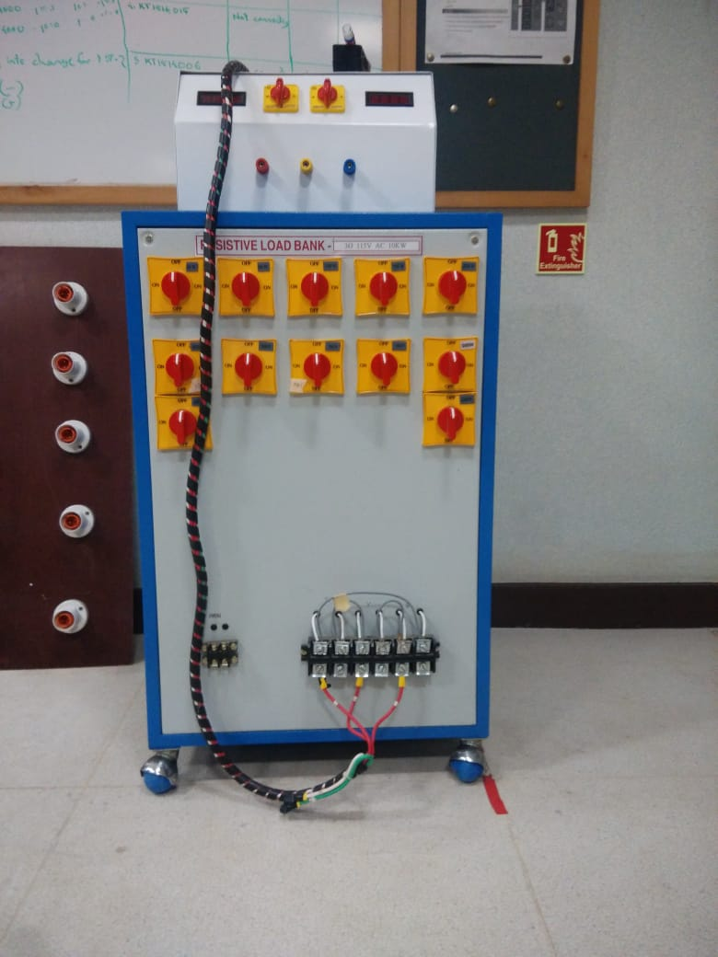
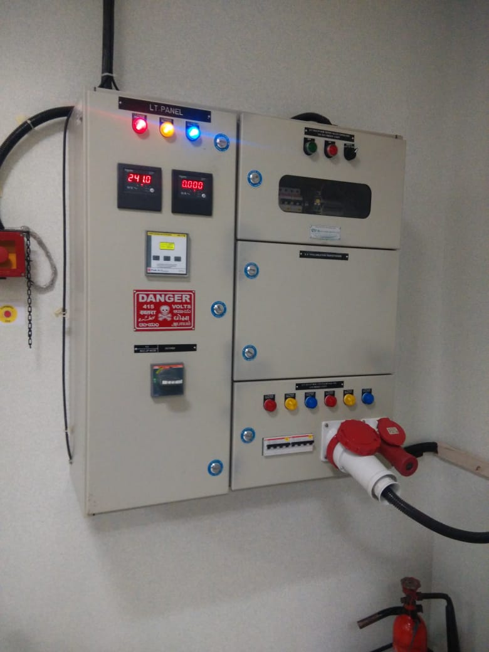
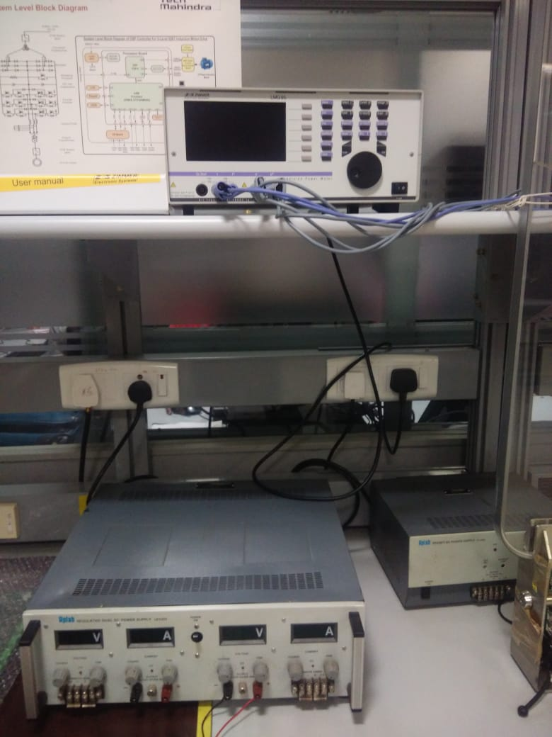
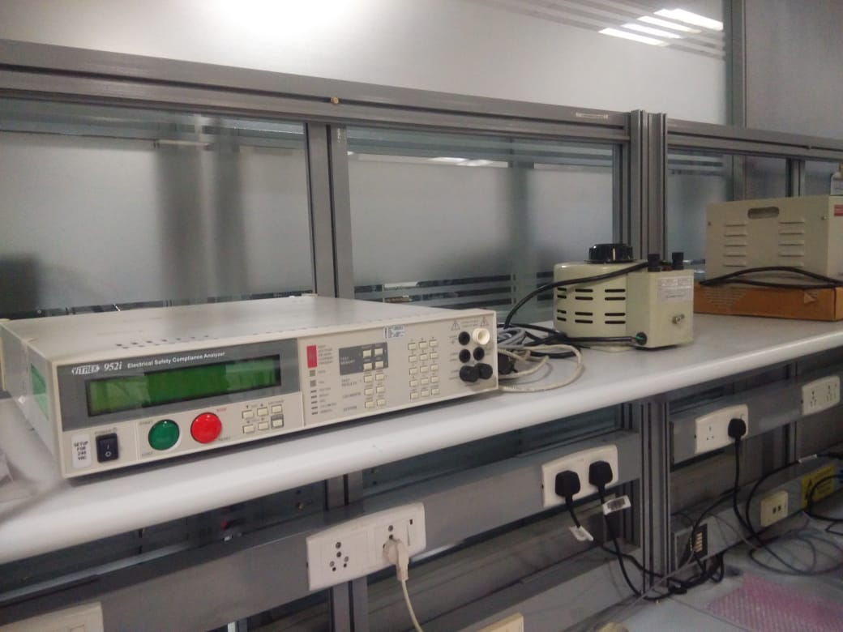
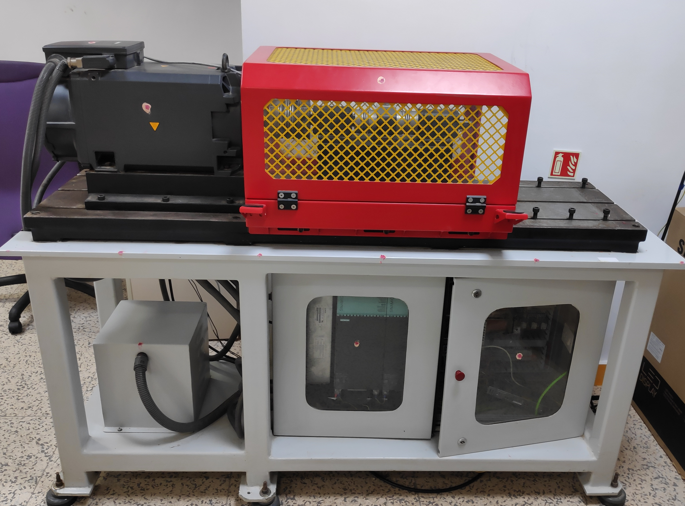
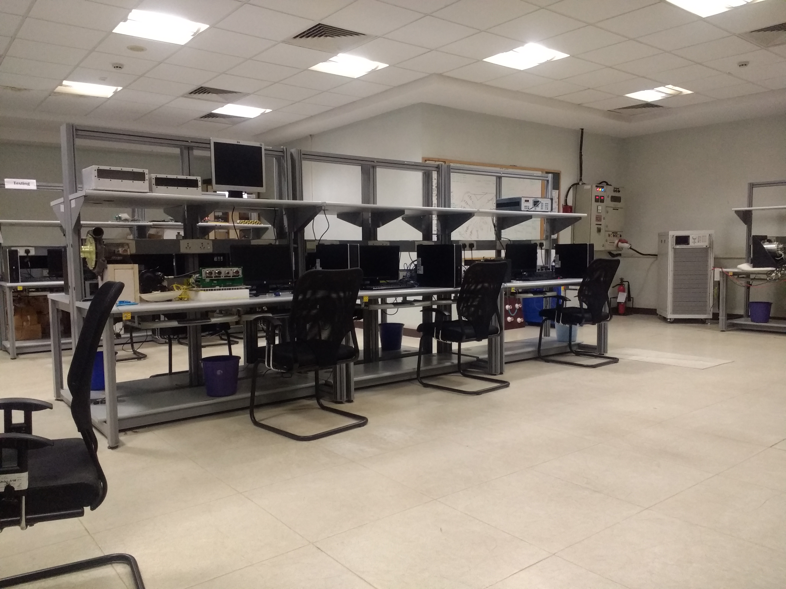
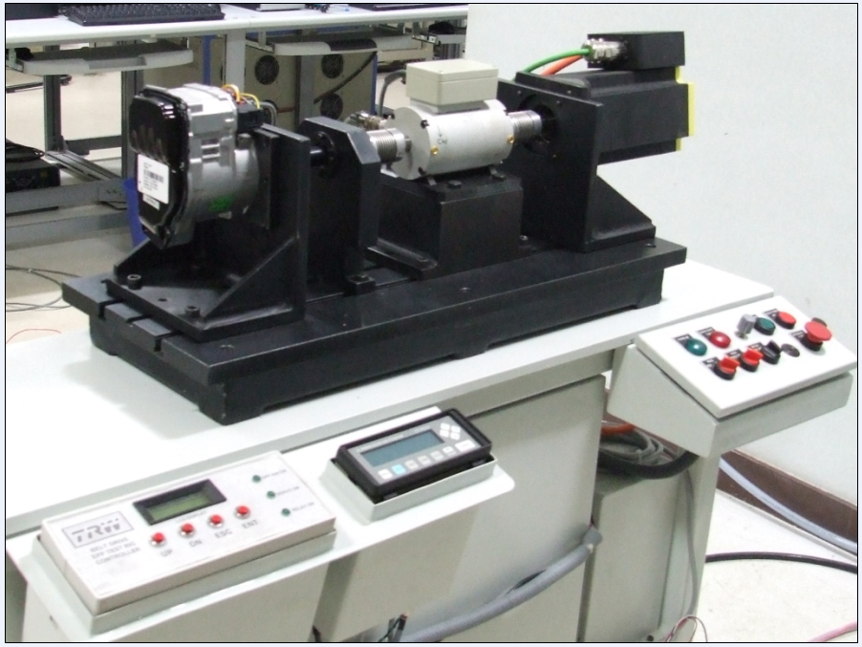
Embedded & Power Electronics Lab (Bangalore)
Source Capability:
25KVA, 3-phase AC
Programmable Power source, 18KVA, AC/DC
Resistive Load bank
Motor Test bench, up to ~30KW
Precision Power meter
Electrical safety analyser (HV tester)

Slide 9
Thank you!
www.techmahindra.com

Slide 10
Case Studies – Others

Slide 11



