Slide 1
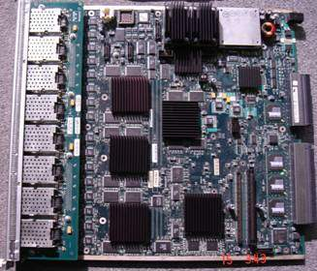
Value Engineering - GBit Port Line Switch
Increase reliability of switch by redesigning the board
Reduce the cost of the 20-layer board
Reduce signal integrity issues
Scope
Solution
Board redesigned in 14 Layers
100% Manual Routing
SI analysis at every stage
Brief Statistics
Board size : 14.4 x 15.8 inches
Components : 3578
BGAs : 15
Nets : 4895
Connections : 21184
High speed requirements
Signal Integrity considerations
High component count & Routing complexity
Large board size & Mechanical considerations
Increased Reliability
Better Signal quality
Significant reduction in manufacturing cost
Reduction in number of layer from 20 to 14
Benefits
Challenges
Tools
Cadence Allegro SPB 15.2
SIGXPLORER

Slide 2
Business needs
Component library development in short turnaround time with near-zero defects
Inputs
Component part numbers or data sheets
Library development process guidelines and verification tools
Outputs
Component schematic symbols
Component footprints
Tools
‘Cadence Allegro’ for Footprints
‘Cadence ConceptHDL’ for Symbols
Highlights
Component Library Creation in short turnaround times varying from 1 to 3 days.
Meeting all of Customer’s quality expectations with near-zero defects . Regular quality metrics review with customer.
Library includes complex components like connectors with high density pin-outs and challenging body outline.
Team ramp-up, Training and ramp-down as per program needs
Target: DPU Critical - Less than 0.5
DPU Non-Critical - Less than 1.0
Illustrative Charts
Target 90%

Slide 3
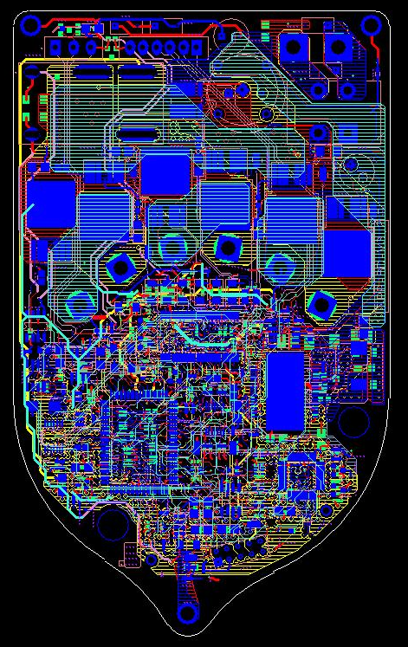
Component library creation using Cadence tool
Business needs
Integrated board for complete Power Steering hardware
High current section with 120 Amps max. current
Power stage circuit with discrete MOSFETs
Optimized, screw-type motor lead frame
Inputs
Ref schematics of power module and main control unit
Outputs
PCB Layout drawings, Gerber files and PCBA drawings
Tools
Cadence Allegro
Orcad Capture
Gcpreview
Highlights
Component Library Creation, Schematic Capture & Layout Design.
Power Module and Main control units merged into a single layout.
10-Layer with 580 components (including test points)
Up to 120 Amps of current carrying capability in high current motor section
Met all of Customer’s Design specifications
MCAD and eCAD integration.

