Slide 1
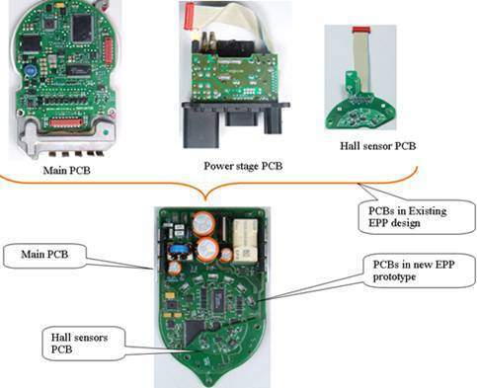
Value Engineering - Automotive Sub-system
Since, Customer was losing competitiveness and business due to high cost, there was a need to study the existing system and evaluate methods of reducing the cost while improving the performance.
Need
Value Engineering Approach
Idea
generation
Business case preparation
Proof of concept
SAVE Value Engineering process applied and identified opportunities for cost reduction
Analyse, Design, Prototype and prove out the concept
High current requirements
Thermal considerations
PCB Layout and packaging constraints
Achieved Savings per ECU to the tune of $ 16 per unit and Total Annual Savings of $ 32 Million
Simpler design
Improved Thermal Performance and Improved Reliability
Decrease in weight equal to 8.8%
Decrease in Inventory due to Commonisation of EPP for RH drive and LH drive vehicles
Simpler manufacturing Process
Solution
Validation
Prototyping
Challenges
Existing design
Benefits
Modified design

