Slide 1
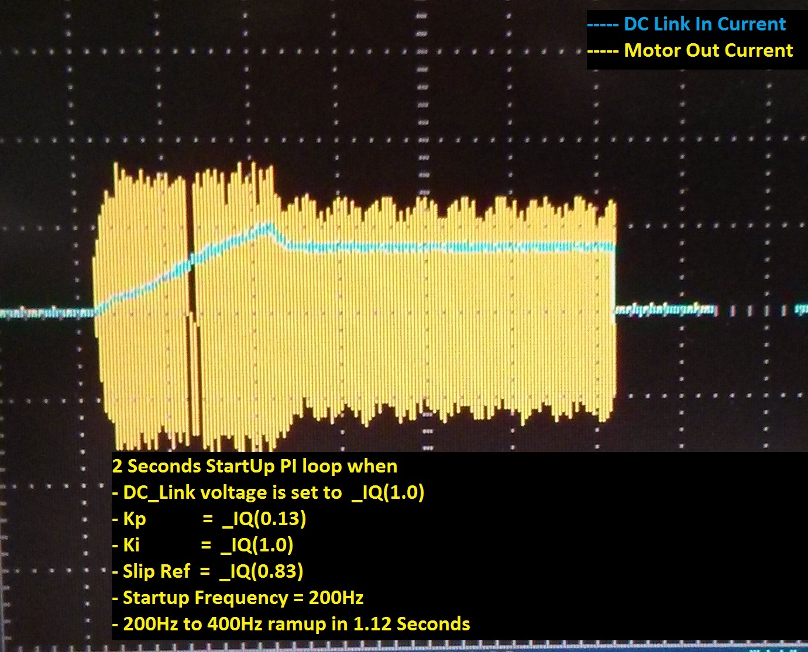
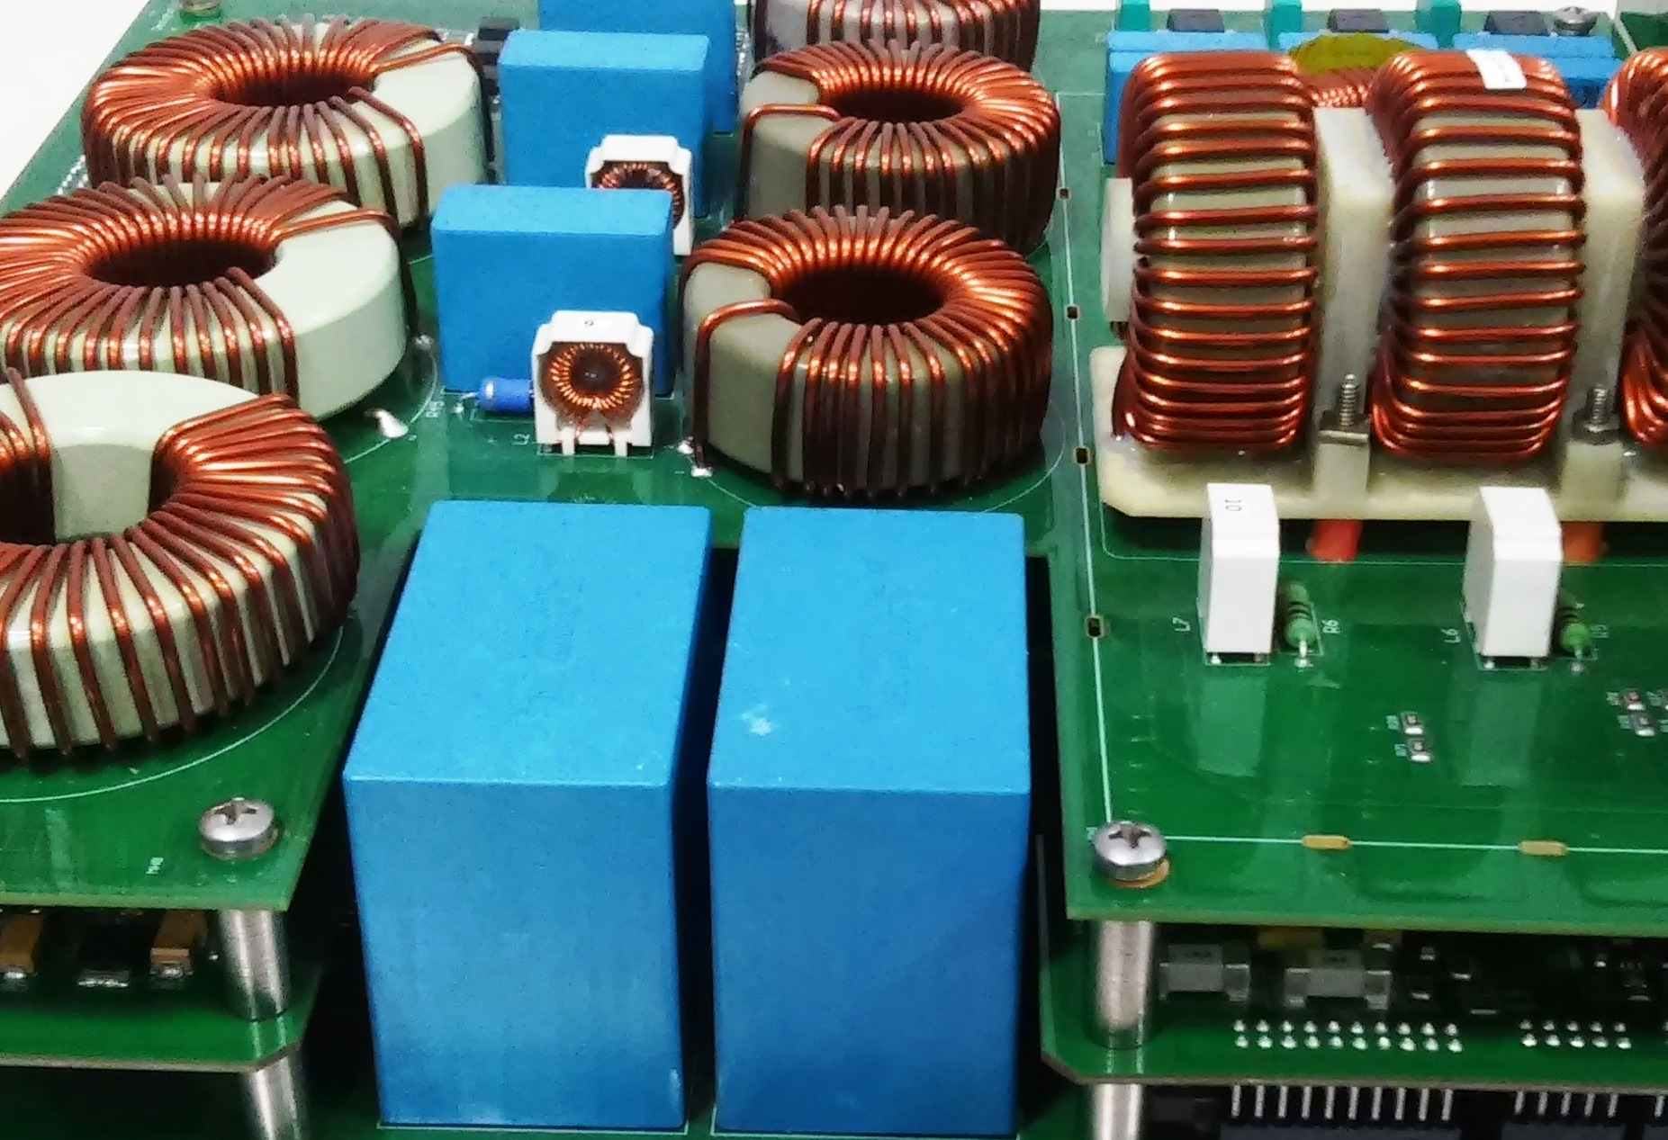
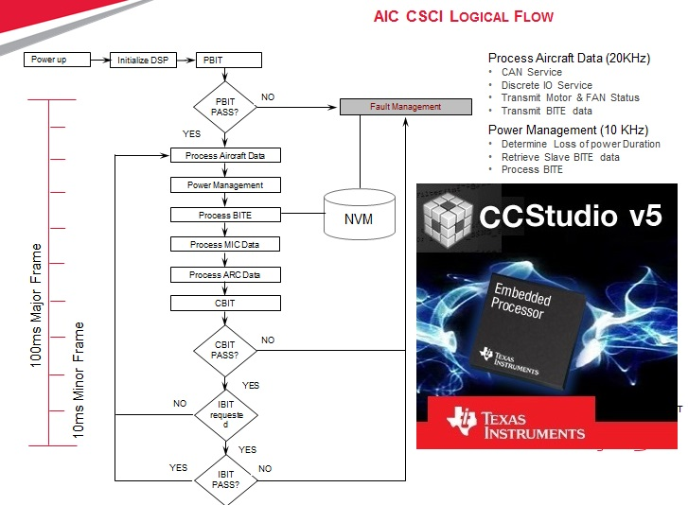
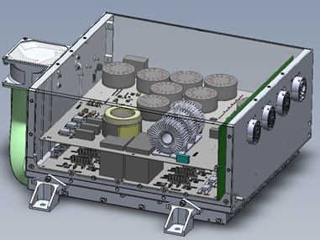
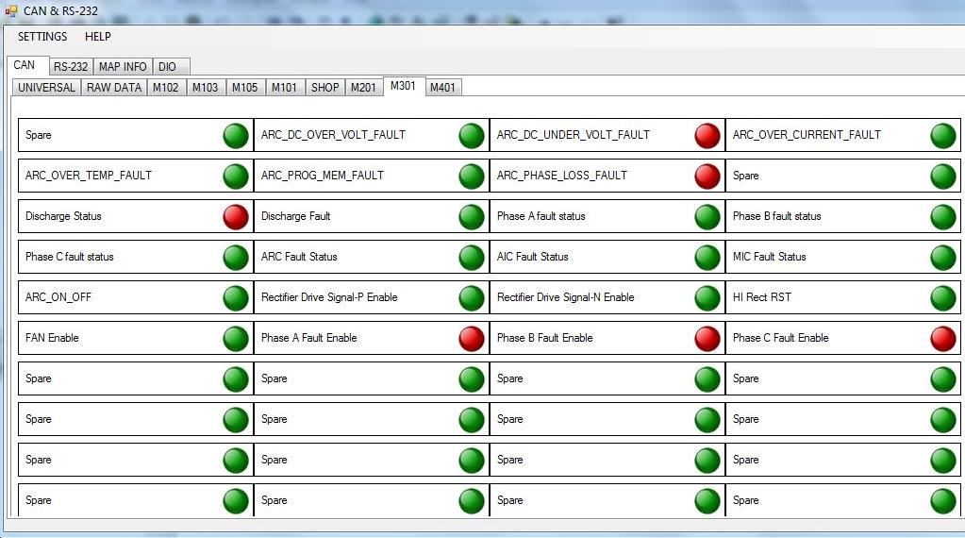
Variable Frequency Motor Drive (VFMD) 1/4
High Complex and limited production
Complete Avionics Equipment Level Solution for Leading Aerospace Tier-1 Supplier
Started with Customer’s system Spec
Modeled & Simulated Power Electronic Performances
Designed & Developed Multi Layered Hardware
Designed & Developed Safety Critical Embedded Software
Designed Mechanical Enclosure & Heat Sink
Developed Test Rigs for Acceptance Testing
System and Environmental Testing
Mechanical enclosure
System Testing and Environmental Testing
D0-160
TechM Scope
Equipment to be light weight
Motor to drive from variable input frequency (360Hz to 800Hz)
Operate three phase AC induction motors of different power rating at constant input frequency
Adhere to DO-178B & DO-254 guidance in development
Strict EMI/EMC requirements to be met because of higher frequency active switching.
Strict thermal requirements to be met because of high power rating
Reliability of equipment with higher MTBF
Hardware – D0254
Requirement
Proto Unit
Engineering Unit
Software DO178D
SSA – ARP4754
Test Rig

Slide 2
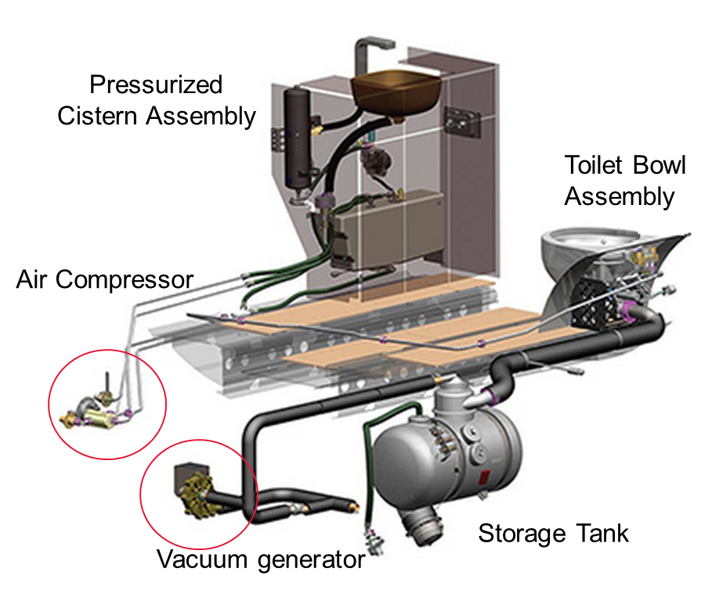
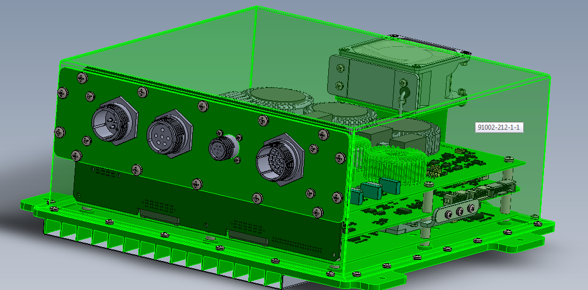
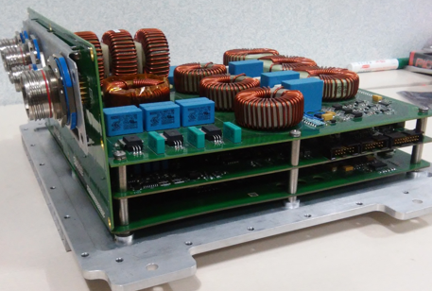
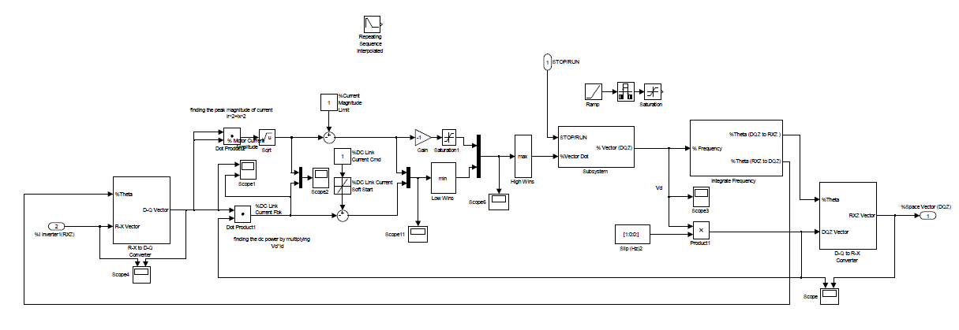
Proto Implementation
2/4
Business Needs
Highlights
Design and Development of Variable Frequency Drive with AFE Rectifier for Water and Waste Management System
Need to Eliminate high cost Transformer and improve power quality
Modeling and Simulation of Rectifier, Inverter and Motor control algorithms –
3-Level topology for AFE Rectifier with PFC
Reduction in the Overall Size and Weight of the Product
Reduced Harmonics & Improvement in Efficiency
Environmental Testing as per DO-160E, DO-178B, DO-254 Certification
Model Based Development approach and Integrated Test Automation – Faster Time to Market
Challenges
Weight Requirement 13 Lbs
MTBF – 30,000 Hrs.
Product life 25 years
Environment
Code Composer Studio
Altium Designer
LabVIEW
Simulink & Matlab
Ansys Icepak
CAD Model
MATLAB Model

Slide 3
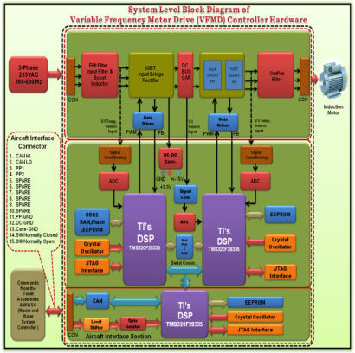
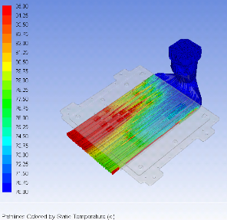
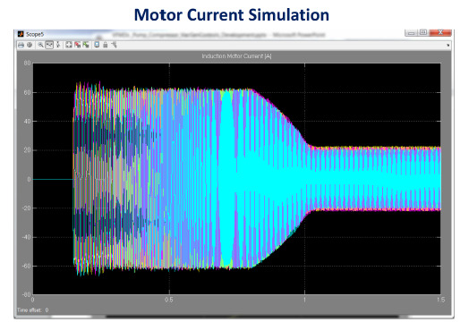
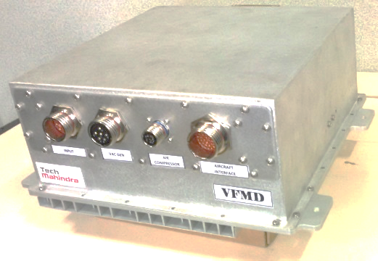
3/4
System Safety Assessment (SSA)
FMEA
FHA
Reliability Analysis and MTBF
CAD Model & Simulations
List of Test
Vibration Test
Power input / cycle
Power PCB
Control
Aircraft Interference
CFD analysis for fan
Electrical Simulation
Mechanical Enclosure

Slide 4
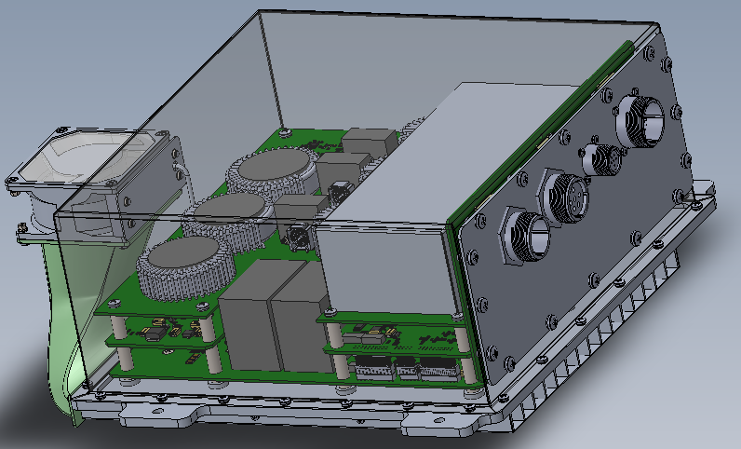

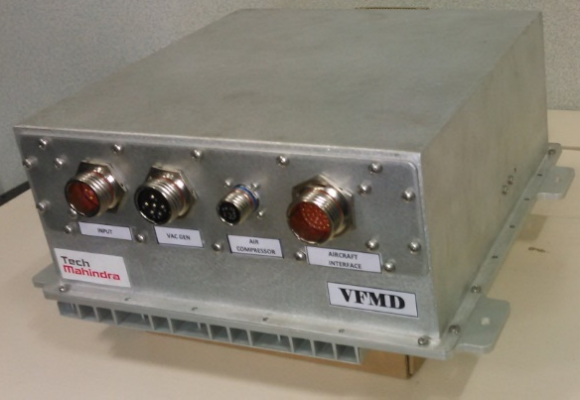
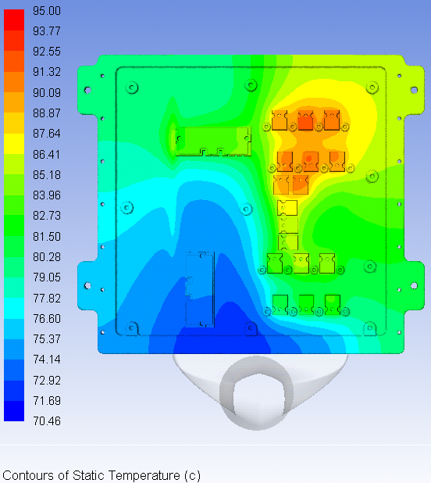

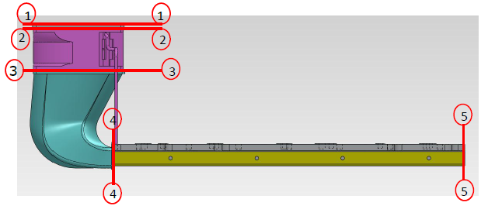
4/4
CAD Model
Proto implementation
Thermal simulation

