Slide 1
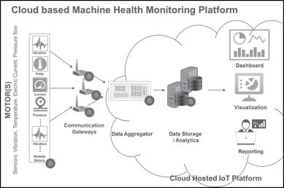
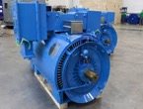
Health Monitoring Solution for Rotating Equipment
Client
Business Scenario
Largest global manufacturer of Industrial Rotating equipment
To build, and host complete End to End Solution to offer Rotating Equipment Health Monitoring as a service to OEM’s customers
TechM Solution (Real Time Monitoring & Analytics)
Integration of Sensor & Communication device with large industrial rotatory equipment enabling real time remote equipment health monitoring and identifying any deviation in its routine working
Vibration based Predictive Analytics for failure prediction
Design and Development of Sensor Module to measure critical parameters to monitor like vibration, temperature, voltage, current etc.,
Development and optimization of Industrial Gateway firmware to collect data from the sensor modules using RF and Wi-Fi to push data to the cloud after performing edge analytics
Leverages machine learning component of Microsoft Azure and applied statistics to understand behaviour patterns and forecast failures.
Dashboards with status based on the measure & target values for Health, Performance & Operational Reporting

