Slide 1
Reference of Non – Automatable and Automatable
Non – Automatable Requirement
Embedded software shall provide an interface with the PC Tool for the OD parameter data to be extracted
UDS AFW support shall adhere to 10xx.xxA, Tool Suite - UDS Interface
Automatable Requirement
The embedded software shall provide interface to MBD software to read and pass the motor temperature
Product shall by default transmit a J1939 PGN with following parameters and indexes at a repetition rate of 10ms

Slide 2
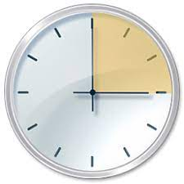



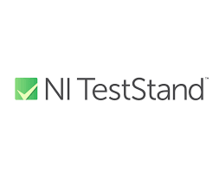


Zero Touch Automation
Test Execution initiated by Scheduler
Test
Build
Code
Python Script shall be invoked to start Automated Test Cases
Source Code Control to CI/CD pipeline
Test Execution in LabVIEW and TestStand
Detail Test Result ,Test Logs summary to Share folder
Test Result Email notification

