Slide 1
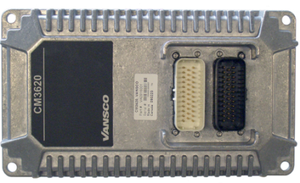
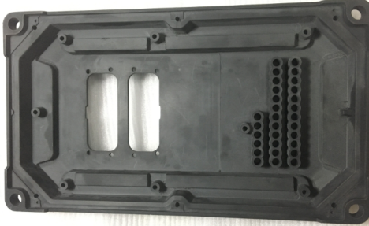
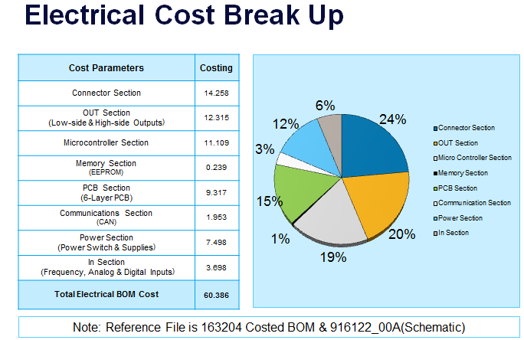
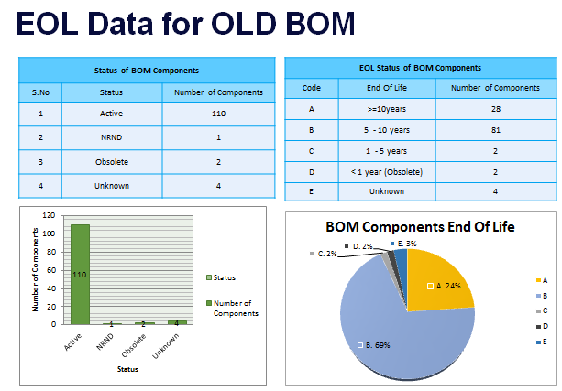
Division: ECD
CM3620 I/O Controller – VAVE Analysis
Scope
To perform VAVE Analysis on the CM3620 I/O Controller. Existing Microcontroller is Obsolete and alternate controller to be identified. The Project has to go through entire VAVE cycle and Schedule and costing to be submitted for Re-Design with new microcontroller.
The project scope included Electrical Cost Reduction, Mechanical Cost Reduction, Re-Design, Certification of the new design, Mechanical Enclosure Development and Firmware Development
Tools / Techniques used
Silicon Expert
Q-STAR
Pugh Matrix
Pareto Analysis
Autodesk Inventor
Allegro Tools
Manuscript
IAR
Collaborator
Parker Coding standards
Achievements
Listed 63 VAVE Ideas
Alternate Microcontroller identified
Cost Savings of $1 have been identified
Plastic Mechanical prototype has been built and shipped Parker for testing and evaluation
Schedule and Costing for the Re-Design Submitted
VAVE process has been defined and shared with Customer
EoL and Obsolescence check performed on the product Bill of Material

