Slide 1
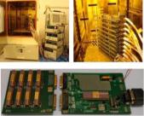
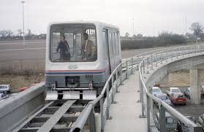

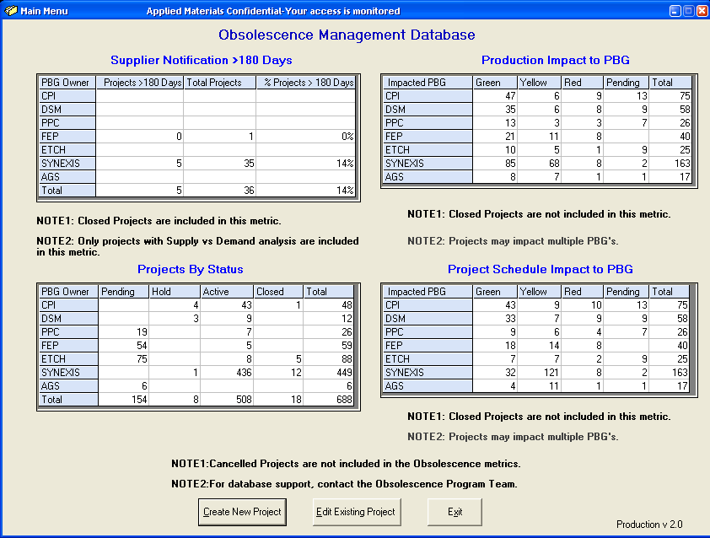

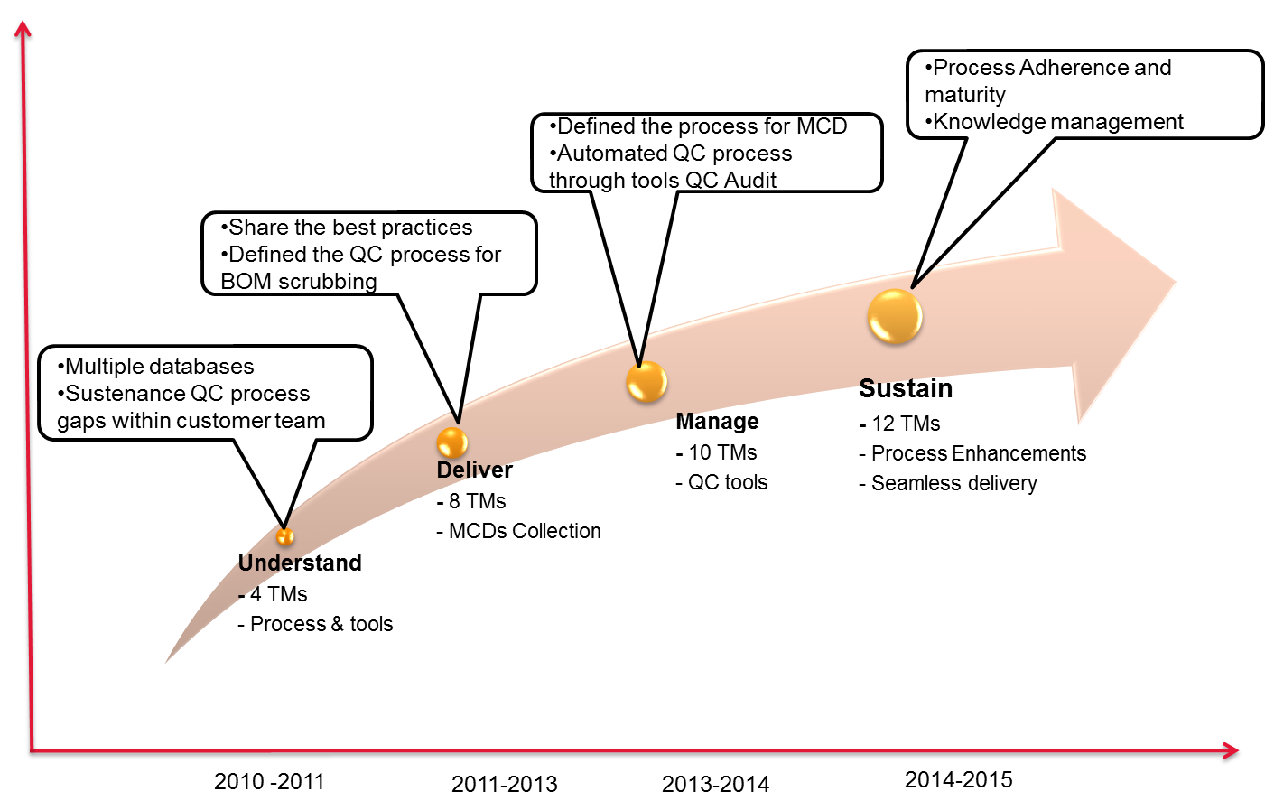
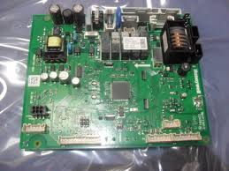
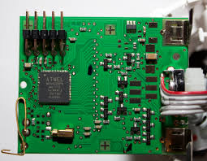

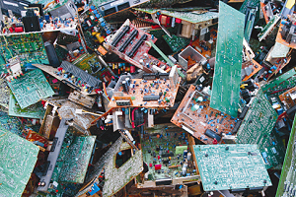

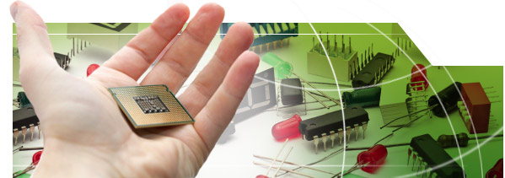
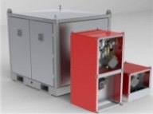
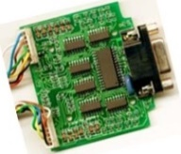
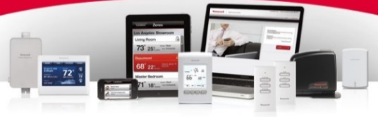

Breadth of our expertise across industries
Semicon equipment manufacturer
US based conglomerate – commercial and consumer product
Semicon equipment manufacturer
NA based Railway Transport Major
Leading Fire and safety solution provider
Global Oil Field Equipment Manufacturer
Developed and Maintaining Automated Database to handle component obsolescence
Monitoring the status of each obsolete part & tracking until implementation.
10000 components scrubbing and monitoring
ECR processed to implement 1100 replacements
Provided uniform solution for affected assemblies with quick turnaround for production issues
Agile Database monitors & track the status of each obsolete part until the implementation of the solution
Highly experienced Engineers integrated with product engineering team for design validation
Obsolescence watch, quality checks, Duplicate Extraction
Mature CE process to achieve high quality outputs in faster line
9+ years of engagement
10000+ components scrubbing and monitoring
Complete life cycle ownership – board redesign, FW upgrade, SW rewrite, prototyping, testing & validation as per compliance requirements
7+ years of engagement
Complete life cycle ownership – board redesign, FW upgrade, SW rewrite, prototyping, testing & validation as per compliance requirements
Value engineering and Standardization
Supplier sourcing support with cost negotiation for best cost
Peak Team Size – 35+
Peak Team Size – 10+
Peak Team Size – 20+
Peak Team Size – 12+
Peak Team Size – 30+
12

