Slide 1
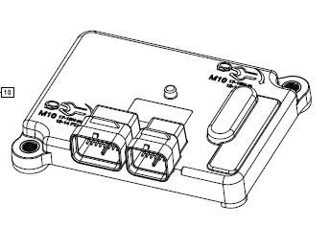
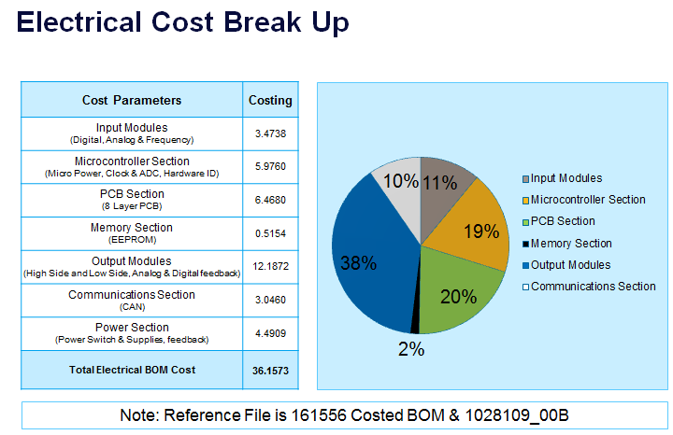
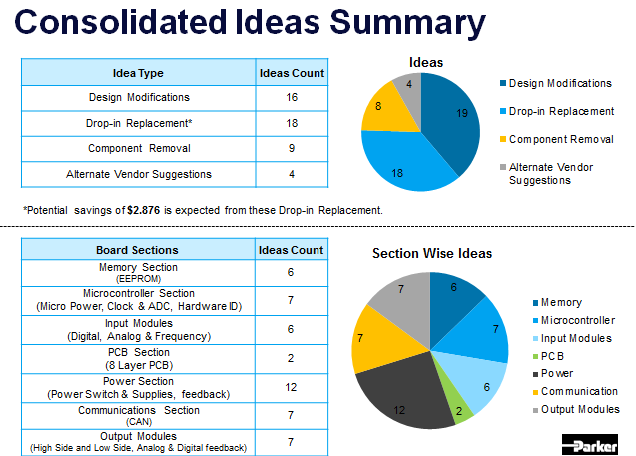
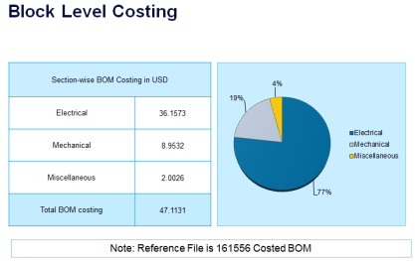
CM2723 I/O controller – VAVE Analysis
Achievements:
Listed 49 VAVE Ideas
Estimated Cost Savings of $7 have been identified (0.35M USD savings per annum for 50K Quantity)
Suggested different power topology approach to reduce costing
EoL and Obsolescence check performed on the product Bill of Material
Schematics modified with the proposed Cost Reduction changes and submitted to Client
Scope:
To perform VAVE Analysis on the CM2723 I/O Controller.. The Project has to go through entire VAVE cycle. The scope of the project includes:
Electrical Cost Reduction Analysis
Competitor product Analysis
Reverse Engineering
BoM of Competitor Product
Comparison with the Client Product
Tools/Techniques used:
Silicon Expert
Q-STAR
Pugh Matrix
Pareto Analysis
Manuscript
Application : Automotive Industry

