Slide 1
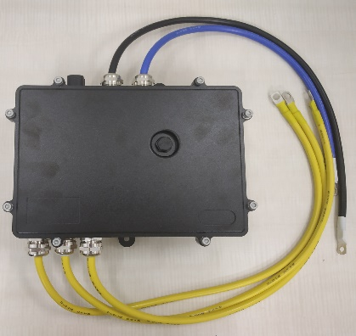
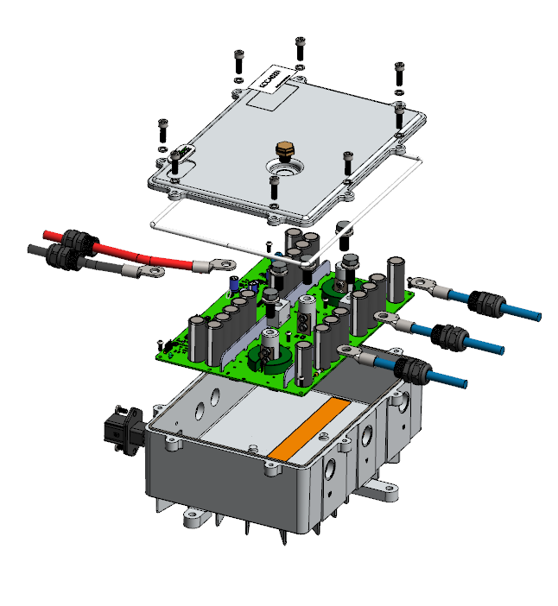
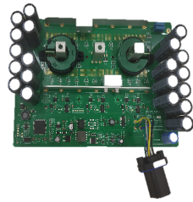
Cost Optimization of Active Rectifier: 1/2
Scope
To identify cost out ideas for active rectifier in below areas
Electronic Design review
Proposing low cost FFF alternate parts for the electronic components
To identify alternate supplier quotes for electronic manufacturing services and mechanical components from China and India
Inputs
Physical unit
Product Cost BOM, 2D drawings, 3D Models, assembly drawing and assembly instructions
Functional Block Diagram, schematics
Estimated annual usage
Manufacturing Location – China
Major Deliverables
Alternate electronic components with optimized specifications
Low cost alternate FFF (Form, Fit & Function) parts with specification and cost comparison sheets
Low cost vendor quotes from India and China for below items
Custom made parts like PCB & Cable harness
Mechanical components
Electronic Manufacturing Services
Business Benefits
Showcased 25% savings on overall product cost
Optimized design in 4 areas (Microcontroller, MOSFET, Angle sensor and cable)
Identified low cost FFF alternates for 8 electronic components
Provided low cost vendor quotes for 6 parts
Provided 9 new Vendor connects to customer from India and China

Slide 2





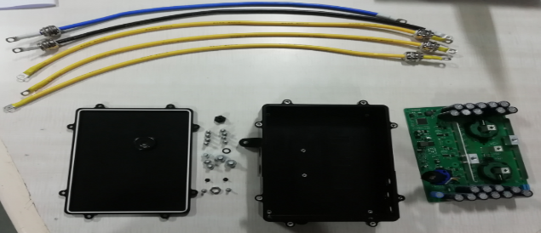
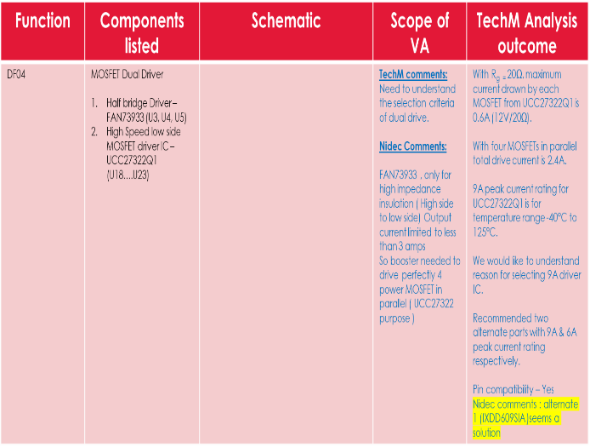
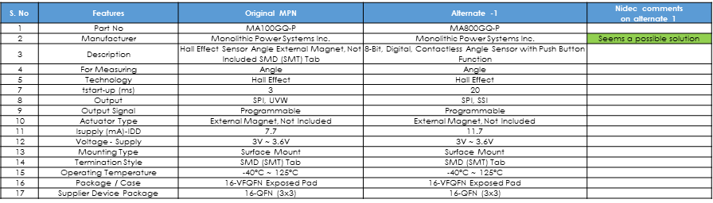
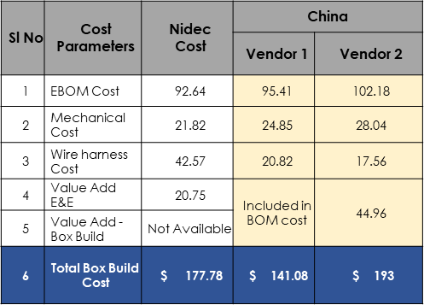
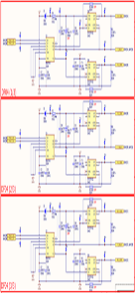
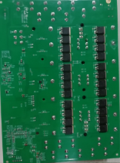
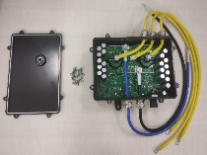
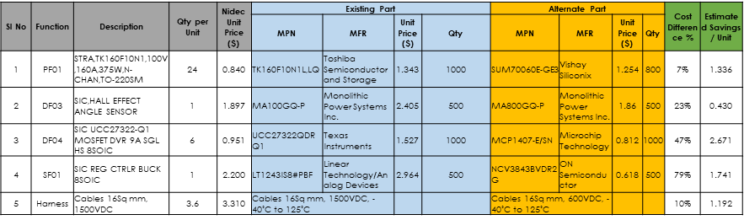
Project Execution Approach: 2/2
Identification of Low cost FFF alternates
Low Cost Alternate vendor Identification
Input Study
Design Review
Idea Generation
Product Study
Understanding the functionality
Teardown
Study the schematic
Identify areas for Cost optimization
Schematic Analysis
Identify high cost components in BOM
Brainstorming on idea generation
Check the feasibility for implementation
Shortlist the ideas
Datasheet study
Prepare Comparison Sheets w.r.t. existing parts specs
Float RFQ to supplier
Verify cost competitiveness
Identify vendors for Mech parts & EMS in China\India
Float RFQ
Quote analysis
Quote Finalization
Teardown
Schematic Analysis
Low cost FFF alternates Specifications Comparison
Vendor Quote Comparison

