Slide 1
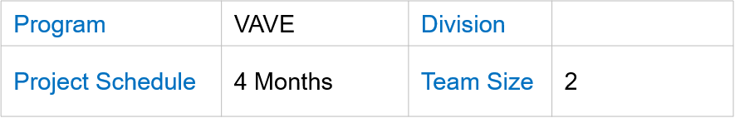
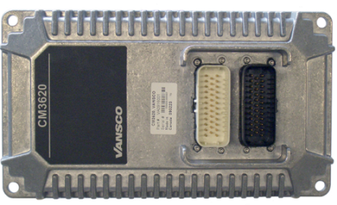
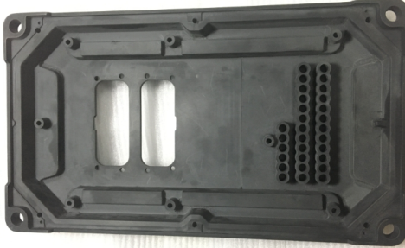
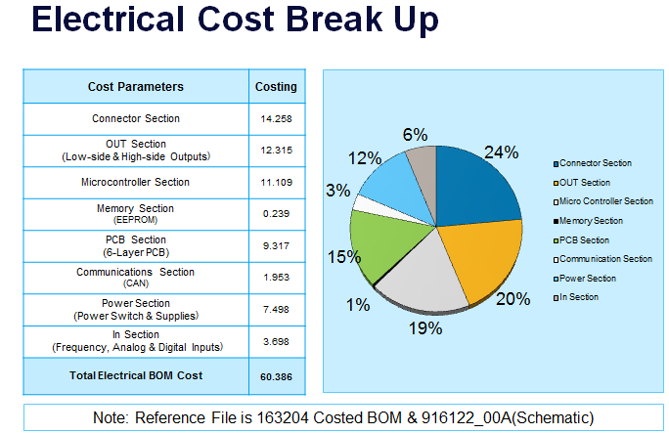
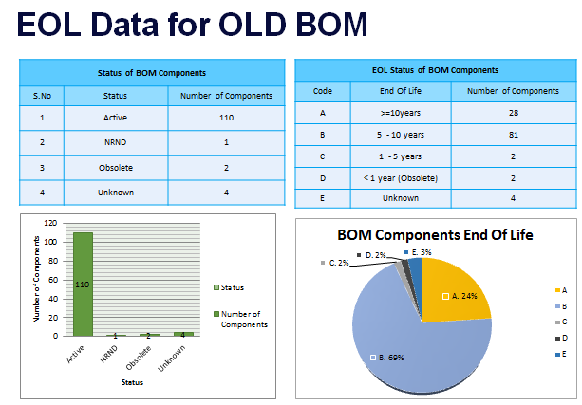
Achievements:
Listed 63 VAVE Ideas
Alternate Microcontroller identified
Cost Savings of $6.44 have been identified (0.5M USD savings per annum for 75K Quantity)
Plastic Mechanical prototype has been built and shipped to Parker
Electrical tests conducted successfully on the new plastic enclosure. Mechanical tests under progress
Schedule and Costing for the Re-Design (including certification) Submitted
EoL and Obsolescence check performed on the product Bill of Material
Scope:
The scope of the project is VAVE Analysis and Re-Design activity including:
Alternate controller identification and Design Modification
Electrical/Mechanical Cost Reduction
Mechanical Enclosure Prototyping (Metal to Plastic)
Firmware Development
Tools/Techniques used:
Silicon Expert
Q-STAR
Pugh Matrix
Pareto Analysis
Autodesk Inventor
Allegro Tools
Manuscript
IAR
Collaborator
Parker Coding standards
Application : Automotive Industry

