Slide 1
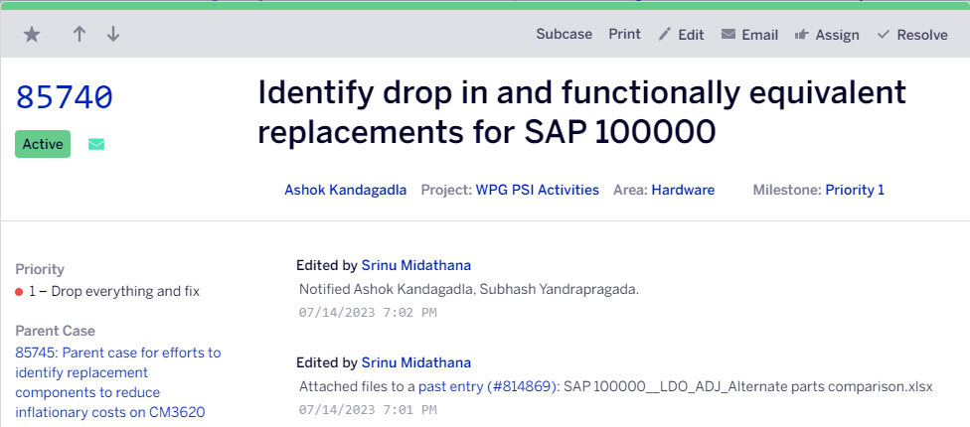
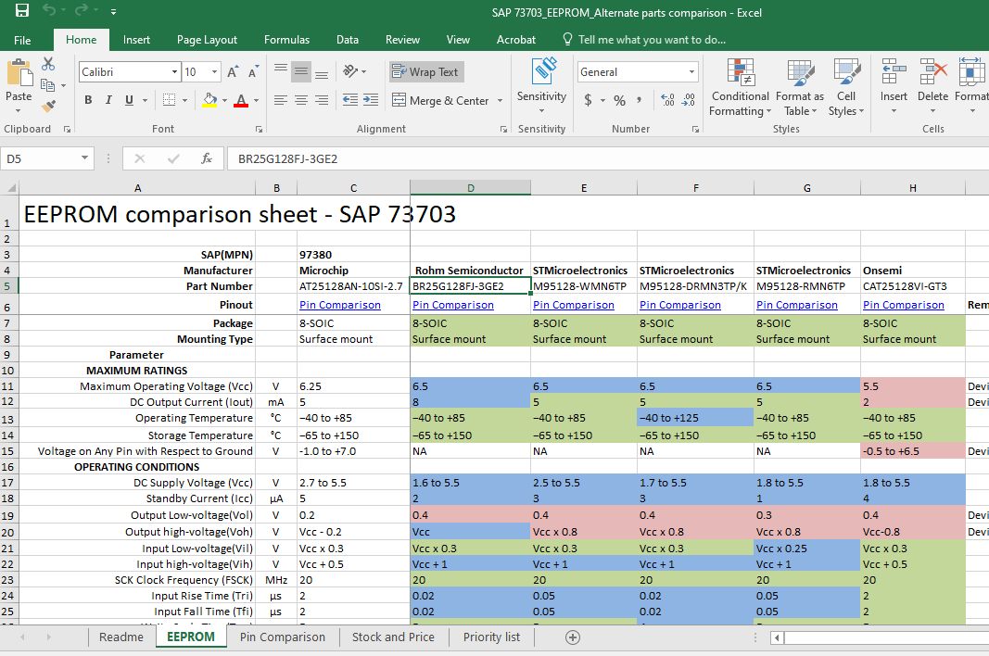
Obsolescence Management
Division: ECD
Scope
Identify the
Drop-in replacement parts
Potential equivalent parts
Alternate parts
Considerations while selection of Alternate
Application Circuit Complexity
Electrical parameters
Manufacturers
Mechanical Parameters (Dimensions, Package, Weight. Etc)
Environmental parameters
Compliances
Long term Availability/End Of Life Lead Time
Lead Time
Cost
Supplier details
Deliverables
Identified the Drop-in / Alternate parts for 40 type of components, which includes
Comparator
Op-Amp
Multiplexer
Shift Register
EEPROM
Regulators
Diodes
High Side Switch, Low Side Switch
Current sensors, etc.
Challenges
Identifying components available with the required features.
Analysis of the components and identifying best match with respect to features and modifications needed for H/W and F/W.

