Slide 1
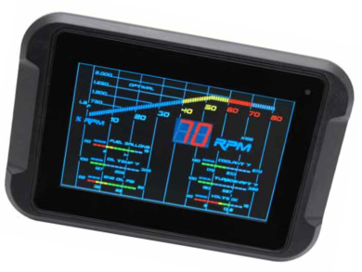
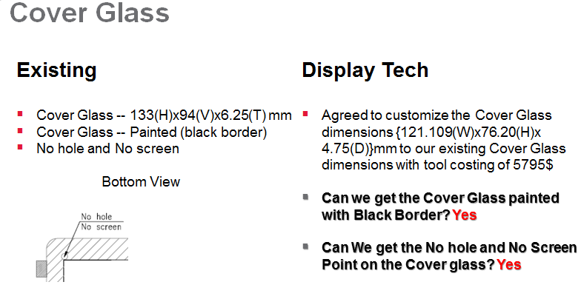
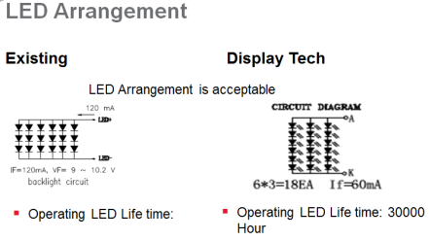
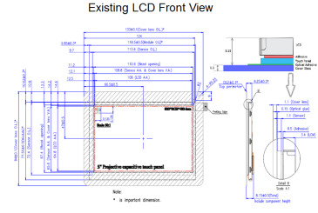
Achievements:
Alternate Display Vendor identification
Existing Display Cost: $42.75
Alternate Display Cost: $16
Cost Reduction Opportunities:
Electrical Cost Reduction – 28.7%
Identified Display vendors from US as well as China.
The estimated saving with the projected Annual Quantity is 0.9M USD.
Scope:
To perform VAVE Analysis on the PHD50 display product. The target was to study the existing Display and explore Cost Reduction opportunities on the existing product cost. There were constraints like Controller, RAM, Mechanical should not be changed. The project scope included the following:
Electrical Cost Reduction
Tools/Techniques used:
Silicon Expert
Q-STAR
Pugh Matrix
Pareto Analysis

