Slide 1
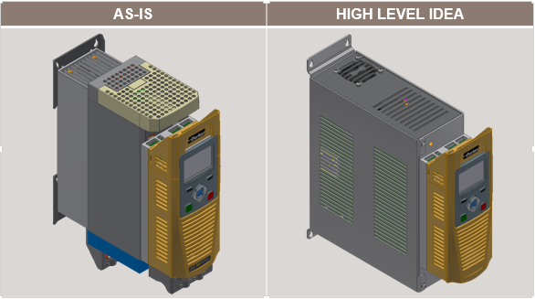
AC30 – VAVE Analysis
Achievements:
Conceptual 3D model by reducing number of PCBs in power stack from 3 to 1
Suggested drop-in replacement of IGBT gate-drive ICs
Proposed to replace some of the sheet metal components as part of enclosure to plastic moulding
Proposed to change molded heat sink to casting type for cost reduction
Estimated savings ~ 6.1% ($21.2)
Project not feasible due to low annual sales volumes (~2500/annum)
Scope:
The scope of the project is VAVE Analysis and identify cost reduction opportunities without any change in product specification:
Analysis of Frame D Power stack
AC30V control module
Mechanical Enclosure
Tools/Techniques used:
Pugh Matrix
Pareto Analysis
Autodesk Inventor
Competition benchmarking
Function Vs Cost analysis
Application : General Industrial Applications

