Slide 1
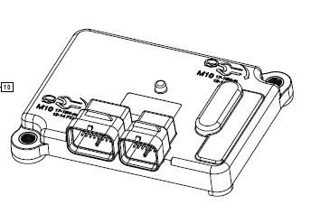
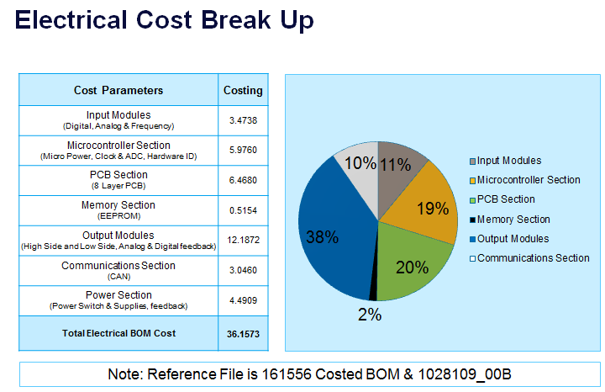
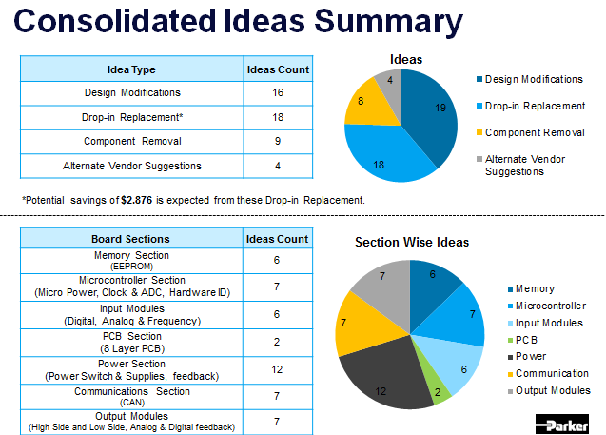
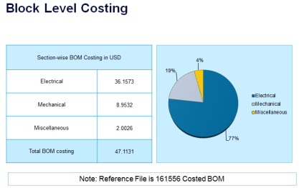
CM2723 I/O Controller – VAVE Analysis
Scope
To perform VAVE Analysis on the CM2723 I/O Controller. The Project has to go through entire VAVE cycle. The scope of the project includes:
Electrical Cost Reduction Analysis
Competitor product Analysis
Reverse Engineering
BoM of Competitor Product
Comparison with the Parker Product
Tools / Techniques used
Silicon Expert
Q-STAR
Pugh Matrix
Pareto Analysis
Manuscript
Achievements
Listed 49 VAVE Ideas
Cost Savings of $7 have been identified
Competitor product Technical approach compared with the
Parker approach
Suggested different power topology approach to reduce costing
EoL and Obsolescence check performed on the product Bill of
Material
Schematics modified with the proposed Cost Reduction changes
and submitted to Parker

