Slide 1
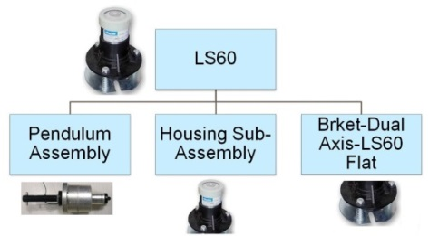
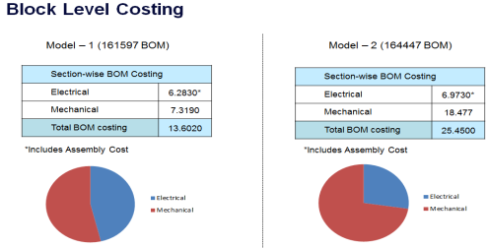
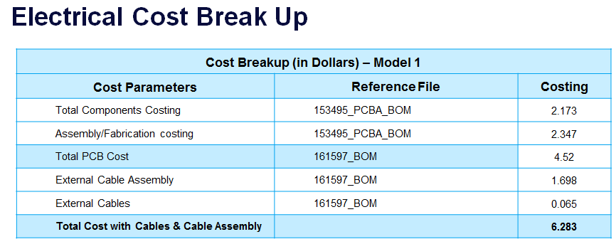
Achievements:
VAVE Ideas:
Ideas Generated: 10
Ideas Accepted: 5
Cost Reduction Opportunities:
Electrical cost Reduction - 2.7%
Provided high level Mechanical ideas which can reduce material weight by 67%
EoL Identification/Compliance Checks:
Identified Obsolescence components in the Bill of Material and identified alternates for the same
Scope:
To perform VAVE Analysis on the LS60 Tilt Sensor product. The target was to achieve 20% Cost Reduction on the existing product cost. The project scope included the following:
Electrical Cost Reduction
Mechanical Cost Reduction
Tools/Techniques used:
Silicon Expert
Q-STAR
Excel based calculations for material estimation
FBD Analysis
Pugh Matrix
Pareto Analysis

