Slide 1
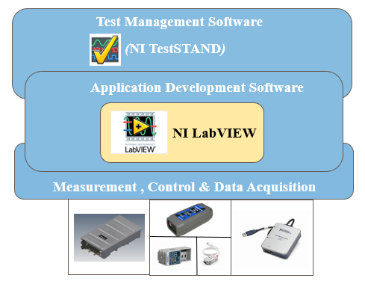
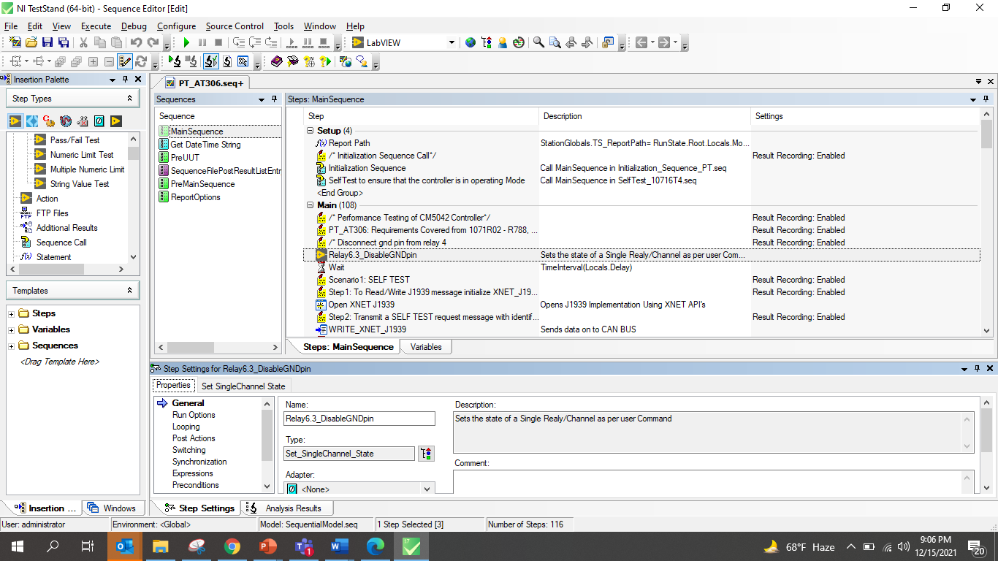
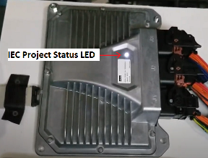
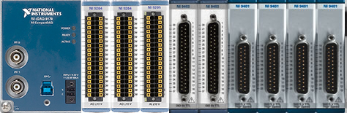
Division: ECD
Parker Hannifin Controller – PHC1 CM5042 & PHC1 CM3033
Scope
The scope of the project was to perform Automation Testing (Verification & Validation) of the Parker Hannifin Controllers CM5042 and CM3033
The scope also includes Automation of the test cases. Perform regression testing using the Automation methods
Challenges
Solution
Execution of test cases at client location because of Latency issues
Developing test cases based onshore hardware setup
Automation Framework Development for different kind of regression test
Automation and Reusability
Executing Performance test, Application testing(Codesys and MATLAB)
Total Automated test cases: 180 in CM5042 and 182 in CM3033
Percentage Automation ~ 71%
Time saving due to Automation ~ 85%
Reusability of LabVIEW Modules ~ 60%
Parker custom tools like CANSniff, Ftool, Jenkins and ECU Test are integrated with LabVIEW and TestStand through Python
Business Benefits
Cost per month saving due to automation of test cases - $4620
Hardware cost saving of ~$3K per test setup
Framework is reutilized between projects thus reducing the development time

