Slide 1
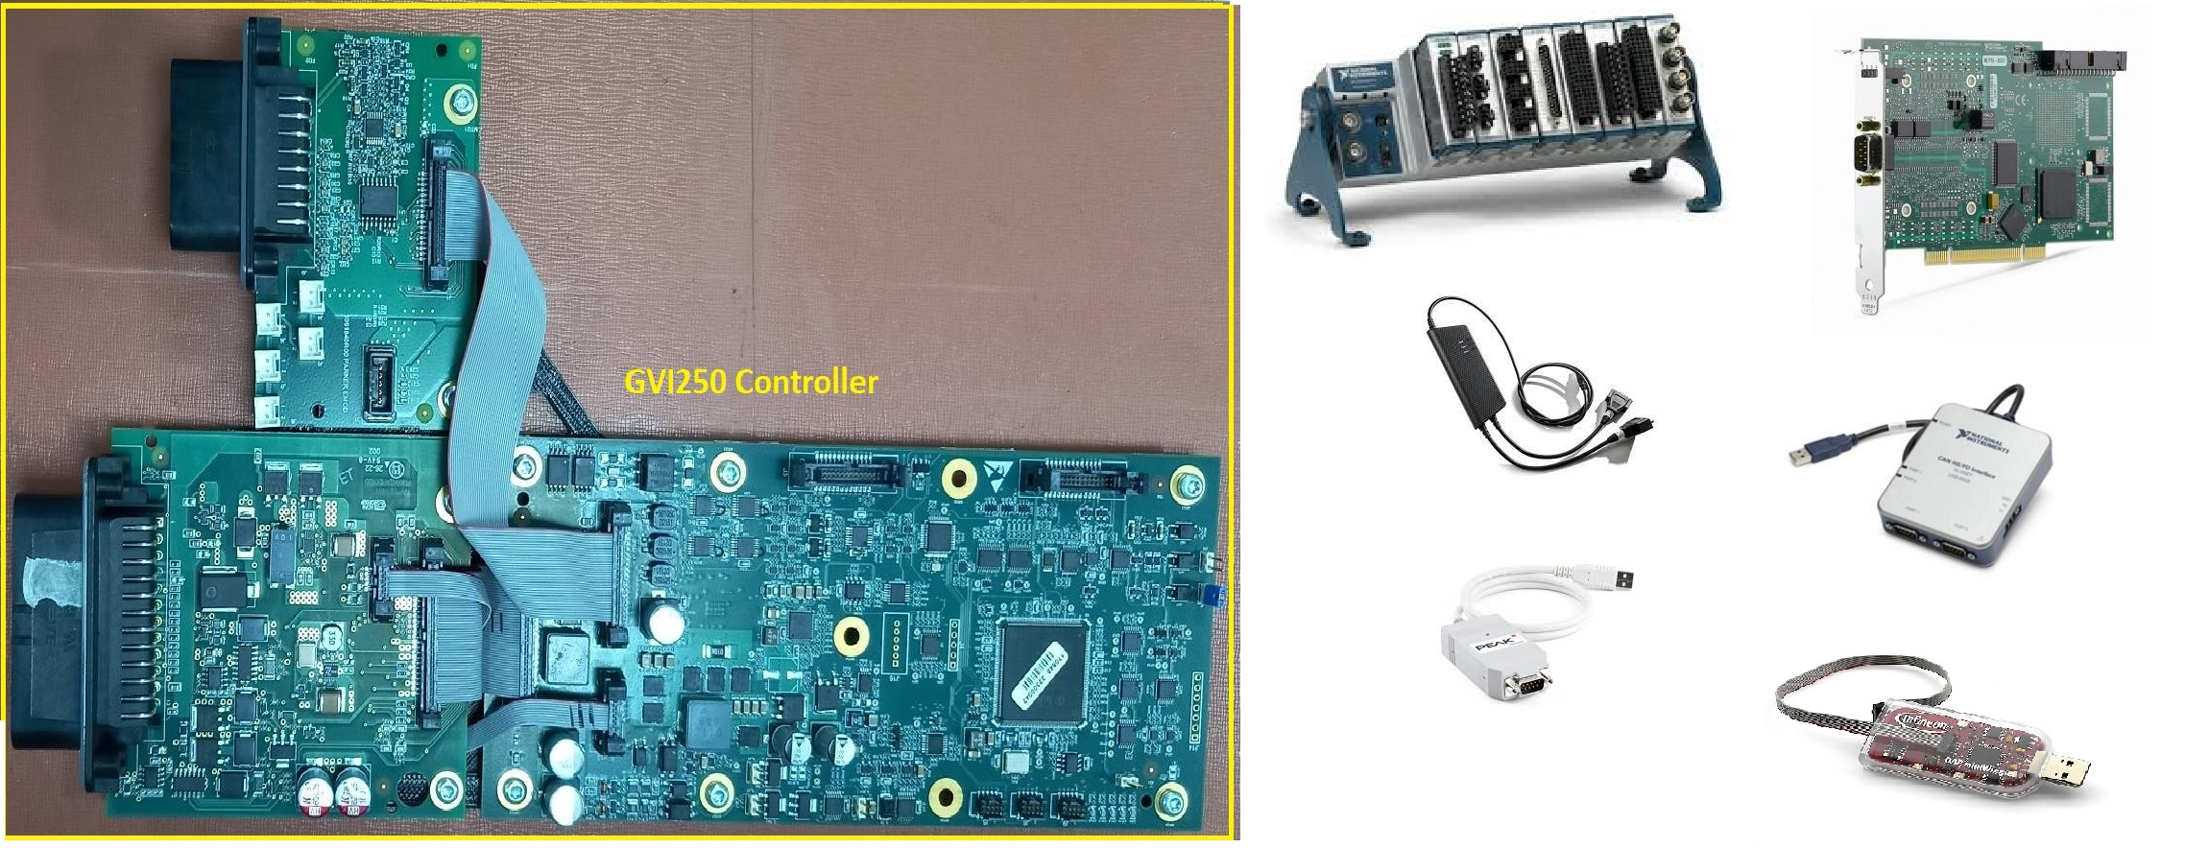
Division: ECD
Global Vehicle Inverter – GVI250
Scope
The scope of the project was to perform Manual and Automation Testing (Verification & Validation) of the Parker Hannifin Controller GVI250.
The scope also includes the automation regression testing of the automated test cases on continuously developed firmware.
Challenges
Solution
Execution of test cases at client location because of Latency issues
Developing test cases based onshore hardware setup
Automation Framework Development for different kind of regression test
Automation and Reusability
Executing of Regression Tests
Total Automated test cases: 110
Percentage Automation ~ 90%
Time saving due to Automation ~ 87%
Reusability of LabVIEW Modules ~ 70%
Parker custom tools like Ftool, CfgTool, Jenkins are integrated with LabVIEW and TestStand through Python
Business Benefits
About 400+ requirements are fully automated.
About 320+ requirements are tested manually.
50+ software bugs were identified, till date, through automated regression tests and manual tests.
Smoke Tests are performed for software product releases.
Resolved software bugs are automated for bugs tracking.
Automated requirements based on image processing using Python.

