Slide 1
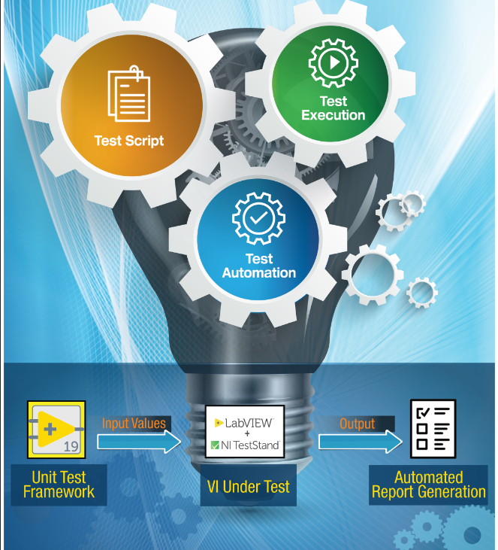


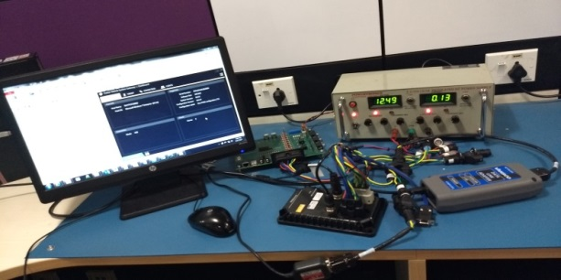
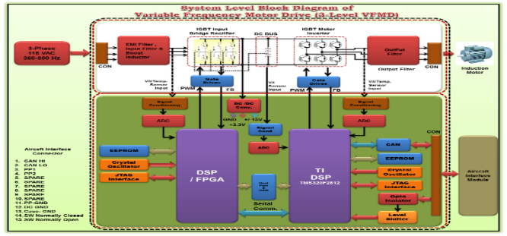
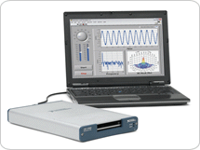
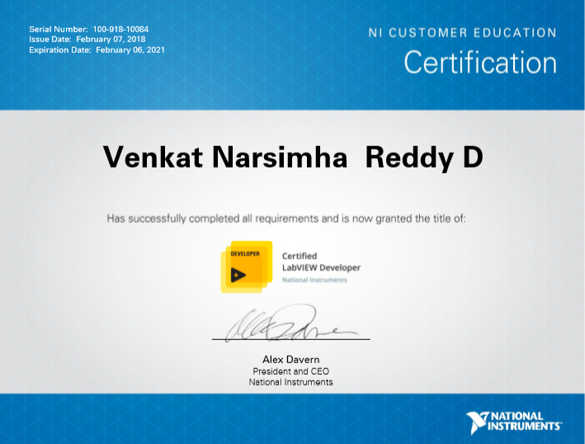
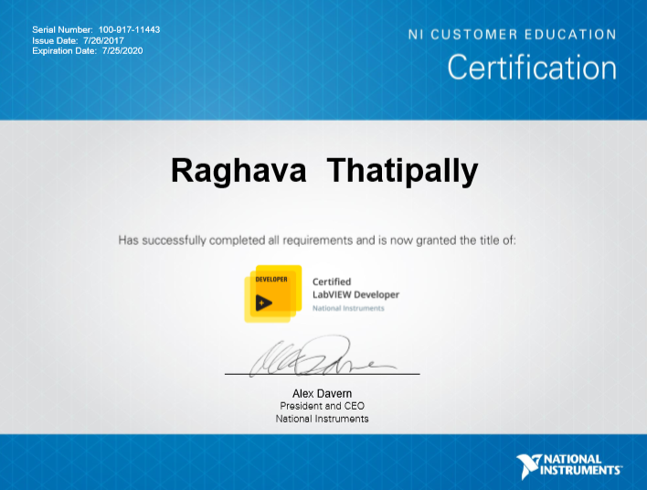
LabVIEW and TestStand Expertise Overview
LabVIEW and TestStand across SDLC and V & V
40+ Person Years of Experience with National Instruments Software and Hardware
NI Certified LabVIEW Developers (CLD) : CLAD – 8, CLD – 10, CLA – 3, CTD – 2
5000+ Tickets closed for various products
Adoption of Automation: 60% of the tickets Automated
Soft UI, Load Box Development: 50 UI Plugins developed, Developed soft load box for each program
Expertise in integrating different automation tools like MATLAB, Simulink, Coded UI, Python and Auto-IT
Specialized areas of expertise
Automotive Testing
Data Acquisition
Control Systems Testing
Simulation & Vision Systems
Automated Test Equipment's (ATE)
Manual/ Automation/ Regression Testing
Hydraulic and Pneumatic Equipment Test Rigs

