Slide 1
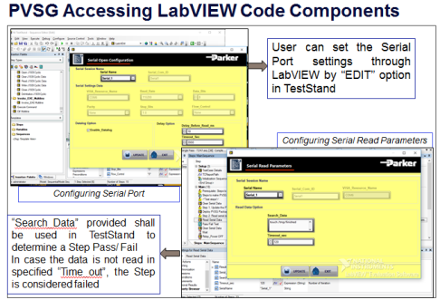
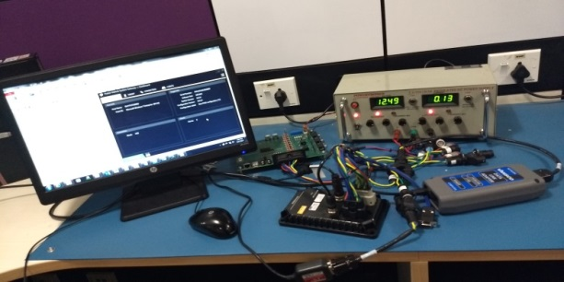
Automated Test Suite for Vehicle System Gateway - Regression Testing
Scope
The scope of the project was to perform Automation Testing (Verification & Validation) of the VSG (Vehicle System Gateway) system
The scope also includes Automation of the test cases. Perform regression testing using the Automation methods
Solution
Environment
Challenges
Automation Framework Development
Automation and Reusability
Total Automated test cases 107 out of 150
Percentage Automation ~ 71%
Time saving due to Automation ~ 85%
Reusability of LabVIEW Modules ~ 60%
Custom tools like CANSniff, SIM Engine, Flash Loader, ECU Test and VMMS are integrated with LabVIEW and TestStand through Visual Studio CodedUI
LabVIEW and TestStand
NI XNET
NI Virtual Bench
Visual Studio CodedUI
CANSniff and CANoe
Phidgets Relay Board
ECU Test Tools
FogBugZ and Manuscript
SIM Engine, Flash Loader, ECU Test and VMMS
Doors
Python
Execution of test cases at client location because of Latency issues
Business Benefits
Cost per month saving due to automation of test cases - $4620
Hardware cost saving of ~$3K per test setup
Framework is reutilized in next projects like CODE – 1 and PHC – 1 thus reducing the development time

