Slide 1
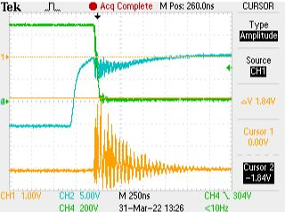
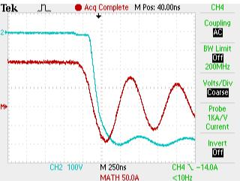
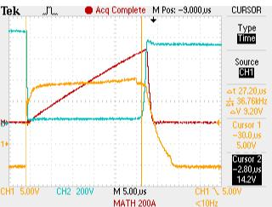
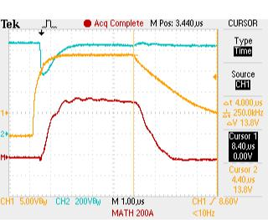
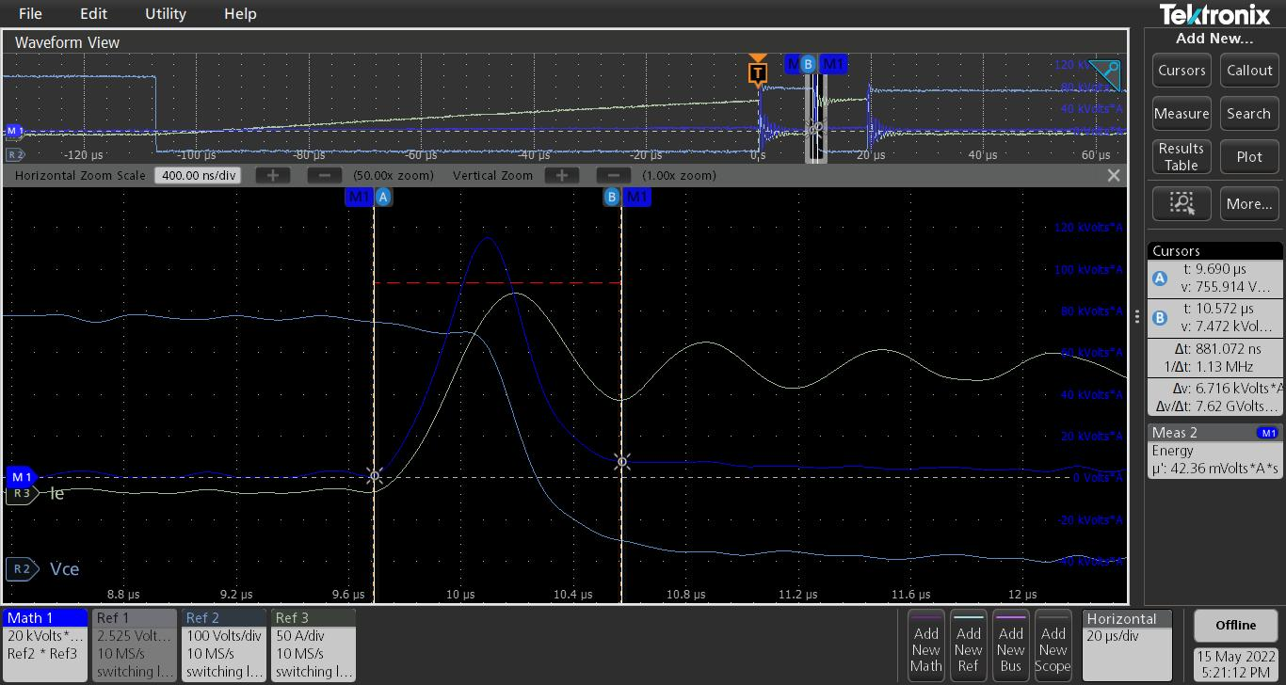
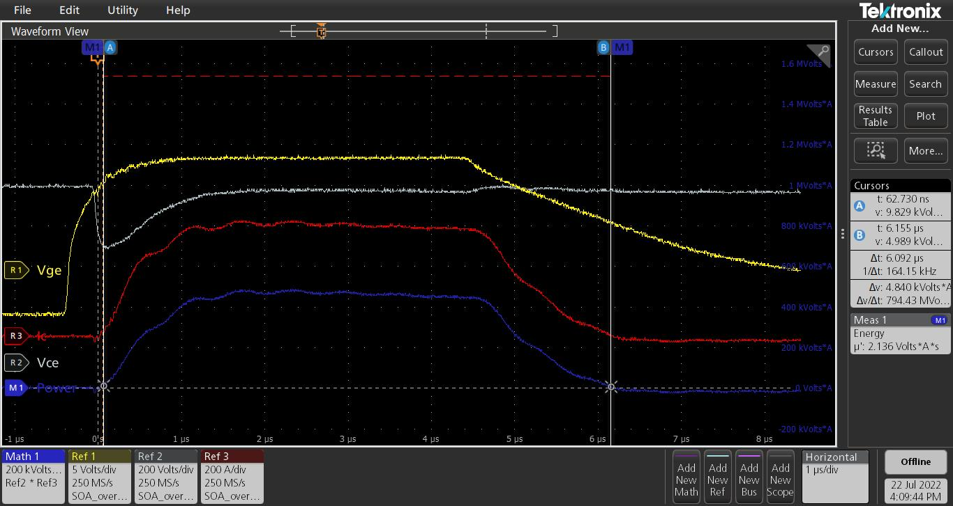
IGBT Validation (Double-Pulse test) for Motor drives
Gate drive circuit and IGBT validation
Miller tests. Time delays, Overshoots, dv/dt, di/dt
Reverse recovery characteristics
Desaturation test, Short circuit Safe operating Area(SOA), Switching loss analysis
15kW / 22kW drive, 50kW drive
Miller tests and Gate drive tuning
Diode reverse recovery
Parameters observation and analysis at different temperatures (25⁰C, 100⁰C, 125⁰C)
Miller shoot through, Current and voltage overshoots
SC-SOA energy loss estimation
Switching loss measurement for comparison against the datasheet values
Switching losses analysis
SC-SOA energy estimation
SC-SOA test -IGBT

