Slide 1
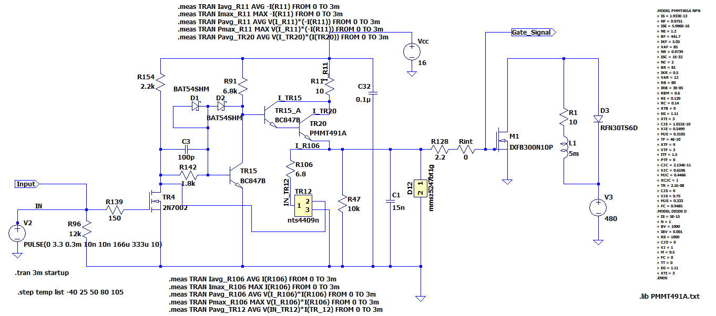
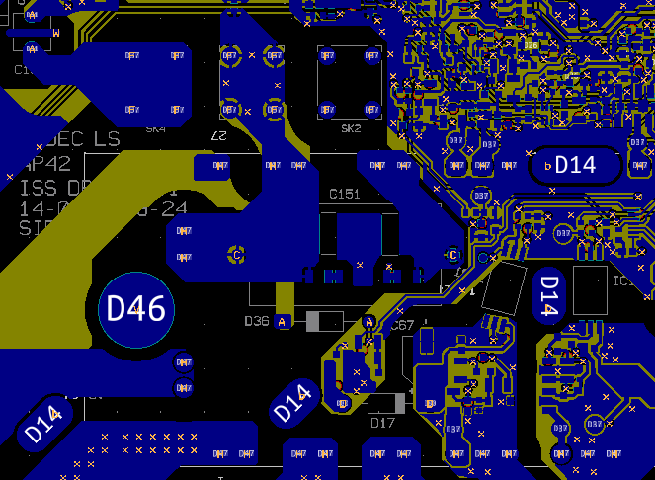
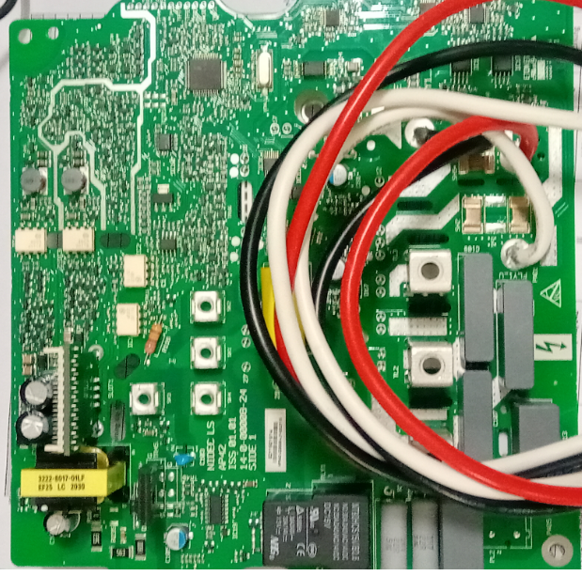
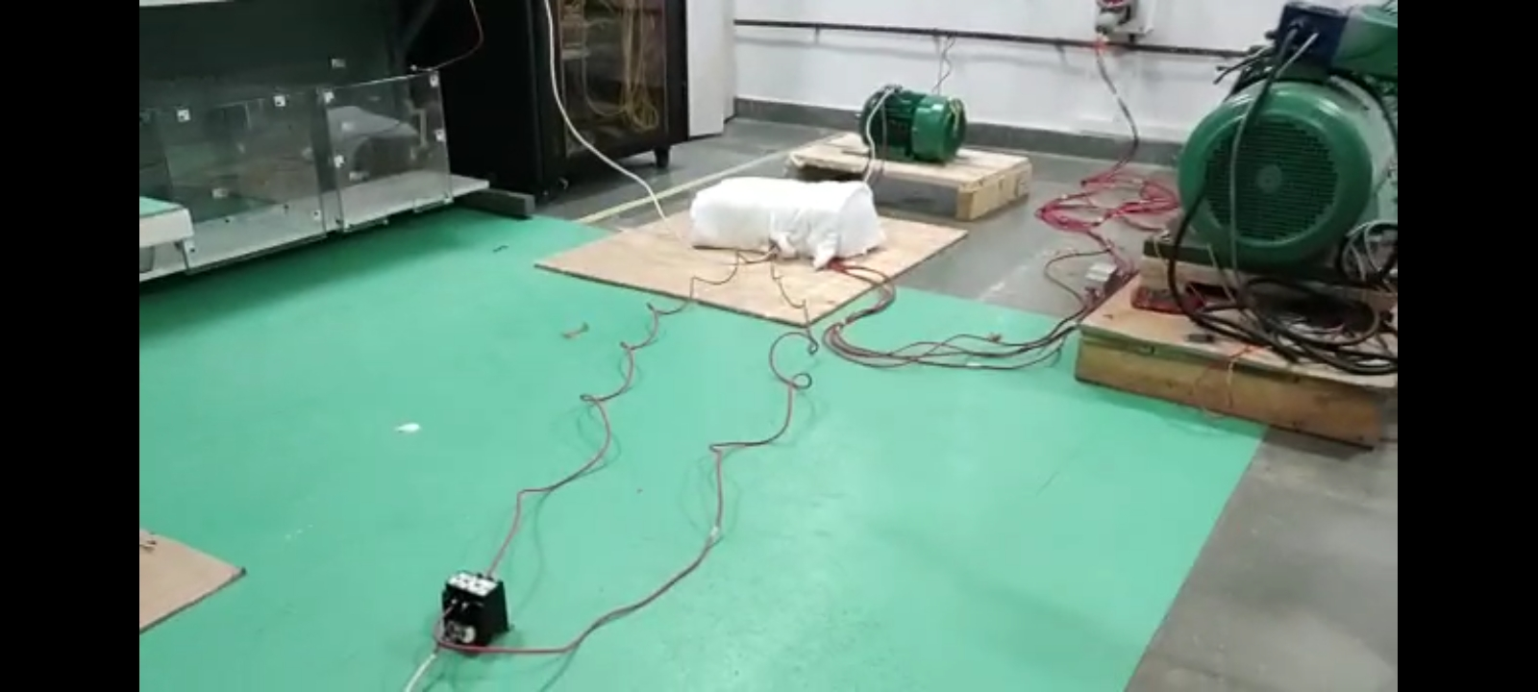
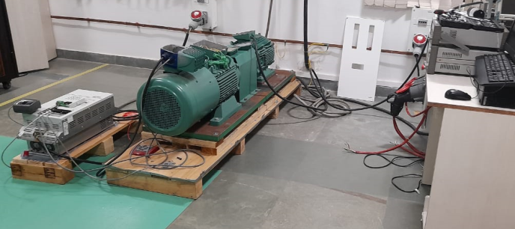
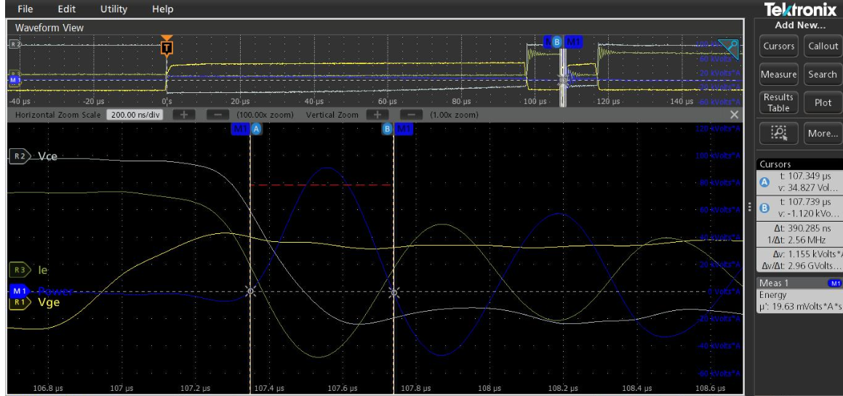
Range Extension of 7.5kW VFD to 15kW and 22kW
Scope
Current loop/Feedback Design, IGBT Gate driver Design
DC bus component identification
Schematics and PCB layout (Mentor Graphics Xpedition)
Mechanical Enclosure Redesign
.
.
Circuit design & Simulation
Schematic and PCB layout
Board manufacturing
.
Achievements
Current Feedback circuit simulation
Gate drive circuit simulation
Board bring-up, Circuit operation tests,
2-pulse test for IGBT validation
Thermal tests. Conformance (EMC, Safety) tests
.
.
Safety and EMC pre-compliance
UL witness Tests
Validation Tests

