Slide 1




SOVER
MEMBERS :
Amitabh Anand (22UME098)
Nikhil Kumar Gupta (22UEC103)
Mohammad Amanullah (22UCH028)
Debadrita Nath (22UME039)
Asmita Chakraborty( (22ME062)

Slide 2


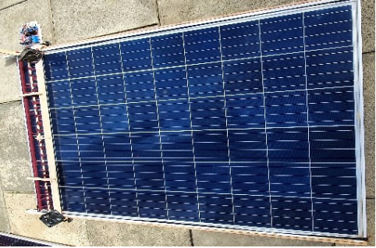
CONTENTS
Introduction
Description
Components
Circuit Diagram
Working
Application & Futuristic Enhancements
Conclusion

Slide 3
INTRODUCTION
In today’s times, development of renewable sources of energy has become one greatest global concern. About 80 percent of the global population lives in countries that are net-importers of fossil fuels -- that’s about 6 billion people who are dependent on fossil fuels from other countries, which makes them vulnerable to geopolitical shocks and crises. Along with the ever-increasing demand is the environmentalist concern of pollution that increases simultaneously. A solution to all this mess is the use of non-conventional sources of energy, Solar Energy being one of them.
Solar energy is directly usable for electrical power generation for residential, commercial and industrial uses. According to the US department of energy, the total amount of fossil fuel which is stored in the earth is equivalent to the energy produced from the sunshine on earth of around 18 days.
Solar energy is harnessed using Photovoltaic Solar Cells over which dust accumulates over time, reducing its efficiency and causing power losses of about 15%. Our robot, SOVER, is basically an automatic, waterless and economic solar panel cleaning system, that can help us overcome this problem.

Slide 4
DESCRIPTION
In a solar energy system, photovoltaic (PV) solar panel provides DC electricity from the continuous flow of energy from the sun. Once the installment of solar panels has been completed, the fuel is free. However for proper functioning frequent maintenance is required.
The particles of dust on the solar panel come mainly from urban and industrial product (SiO2, Al2O3, Fe2O3, CaMg(CO3)2, Ca(OH)2, CaO and CaCO3). There are already pre-existing mechanisms such as- electrostatic cleaning methods, water-based methods, A semiautomatic wiper control system, vacuum cleaning method, etc but each have their own limitaions.
SOVER is waterless and works on two steps cleaning mechanism. Therefore, wastage of water is completely avoided by this system. An Exhaust fan works as an air blower which initially removes the dust from the surface of the solar panel. Then, a wiper is utilized to swipe the remaining dust from the surface. Therefore, no water is needed for the system for cleaning. This feature keeps the solar panel safe from scratch. The proposed solar panel cleaning system is fabricated with easily accessible components.

Slide 5
COMPONENTS
Solar Panel
DC Gear Motor (motor drive module)
2 Push Buttons
Exhaust Fans
Microcontroller (Arduino Uno),
LDR sensor
Buck boost converter

Slide 6
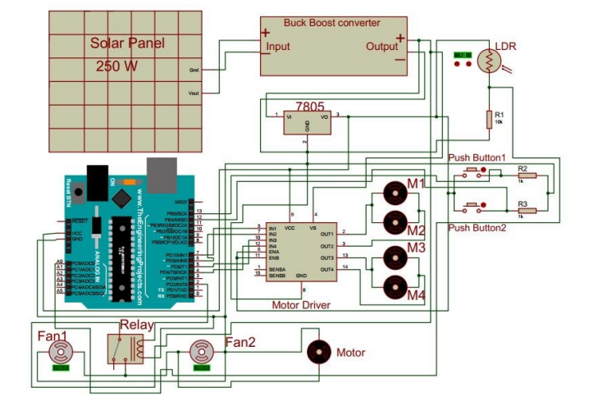
CIRCUIT DIAGRAM

Slide 7
WORKING
Start
Active all sensors and microcontrollers
A solar panel is placed in the top left corner which produces dc electrical power.
A buck boost converter is used here to keep the output voltage constant. The output voltage of the converter is set at a certain level and therefore, the variation of the sunlight does not have any effect on the output voltage.
Two reference lines are set for the movement of cleaning shaft and exhaust fan. Each line consists of 2 motors and wheels.
When the sunlight comes out, microcontroller and LDR measure the value and the whole system is designed in such a way that the system will start its operation at the beginning of the day typically between 10-11 am regularly irrespective of the presence of dust.
Input of LDR by tracking sunlight
Sunlight Detection
No
Start Cleaning
End

Slide 8
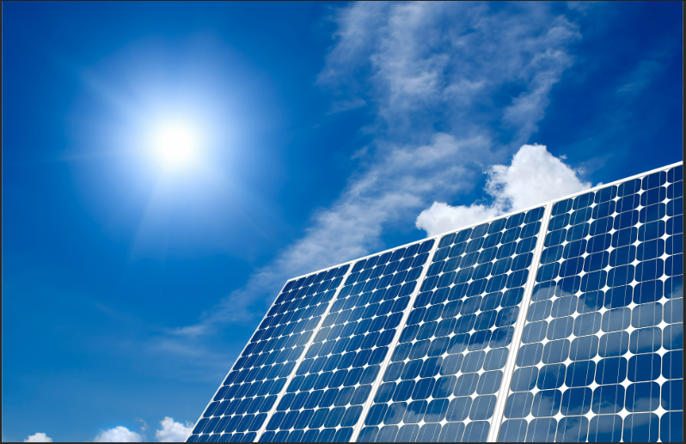
APPLICATION AND FUTURISTIC ENHANCEMENTS
Solar Panels are used all around the globe for all sorts of purposes and hence it implies that SOVER can be utilised everywhere. Starting from mass energy production in factories to automobiles to Solar Cookers we might find its use in every domain of our safe, secure and eco-friendly future.
In future we plan to add a tilting mechanism to the solar panel system itself according to the position of the sun in the sky, so that the maximum amount of Solar energy can be captured.
When space shuttles are on their space voyage they
often encounter debris which accumulates on the
solar panels. Using this mechanism, this problem too
can be solved.

Slide 9
Conclusion
Though we are still novice in the field of robotics, we can see the scope for a robot like SOVER which can be a very useful to ensure us a sustainable future. We will surely be benefitted from this innovative idea. We look forward to work on this model under the guidance of our seniors to prove its effectiveness.
Thank You!!!

