Slide 1
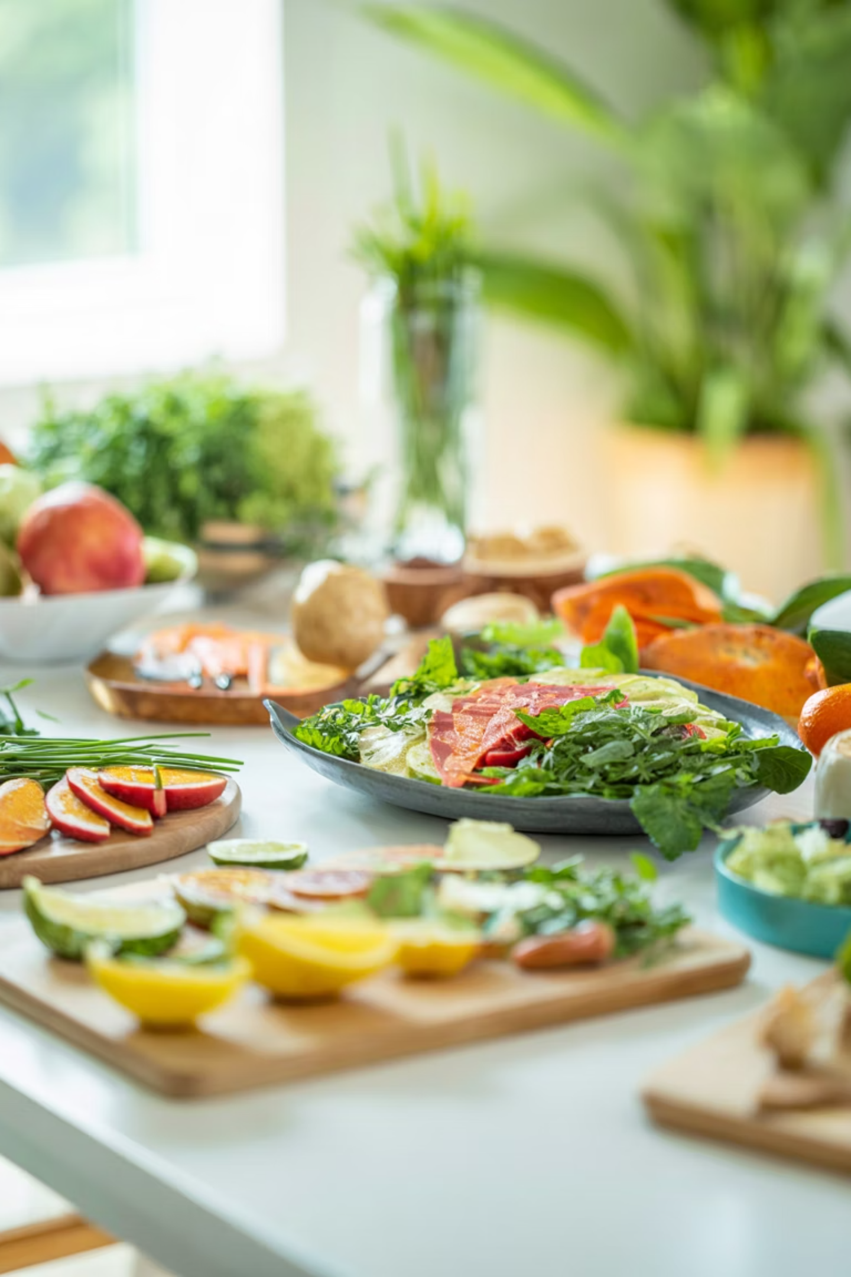
NutriAI
Your AI-powered nutrition companion — track, discover, and eat smarter.
Ruby Albers, Sisira Boppana, Bhoomi Mehta, Sara Chandorkar, Noah Conrad
Notes:
Sara -

Slide 2

The Problem
Tracking is tedious
Hard to stay on goal
Manual logging is slow and discouraging
No personalized guidance for calorie targets
Recipe discovery gap
Finding meals that fit your diet takes effort
Notes:
Sara - There are many apps available to track your calories, but they don’t act as your own personal nutritionist, and they do not encompass a variety of cuisines and dietary restrictions. Thats why we created NutriAI. Personal nutritionist in your pocket!!!

Slide 3
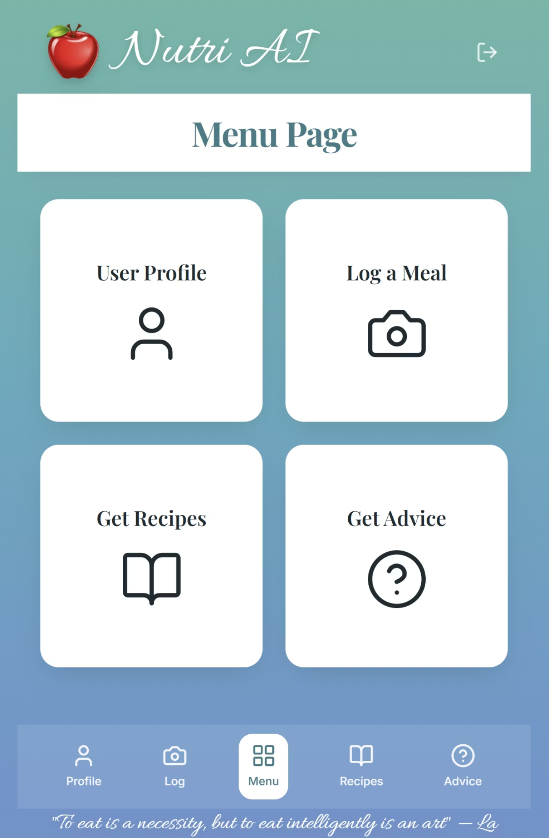

What is NutriAI?
A mobile-first web app with four core modules:
User Profile
Goals, age, weight
Log a Meal
Manual or AI camera
Get Recipes
Filtered by diet, calories, and cuisine
Get Advice
Smart, personalized tips
Notes:
Ruby - NutriAI is designed as a web app with four different features to assist you in your health goals. User Profile to set your goals and personalized information, log a meal to track your daily intake (manually or with AI camera), get recipes based on diet calories, and cuisine, and get advice to interact with your personalized AI nutritionist.

Slide 4
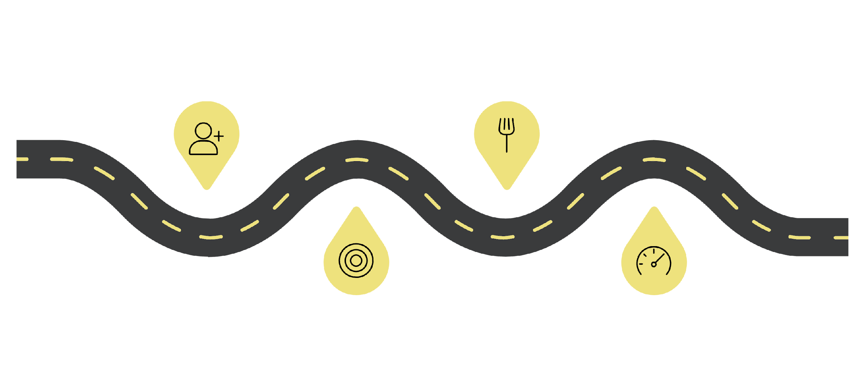




User Flow
Sign Up
Log Food
Create an account quickly
Track meals in seconds
Set Goals
View Dashboard
Choose targets and preferences
See progress at a glance
Notes:
Ruby - we have made it simple to start using our app read slide girl

Slide 5
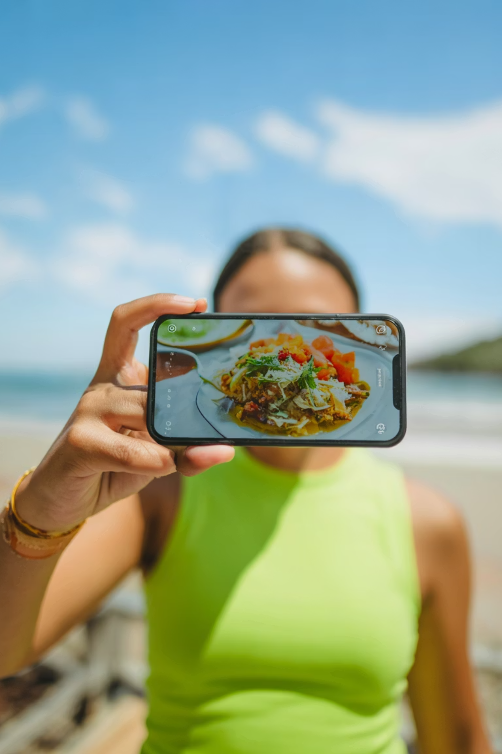
AI Food Recognition
Upload a photo
1
Upload from camera roll
AI identifies food
2
Computer vision API detects items & estimates portions
Confirm & save
3
Confirm before logging — full user control
Notes:
Sisira - A key element of NutriAI is uploading photos from your camera roll and let the Gemini flash identify the food and nutritional stats. Uploaded photos are added to your daily log to track your calorie goals.

Slide 6
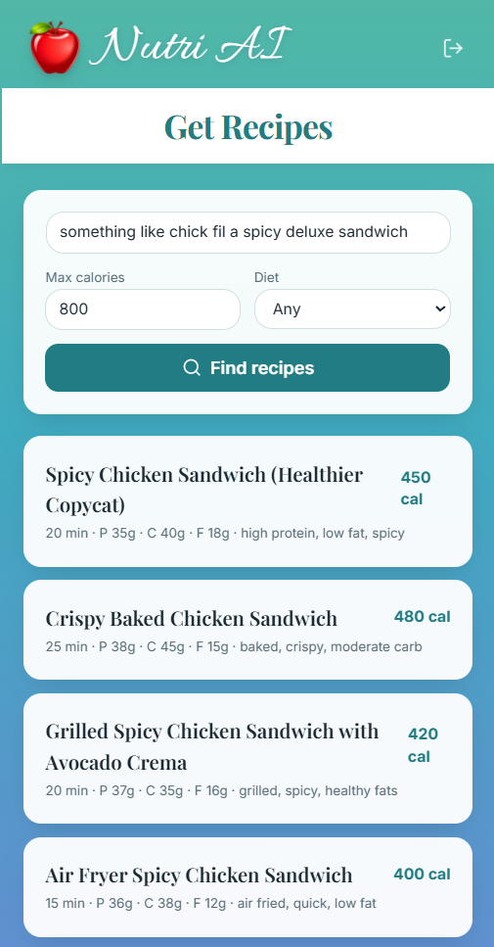
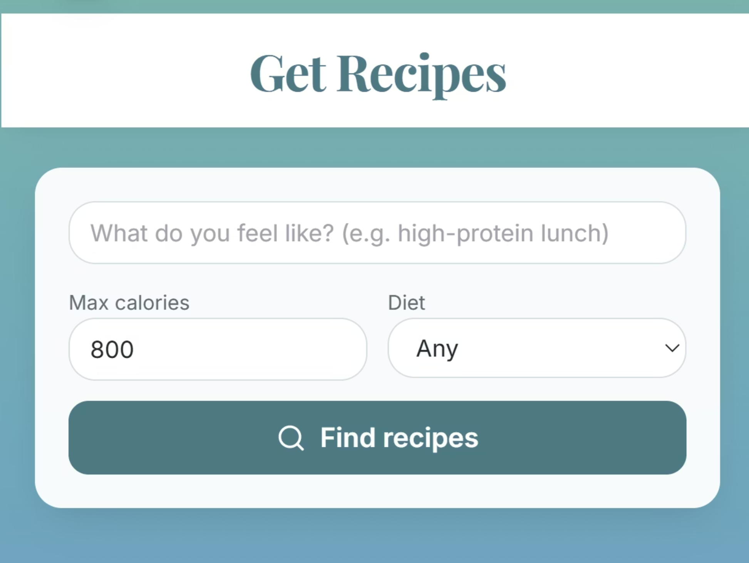
Recipe Discovery
Filter recipes by:
Calorie range
Dietary preference (vegan, vegetarian, etc.)
Each result shows ingredients, steps, and full nutrition info — powered by a recipe API (Nutritionix).
Notes:
Sisira - As you can see in the walkthrough, we can search through multiple cuisines or describe the type of lunch you’d like to have. You can use a prompt like “I want to eat something like Chick fil a sandwich within my calorie limit for the day”.

Slide 7
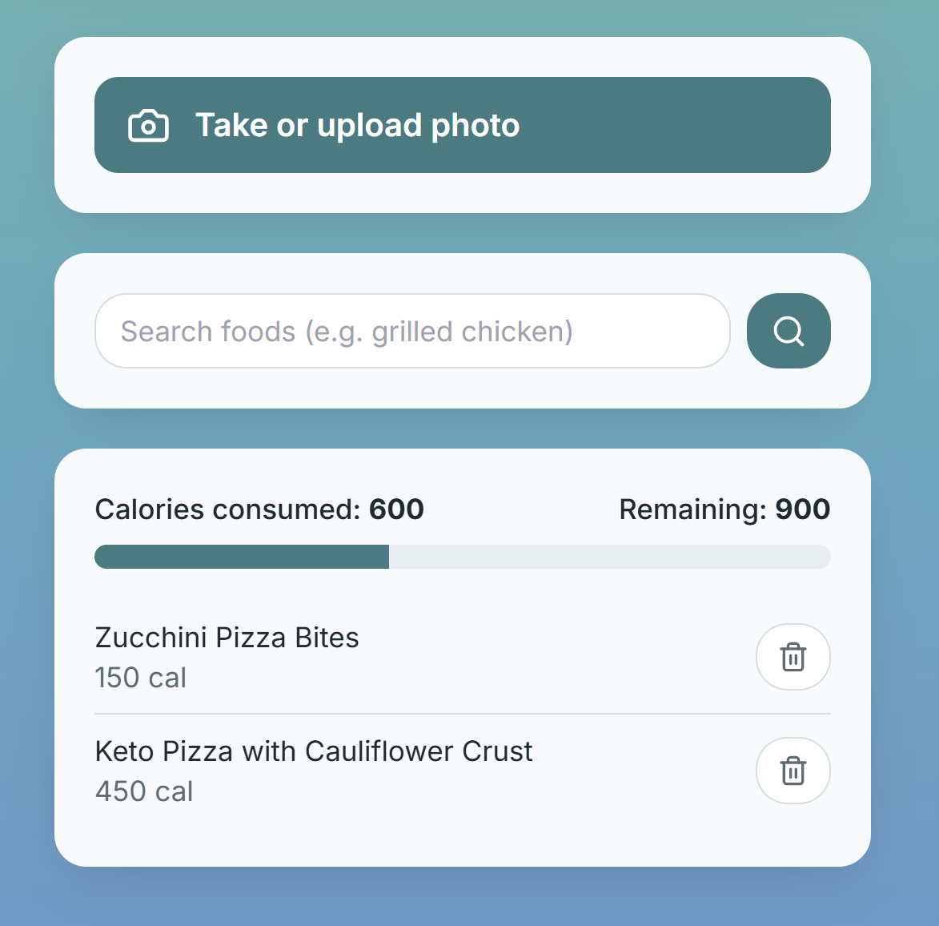
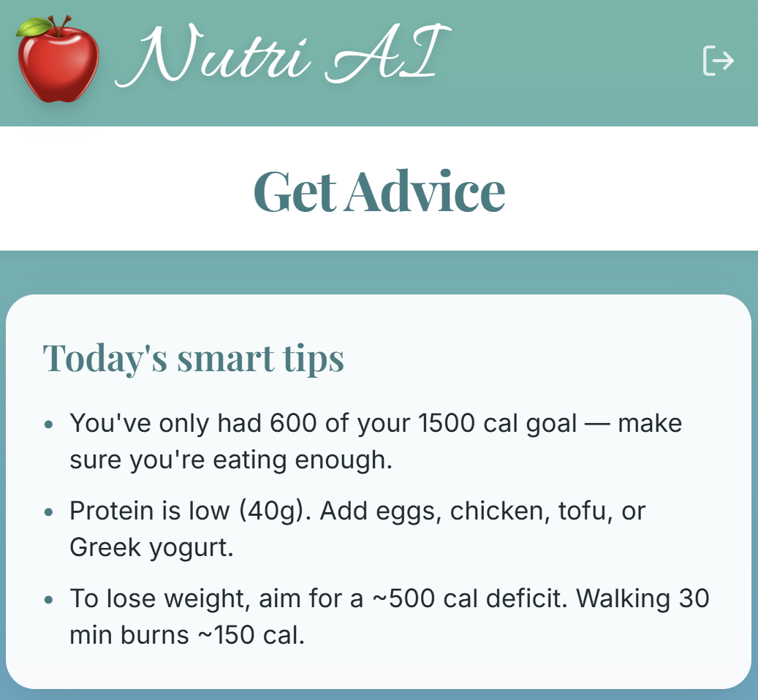
Dashboard & Tracking
Daily Summary
Macro Breakdown by Recipe
Calories in vs. goal at a glance
Protein, carbs, fat — visualized
Meal History
Full log of past meals

Slide 8



Where AI Powers NutriAI
Vision Recognition
Smart Search
Personalized Advice
Google Gemini 2.5 Flash identifies food from photos
Autocomplete + suggestions based on past behavior
Recommendations improve over time with user history
Notes:
Sisira

Slide 9








Tech Stack
Frontend
Backend
React — mobile-first, responsive
Node.js / Express or serverless
Database
APIs
Supabase
Nutritionix · Gemini Flash 2.5
Notes:
Sirisiaisaisi

Slide 10
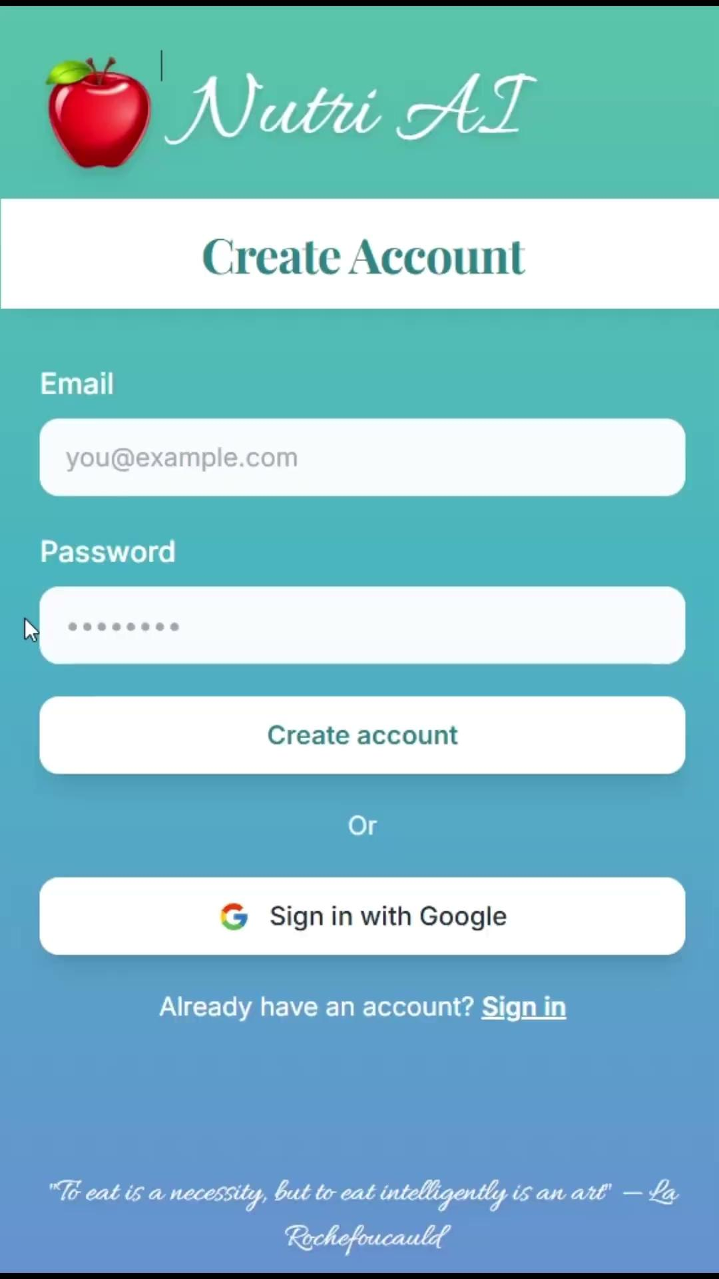
App
Walkthrough
Notes:
Bhoomi do ur thing

Slide 11
Thank you!
Questions?
Notes:
Noah

Slide 12
Team Member | Unity ID
Ruby Albers | rcalber2
Sisira Boppana | sboppan
Bhoomi Mehta | bmehta
Noah Conrad | ncconrad
Sara Chandorkar | schando

