Slide 1
PySerial and Arduino
IndyPy Meetup
December 2013
https://github.com/darkstar36/IndyPySerial

Slide 2
What is serial communication?
In telecommunication and computer science, serial communication is the process of sending data one bit at a time, sequentially, over a communication channel or computer bus. This is in contrast to parallel communication, where several bits are sent as a whole, on a link with several parallel channels.

Slide 3
Examples of serial usage
PS/2 (for mice and keyboards)
Apple desktop bus
COM ports (seen on older PCs)
Electronic components communicating with one another on a circuit board. (common)
MIDI
USB, firewire, and even Ethernet use serial communication for some applications.

Slide 4
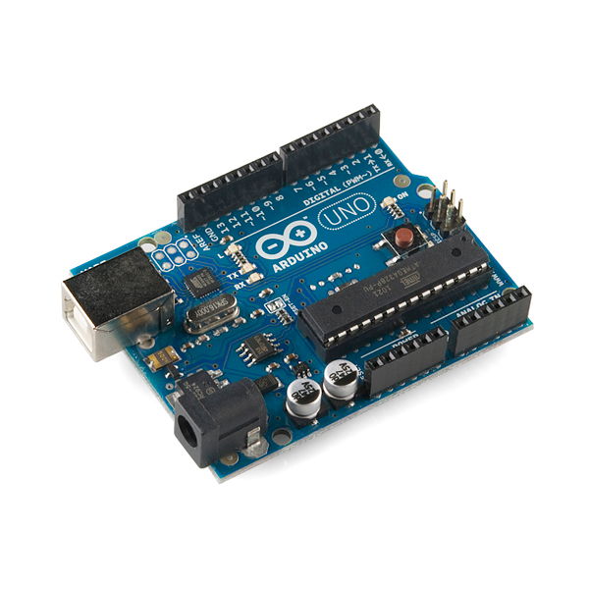
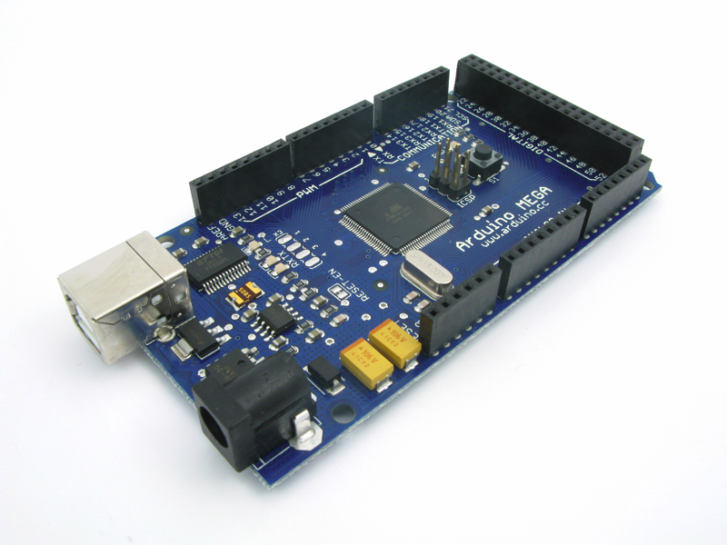
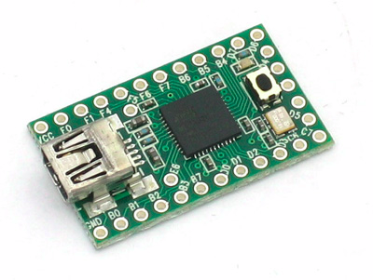
What is Arduino?
Arduino is a popular open source electronics prototyping platform. It is easy to use, and doesn't have a steep learning curve.
Arduinos come in all different shapes and sizes.
Arduinos are programmed in C++ (but don't let that scare you)
Arduino is the most popular prototyping platform and has a large, community-centered user base.

Slide 5


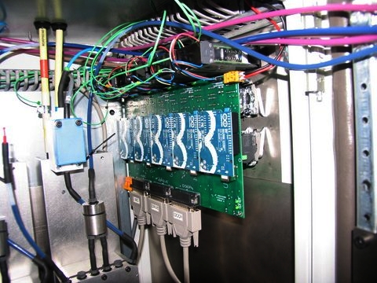

What can be made with Arduino?
Arduino is even being used in industrial applications now!

Slide 6

What does this have to do with Python?
Arduinos use serial communication over USB.
PySerial is a library that can be used to communicate with serial devices, including Arduino.
Why should you use PySerial? It's full featured and easy to use.

Slide 7
Basic usage
Writing Example
Open port 0 at “9600,8,N,1”, no timeout:
>>> import serial
>>> ser = serial.Serial(0) # open serial port (Windows example, COM0)
>>> print ser.name # check which port was really used
>>> ser.write("hello") # write a string
>>> ser.close() # close port

Slide 8
Basic Usage 2
Reading Example
>>> ser = serial.Serial('/dev/ttyS1', 19200, timeout=1) #(Unix-like example)
>>> x = ser.read() # read one byte
>>> s = ser.read(10) # read up to ten bytes (timeout)
>>> line = ser.readline() # read a '\n' terminated line
>>> ser.close()

Slide 9
Configuring ports later
>>> ser = serial.Serial()
>>> ser.baudrate = 19200
>>> ser.port = 0
>>> ser
Serial<id=0xa81c10, open=False>(port='COM1', baudrate=19200, bytesize=8, parity='N', stopbits=1, timeout=None, xonxoff=0, rtscts=0)
>>> ser.open()
>>> ser.isOpen()
True
>>> ser.close()
>>> ser.isOpen()
False

Slide 10
Additional Features
PySerial is very easy to use, but it has a lot of great features.
It has an extensive API
PyParallel

Slide 11
For more information
http://pyserial.sourceforge.net/index.html
http://arduino.cc/
https://github.com/darkstar36/IndyPySerial
http://hacknmod.com/topics/arduino
http://www.reddit.com/r/arduino

