Slide 1

AI For Games: Being A Good Dad

Slide 2
Problem Description
AI are never challenging enough, either far too easy or depressingly strong
Ultimate tic tac toe is a twist on the classic pen and paper game that adds an extra layer of complexity to this solved game
Developing AI
Creating an evaluation function for this game is difficult so heuristic based AI (such as MiniMax) are not feasible
Instead monte carlo tree search will be implemented for asymmetric tree search
A brute force method may be possible but will not be developed

Slide 3
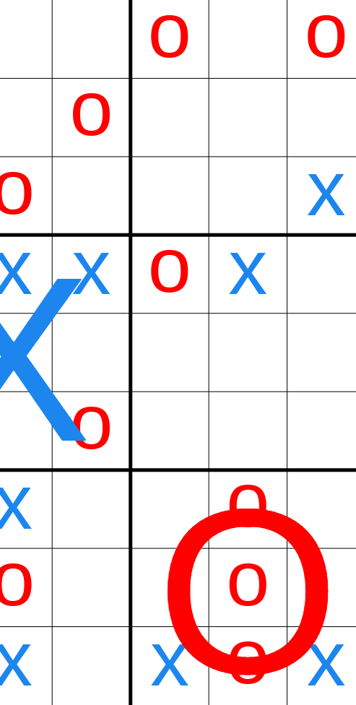
The Game: Ultimate Tic Tac Toe
Criteria
Game must be quick to play
Must be somewhat novel
Rules must be quick to learn
Choice to implement
Allows complete control over code
Don’t have to deal with adapting API’s that are not designed for AI play

Slide 4
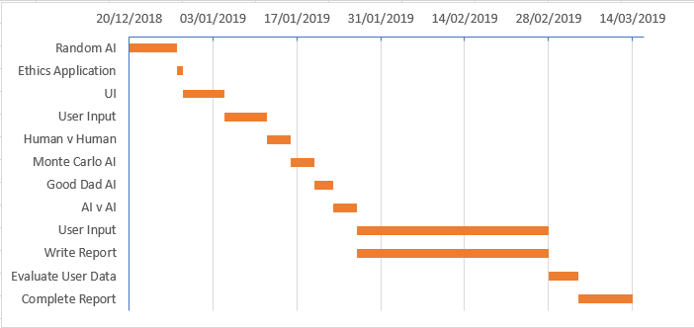
Project Plan

Slide 5
Design
Client
.Net Web app with angular front end
Layered Architecture Server side
MVVM Architecture Client Side
API Layer
Logic Layer
Data Layer
Database

Slide 6
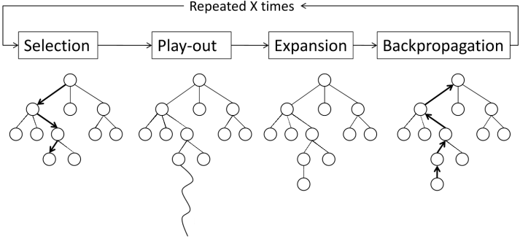
AI Design
Random AI
Will pick moves at random
Intended to be easiest AI opponent
Good Dad Ai
Will use modified Monte Carlo Tree Search (MCTS)
Will take into account the players skill level and move accordingly
MCTS AI
Will use pure MCTS algorithm to attempt to find best possible move
Rule Based AI
Will follow the strategy put forth in Group Actions on Winning Games of Super Tic-Tac-Toe (George and Janoski, 2019)
Will give user advice on how to best play based on it’s rule set

Slide 7
Evaluating AI
User Comments
Play through sessions
Or online questionnaire after games
Experiments
Measure player performance (How often they pick the best move, second best etc) let them play a couple games against an AI then measure performance
Have player play against an anonymous AI then a second AI and have them comment on how much they enjoyed one game compared to the other
Have Good Dad play other AI to measure how well it adjusts its playstyle

