Slide 1

Monitor
Feasibly study and business plan

Slide 2
By
Mustafa Elaalm
Muhammed Shaker
Omar Elsafty
Muhammed Farag

Slide 3
Agenda
Executive Summary
Business and Industry Profile
Marketing Strategy Plan
Market Plan
Financial analysis

Slide 4
Executive Summary
Project overview:
Cloud based application to monitor projects, allocate and optimize your resources, detect the cost for the project, controlling the data sharing.
The problem definition:
A study conducted by the University of Hamburg revealed that the focus of our mind drops from minutes to seconds when we are on the web. Human ability to pay attention is about eight seconds as of 2015, down from 12 in 2000 as portrayed in statistics by The Associated Press. Eight seconds is about the same amount of time it took me to type this sentence right now. That’s the reality at your workplace.
The internet has trained our minds to shift attention from one thing to another lightning fast – mainly irrelevant stuff on social media. As the workloads continue to increase day after day, it’s becoming impossible to memorize more than three tasks at a time, which eventually results in reduced productivity at your agency.

Slide 5
Mission
Discover a better way to track time and manage tasks, fully customizable workflow and time tracking to match how you work. Gain visibility into your efforts and easily report on your work.
Vision:
using our skills and abilities we want to build a dependable and strong website that allows our clients to manage their businesses easier, leading to a better work environment.
Goals
Raise customer retention
Create more inclusive workplace culture
Grow internationally

Slide 6
Objective:
To help you manage all your work in one place, prioritize your tasks, eliminate the geographic barrier and empower team collaboration and share the workload between them. Our service is a Task tracking software allows you to integrate and manage all tools and activities in one place. No need to remember multiple usernames, passwords, URLs and what not. All of your projects and processes are right there in front of you, on one big, user-friendly platform. Whether you are working on a few low-priority tasks, some personal to-do’s or a single large project, task tracking software will make your life a lot easier.
Slogan:
“Raising the bar for project management perfection”

Slide 7
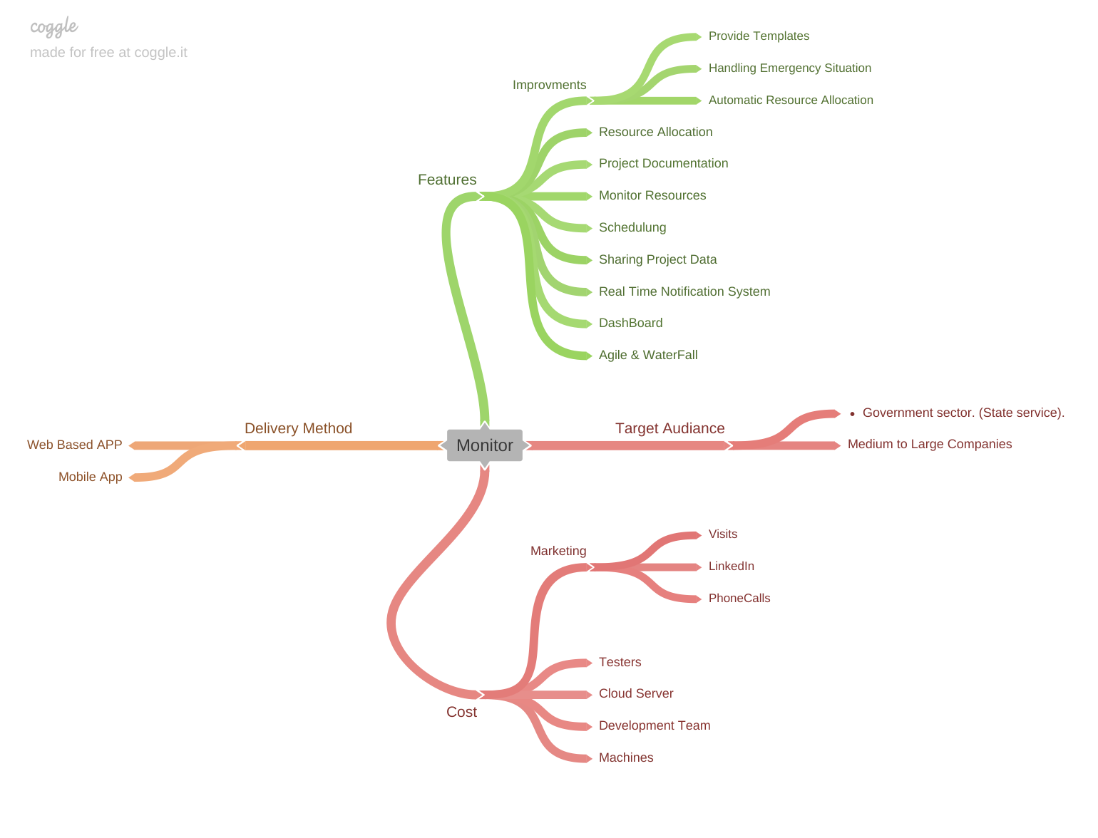
Mind Mapping

Slide 8
Business and Industry Profile

Slide 9
PESTEL
Politics
Considering the political situation in Egypt, Egypt seeks to be among the top 20 countries in the world in the field of intellectual property rights, this achieves the encouragement required to induce thinking about what is new and innovative.
The Ministry of Communications and Information Technology seeks to enhance the development of the infrastructure of information and communications technology and digital services in government agencies.
And for easing paying taxes, Egypt made paying taxes easier by implementing an online system for filing and payment of corporate income tax and value added tax.

Slide 10
PESTEL
Economical
Egypt’s macroeconomic situation has improved significantly since 2016. Over the last three years, the authorities have carried out an ambitious home-grown reform program that aimed to correct large external and domestic imbalance and promote inclusive growth and job creation. Critical macroeconomic reforms implemented under the program have been successful in achieving macroeconomic stabilization, a recovery in growth and employment, and putting public debt on a clearly declining trajectory. Fiscal savings have been partly utilized to ease the burden of adjustment on the poor.

Slide 11
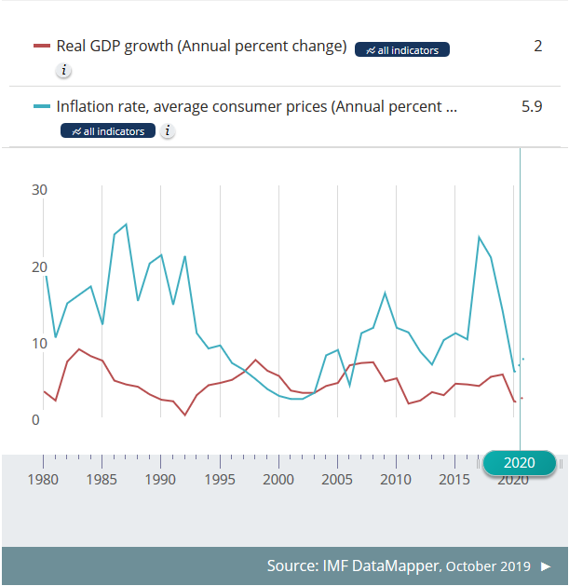
While Egypt’s fiscal space has gradually improved, thanks to fiscal consolidation measures in previous years, the implications of the COVID-19 pandemic might temporarily hinder the budget deficit and government debt reduction efforts.

Slide 12
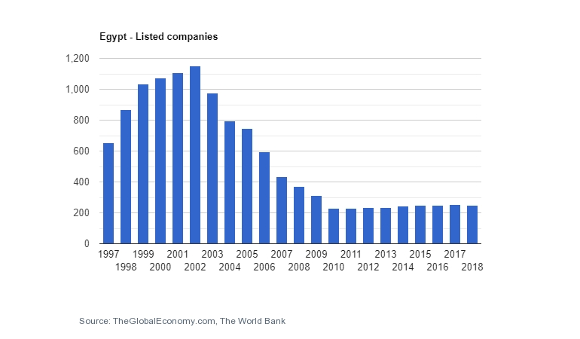
“Sixty Egyptian companies were ranked among the top 500 companies in the Arab world in 2014, up from just 35 in the previous year”

Slide 13
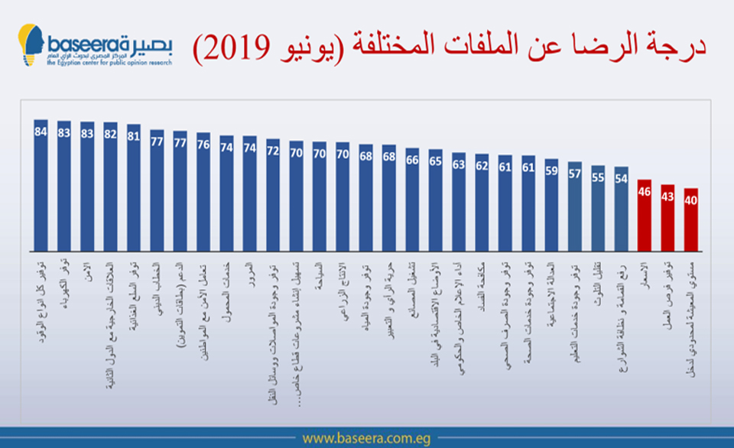
PESTEL
Sociocultural
The average Egyptians 'evaluation of the twenty-nine items was calculated to reflect the Egyptians' evaluation of the general performance. The results showed that the average overall satisfaction index was 67 points from 100 points compared to about 58 points in June 2018.

Slide 14
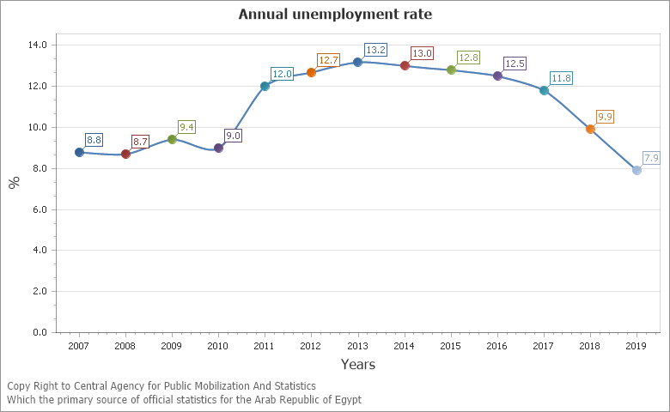
PESTEL
Sociocultural
Annual unemployment rate: Indicator Description: They are individuals (15 - 64 years) who are able to work, want, looking for it but they don’t find it relative to work force in the same age category and having platforms that help you work from home - especially in the current global conditions - ensures a higher rate of employment in Egypt.

Slide 15
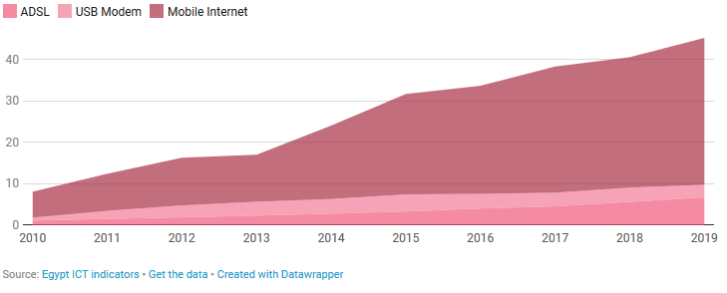
PESTEL
Technology
Egypt has 45.21 million internet users although the official report cited only 40.9 million users. At least 35.44 million Egyptians use Mobile Internet while 6.74 million use ASDL and 3.03 million use USB Modems.
This graph shows the number of internet users (in millions) via ADSL, USB Modem and Mobile Internet. We can see that Mobile Internet users have significantly grown within the last 9 years as mobile phones, and particularly smartphones, become more popular.

Slide 16
PESTEL
Legal
The Arab Republic of Egypt made starting a business easier by abolishing the requirement to obtain a certificate of no confusion and improving its one-stop shop.
Article (60) of the Press and Media Regulation Law states:
and the council decides on the request within a period not exceeding ninety days from the date the request is fulfilled, against a fee not exceeding two hundred and fifty thousand pounds for the medium Informative and fifty thousand pounds for the website, it is collected in cash or any other payment method

Slide 17
Porter's Five forces
Rivalry Among Other Enterprises: : . Number of competitors is quite large . Competitors are different in size ** Due to the world situation nowadays the field is growing very fast.

Slide 18
Porter's Five forces
Bargaining Power of Suppliers: . Switching risks are low . Safe exit plans with low financial losses, The cost will be for development Team , cloud storage and Web Hosting . ** Due to the world situation nowadays the field is growing very fast.

Slide 19
Porter's Five forces
Power of Buyers: . Number of potential beneficiaries is high because it targets all companies which can adapt to working from home situation and wanted a platform to communicate and collaborate . . Beneficiaries want differentiated services: there are many type of industries and each one has its own needs by the time we can customize our app to many industries so they feel that our application is designed pacifically for them . . For our Beneficiaries it`s easy to collect information for comparing suppliers

Slide 20
Porter's Five forces
Threats of new Entrants: . Government does not restrict the entrance of new entrants. . Capital requirements to enter are low . Advantages of economies of scale are absent. .Beneficiaries are not loyal to existing enterprises, but we can work on this point by the customization of our application and offering good prices for our service .

Slide 21
Porter's Five forces
Threats of substitutes: . Quality substitutes are not readily available : there are many other application but they don`t provide the all essential features in our application . . Prices of substitute products are almost equal to the industry product . .Buyers’ switching costs are high because he will need to copy all his documentation and files to a new application which is not that easy

Slide 22
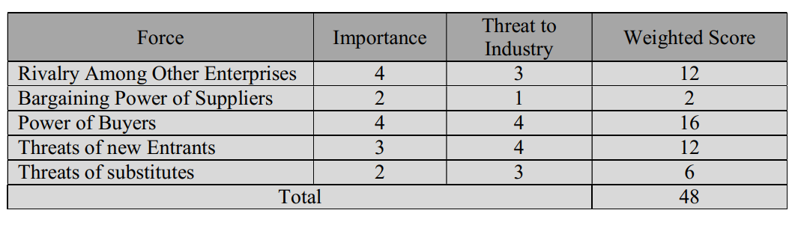

Slide 23
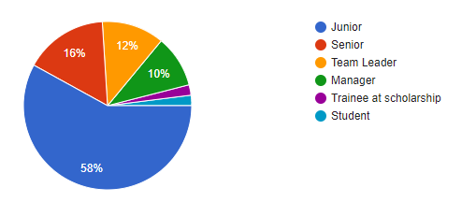
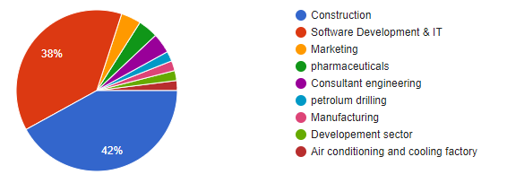
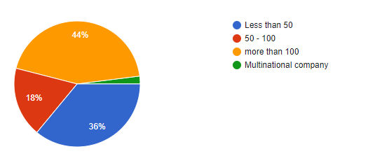
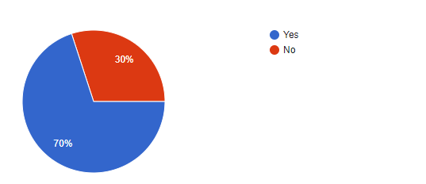
Reality Test
Positions
Company Industry
Company Size
Agreements On Working from Home

Slide 24
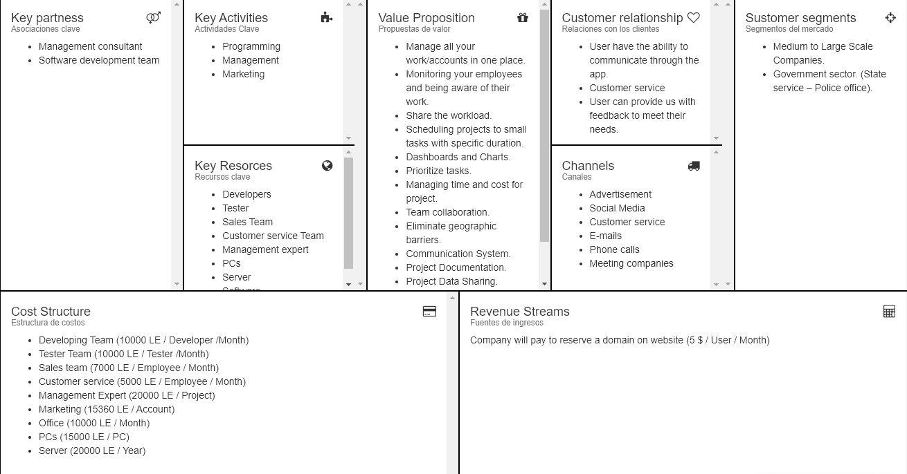
Business Model Canvas

Slide 25
Test the value proposition
According to our online and offline survey we found that the most percentage of people have the idea of recycling their pencils but they don't know how to apply it.

Slide 26
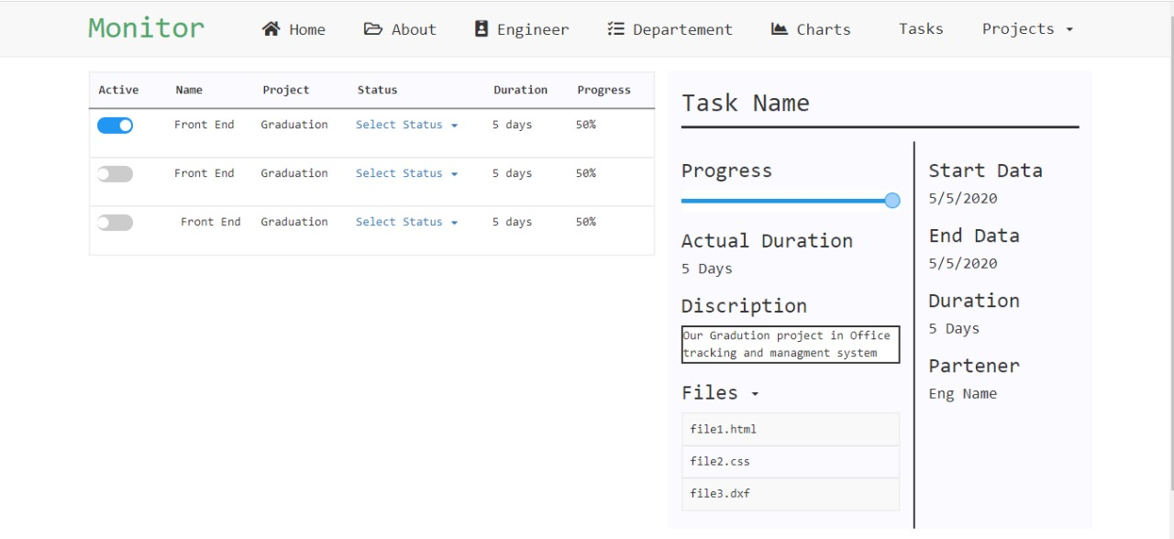
Service prototype
View tasks for Employees

Slide 27
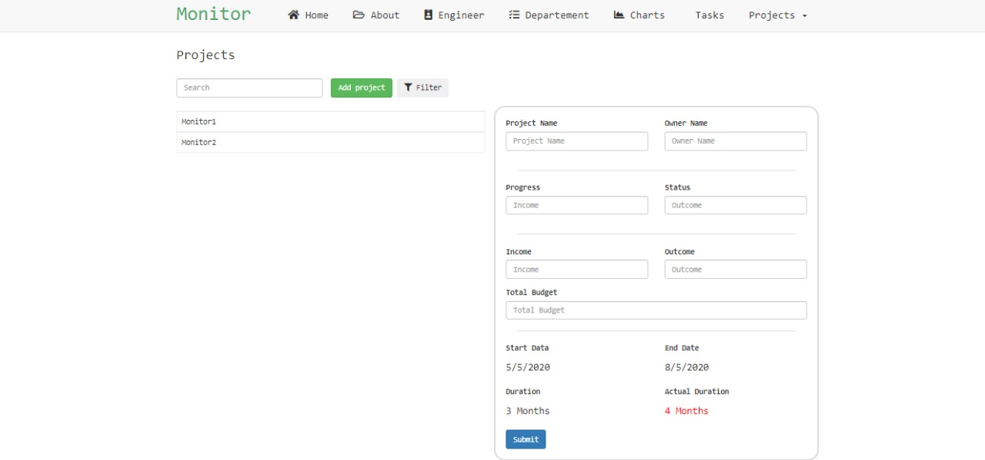
Service prototype
Project Manager View

Slide 28
Marketing Strategy Plan

Slide 29
SWOT Analysis

Slide 30
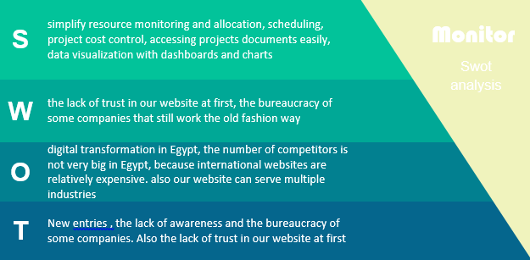

Slide 31
Competitive profile matrix
Key success factors |  |  | Our product |  | Workflow max |  | Gantt Pro |  | Project manager
 |  | Weight | score | Weighted score | score | Weighted score | score | Weighted score | score | Weighted score
1 | Innovation | 0.1 | 3 | 0.3 | 4 | 0.4 | 3 | 0.3 | 4 | 0.4
2 | Marketing | 0.1 | 4 | 0.4 | 3 | 0.3 | 4 | 0.4 | 4 | 0.4
3 | Brand reputation | 0.15 | 3 | 0.45 | 4 | 0.6 | 3 | 0.45 | 4 | 0.6
4 | Product quality | 0.25 | 4 | 1 | 3 | 0.75 | 4 | 1 | 4 | 1
5 | Customer service | 0.1 | 3 | 0.3 | 4 | 0.4 | 3 | 0.3 | 3 | 0.3
6 | Price competitiveness | 0.15 | 4 | 0.6 | 3 | 0.45 | 3 | 0.45 | 2 | 0.3
7 | Technical competence | 0.15 | 3 | 0.45 | 3 | 0.45 | 3 | 0.45 | 4 | 0.6
8 | Total | 1 | 3.5 |  | 3.35 |  | 3.35 |  |  | 3.6

Slide 32
Market Plan

Slide 33
1-Market strategy
After Corona virus outbreak the need to a new Management System Software for multiple industries and the global trend to work from home. Our website simplifies data sharing, resource monitoring and allocation using different techniques that make companies maximize their revenues by making the best use of its resources.

Slide 34
Market Segmentation We target medium to large scale companies that need an office management system in Egypt.
Target Market Knowing to whom our service will fill the need and who are going for it is a key of success. Based on the survey we made, between employees there is a need to gather the data of previous projects and simplifying accessing it. It also stated that employers need to monitor their business workflow on one platform customized to their needs, which makes them our target audience.

Slide 35
Market Techniques
Social media: Facebook and LinkedIn.
Public relations and connections.
Direct Emails and phone calls to company owners.

Slide 36
Product positioning
Who is your ideal customer?
Companies that have more than 100 employee
Where are your target customers?
All industries that need a project management planning system in Egypt.
Why do they need a solution?
They need an inclusive workplace
Arranging tasks by priority
Lack of data centralization
Communicating easily between employees
What does your product do to help them solve this challenge?
Our service’s features include solutions for all these challenges
How does your product uniquely meet their challenge?
We concentrated on tasks priorities and calculating time for the task

Slide 37
Marketing mix
Product
Place
People
Price
Physical evidence
Promotion
Process

Slide 38
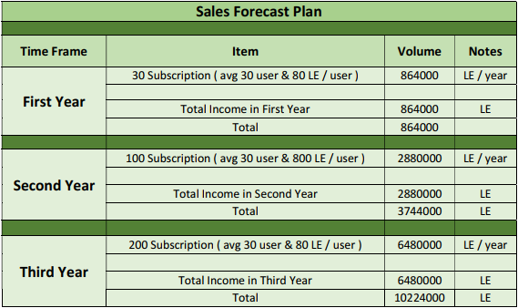
Financial Plan
Sales Forecast Plan

Slide 39
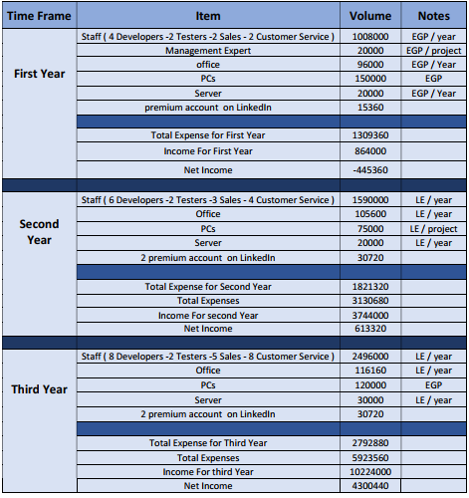
Financial Plan
Expenses Forecast Plan

Slide 40
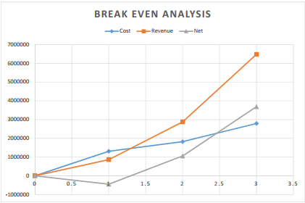
Financial Plan
Break even analysis
years | Cost | Revenue | Net
1 | 1309360 | 864000 | -445360
2 | 1821320 | 2880000 | 1058680
3 | 2792880 | 6480000 | 3687120

