Slide 1

VDeditor
Выполнили студенты II курса:
Ковальчук Д.А.
Годунова В.И.

Slide 2
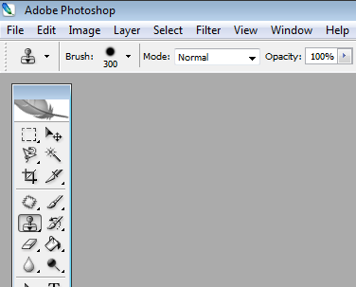
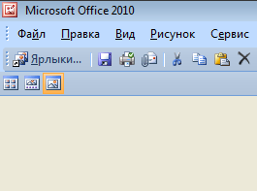
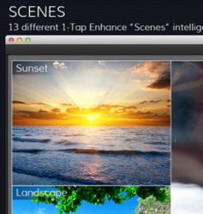

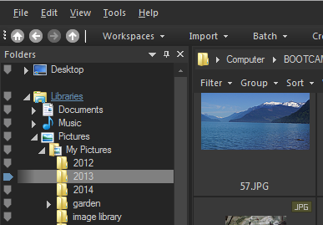
Overloaded market of photo editors

Slide 3
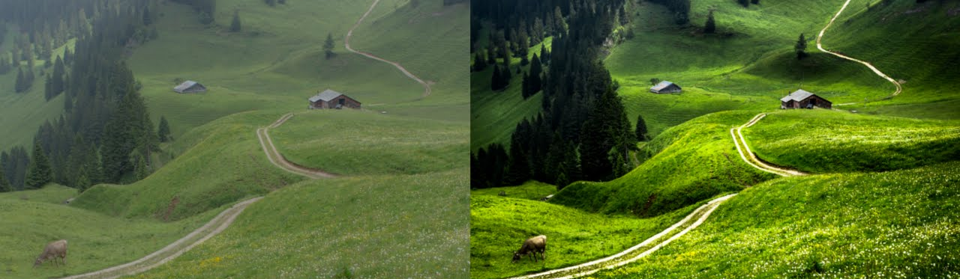
What’s new? Future developments
Functionality of saving most common actions with images to a file allows users to create “macroinstructions” that will make the process of editing images faster and easier

Slide 4
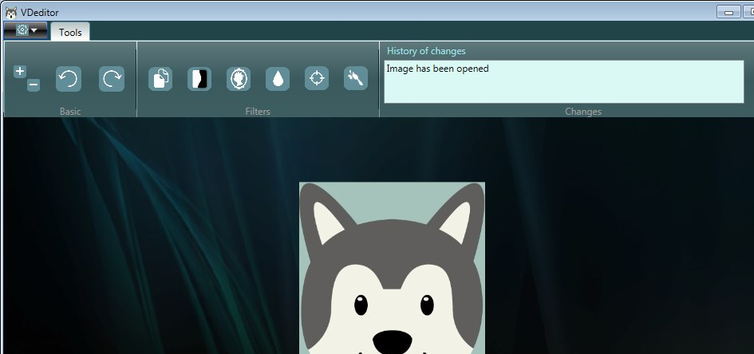
Interface
Main Menu
Rotation
Black&White
Blur
Aquarelle
List of occurred changes
Resize
Contrast
Sepia
Acutance
Image Area

Slide 5
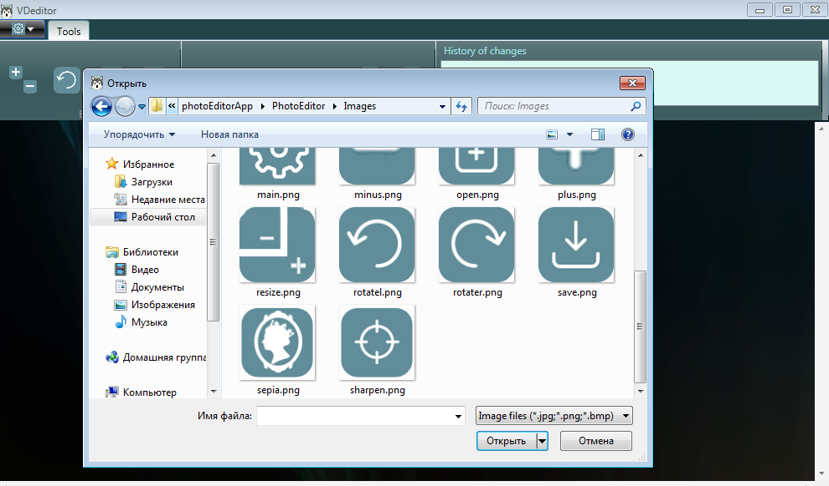
Open/Save File Dialog

Slide 6
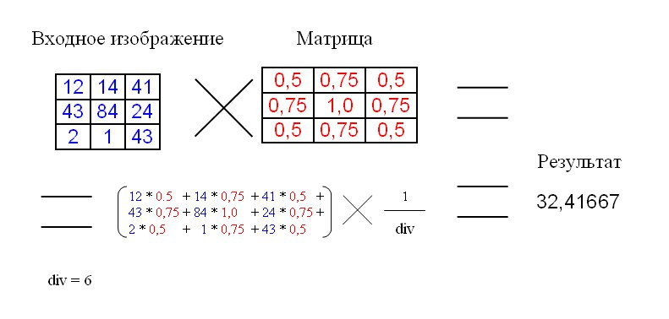
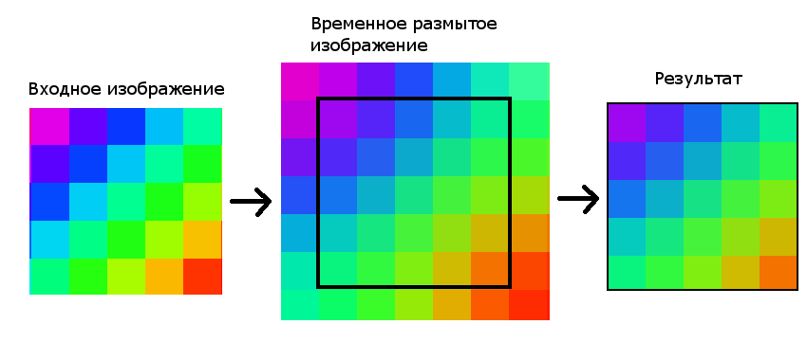
Filters’ implementation
Convolution Matrix

Slide 7
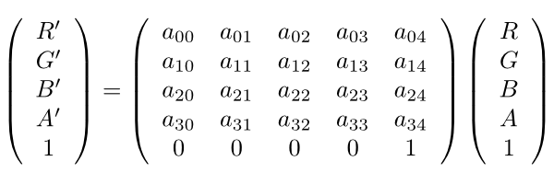
Filters’ implementation
Color Matrix

Slide 8






Filters’ implementation

Slide 9

Too much aquarelle…

Slide 10
Thank you for your attention!

