Slide 1
Concluding thoughts

Slide 2
Disadvantages of Scikit-Learn
Scikit-learn models don’t parallelize as well as other libraries/frameworks/languages.
Scikit-learn is not widely used for deep learning.

Slide 3
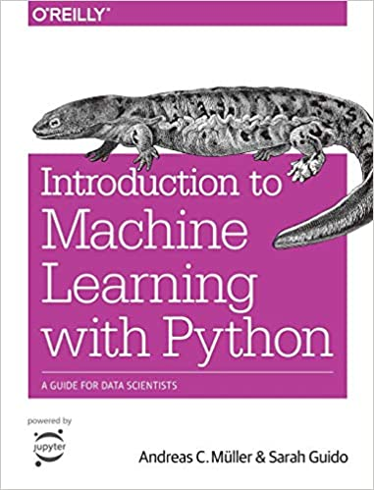
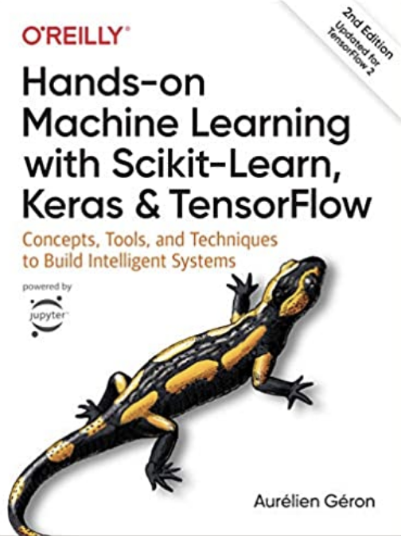
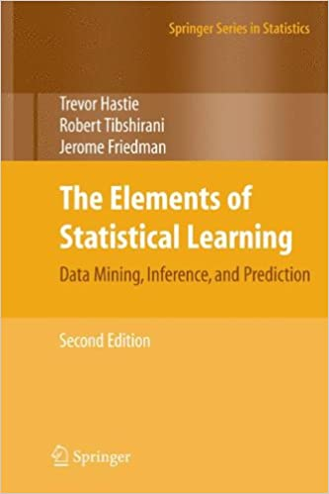
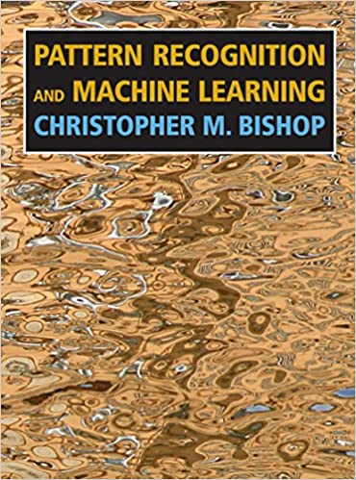
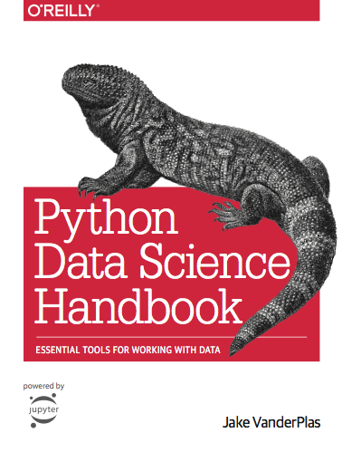
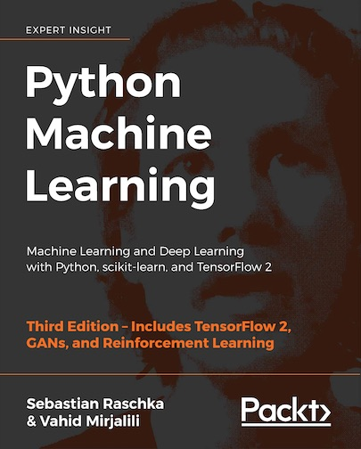
Where to Learn Machine Learning (Books)
Getting familiar with machine learning can take multiple courses and books
So here is my advice for learning more
Python in a Jupyter Notebook

Slide 4
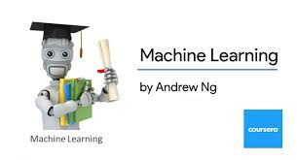

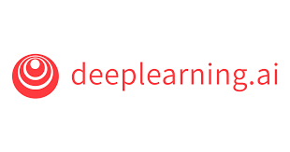
Where to Learn Machine Learning (Courses)
Coursera Machine Learning
Great Theory, MATLAB based (don’t recommend MATLAB assignments)
Free if you audit
Machine Learning A-Z: Hands-On Python & R in Data Science
Great concepts and theory.
Updated often and great way to learn for interviews.
Coursera Deep Learning Specialization
Great Theory, Mostly TensorFlow based
Free if you audit
Fast AI Course
Free learn by doing, Fastai based
Python in a Jupyter Notebook

Slide 5
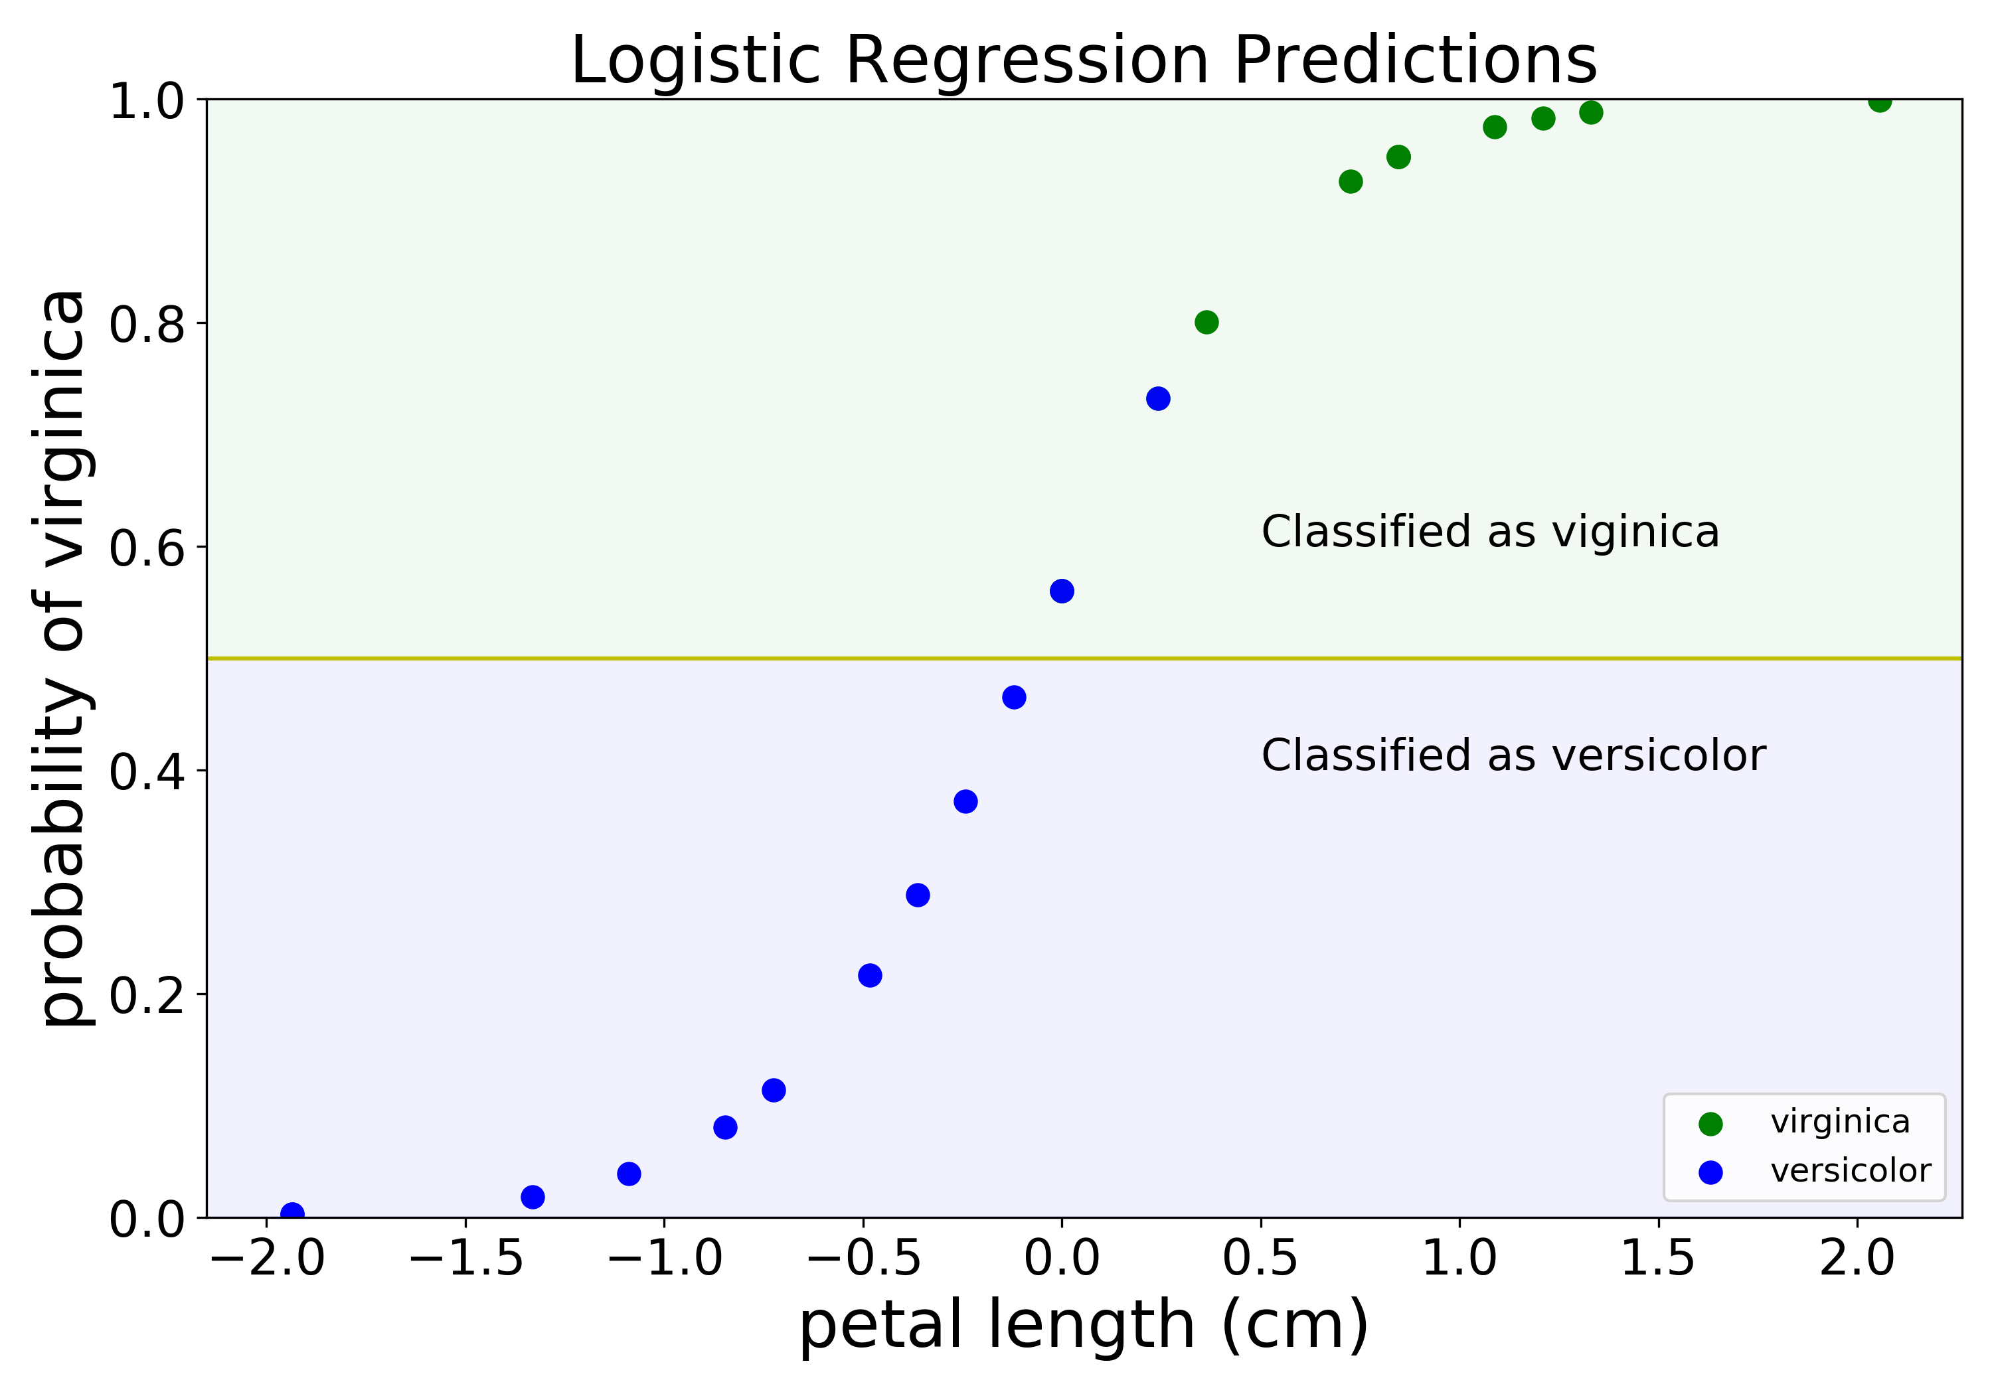
Concluding Thoughts
Hope you enjoyed this talk
Talk should be posted on YouTube eventually
Stay in touch! Feel free to connect with me on LinkedIn or Twitter (@GalarnykMichael)
Logistic regression predictions
Python in a Jupyter Notebook

Slide 6
Extra: Where to Learn Scikit-Learn (Books)
Getting familiar with machine learning can take multiple courses and books
So here is my advice for learning more
Python in a Jupyter Notebook

