Slide 1
Introduction to Machine Learning: From Theory to Application

Slide 2



About Me
ML PhD Student at Georgia Tech
What I have done:
Understanding Fitbit Data
Machine Learning with Python Instructor
LinkedIn Learning Instructor

Slide 3
What you should know for this talk
Linear regression
Python strings
Integers and floats
Conditionals and booleans-if, else, and elif
For loops
Lists, tuples
Dictionaries

Slide 4
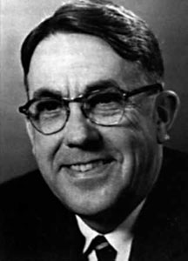
What is Machine Learning?
“field of study that gives computers the ability to learn from data without being explicitly programmed.”
- Arthur Samuel

Slide 5

What is Machine Learning?
“‘Learning’ enters when we give these models tunable parameters that can be adapted to observed data; in this way the program can be considered to be ‘learning’ from the data."
- Jake Vanderplas

Slide 6
What is Machine Learning?
“Once models have been fit to previously seen data, they can be used to predict and understand aspects of newly observed data.”
- Jake Vanderplas

Slide 7
Two Basic Types of Machine Learning
Supervised learning
Modeling the relationship between measured features of data and some target (label/value). When target is a label, it is classification. When target is a continuous value, it is regression.
Unsupervised learning
Modeling the measured features of data without some target (label/value).

Slide 8
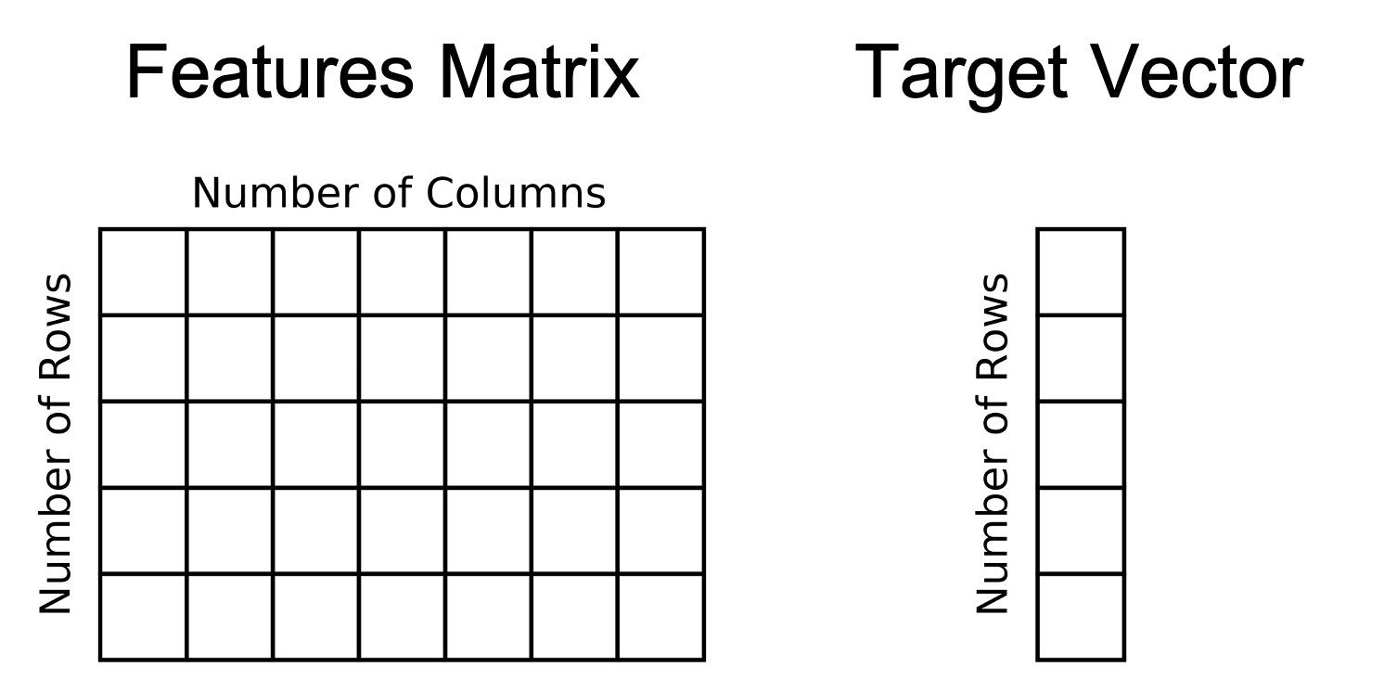
Supervised learning

Slide 9
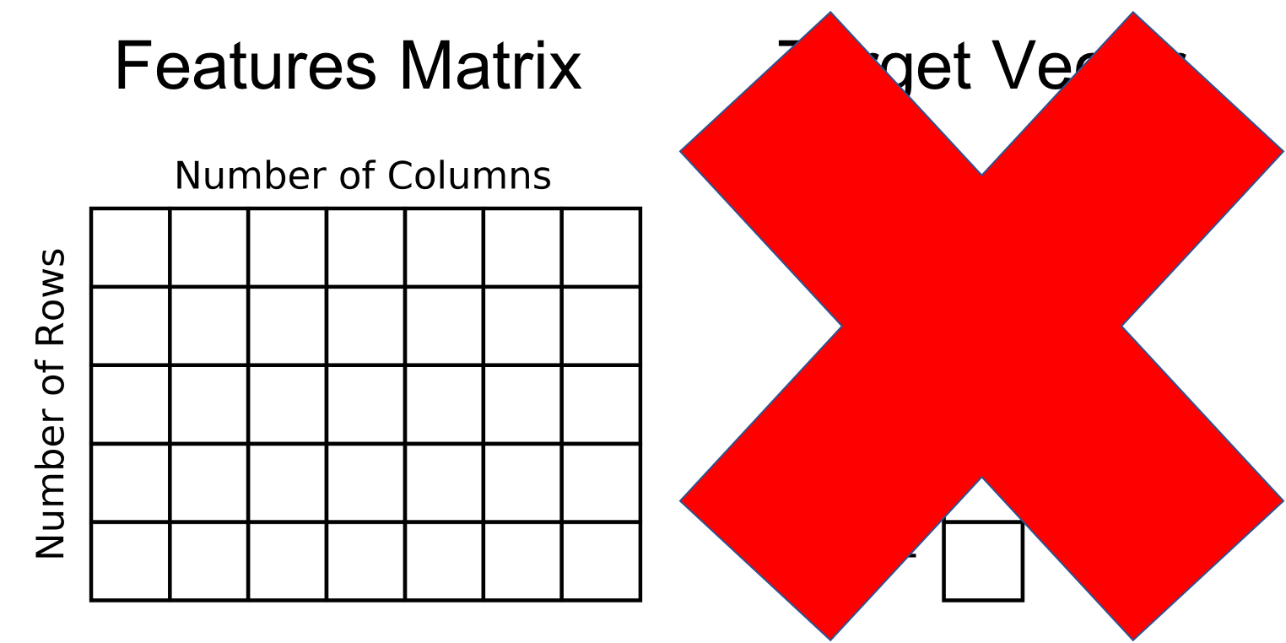
Unsupervised learning

Slide 10
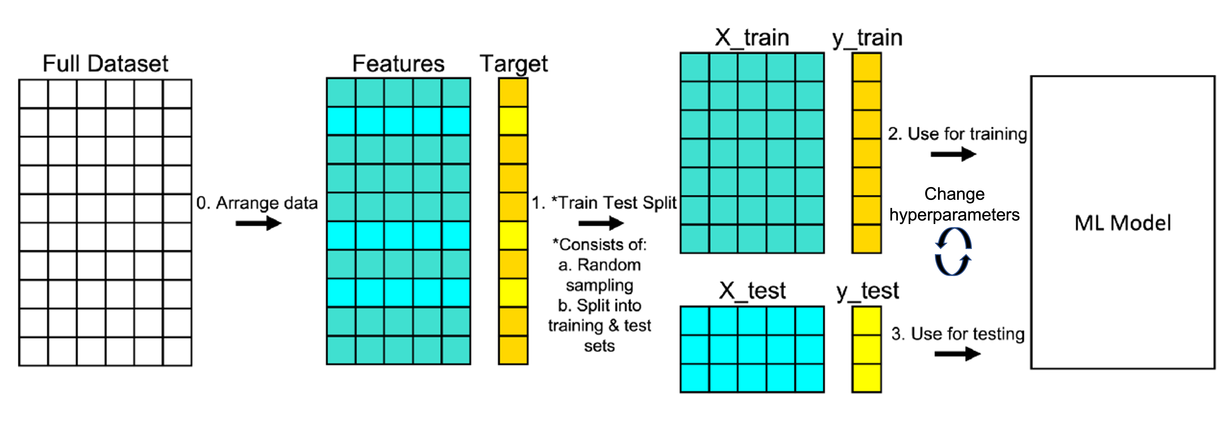
From Theory to Application
A Little Theory + Diagrams gives us the why: understanding how models learn patterns from data.

Slide 11
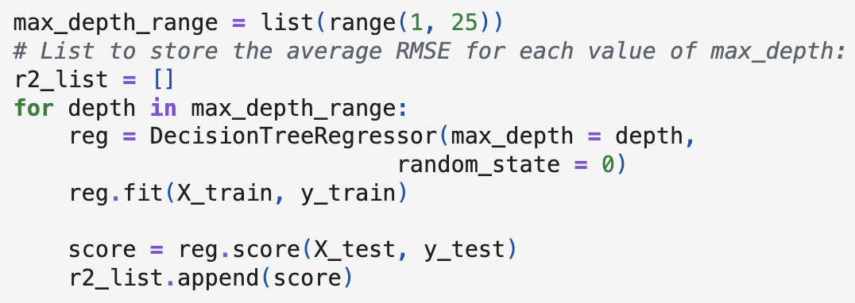
From Theory to Application
Application shows the how: turning that understanding into working code.

Slide 12
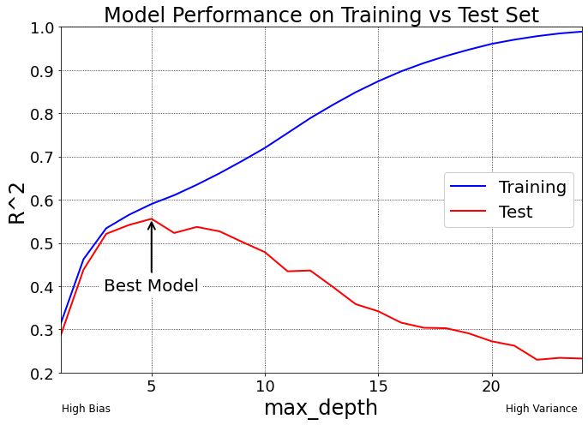
From Theory to Application
Images will help with explanations

Slide 13
Why use Scikit-Learn for Machine Learning?
This is a not a long talk.
Programming machine learning algorithms from scratch is no easy task.
Scikit-learn provides a large amount of well programmed algorithms.
Syntax allows you to try multiple algorithms quickly.
Library works well with other python libraries like NumPy, pandas, and matplotlib.
Library is popular.

Slide 14
Why about using Cursor/Claude/etc?
You can use it.
Understanding how things work will enhance your ability to utilize these tools.

