Slide 1
THE PROBLEM
Parameter-Efficient
Fine-Tuning (PEFT)
Full fine-tuning a 4B model needs ~38 GB of GPU memory.
THE IDEA
Freeze the base model. Train a small set of new parameters.
Michael Galarnyk
THE RESULT
Fine-tune large models on one GPU with matched task quality.
ODSC AI West · October 29, 2026
1
Notes:
Opening (~30 sec): 'This talk is about parameter-efficient fine-tuning: how the field went from full fine-tunes that cost 780 GB of VRAM to training 65B parameter models on a single 48 GB GPU, without losing accuracy.'
Talking points:
• Point at THE PROBLEM card: full FT of a 65B model = 780 GB, doesn't fit anywhere reasonable.
• Point at THE IDEA card: two moves stack: low-rank update on frozen base (LoRA), then quantize the base to 4-bit (QLoRA). Each attacks a different memory cost.
• Point at THE RESULT card: 65B fits on one GPU, matches 16-bit full FT on downstream benchmarks. That's the whole talk in one slide.
Q&A anticipated: 'Why should I care about PEFT if I can just use closed models?': Open-weight tuning is what makes per-tenant / per-domain customization economical, and this stack is the reason it's affordable.
Time budget: 30 sec.

Slide 2
Full fine-tuning is memory-bound
2
Notes:
OPENING LINE:
"Before we get to any method, let's be honest about the pain that motivates the whole PEFT literature."
TALKING POINTS:
- One-sentence section: full fine-tuning doesn't scale: you'll see the math and the numbers on the next two slides.
- Keep divider brief. It's a beat, not a slide with content.
Q&A ANTICIPATED: None on dividers.
TIME BUDGET: 10 sec.

Slide 3
Full fine-tuning Nemotron 3 Nano 4B: gradients + optimizer dominate the ~38 GB
Our RTX PRO 5000 GPU
(24 GB)
Parameters
Gradients
Optimizer
Activations
Out of Memory
1 square = 1 GB
Parameters
(bf16) 7.5GB
Gradients
(bf16) 7.5GB
Optimizer
(bf16) 15GB
Activations
(bf16) 7.6GB
Total
~38GB needed
3
Notes:
Opening (75 sec): 'This diagram is the shape of the problem, for the model we actually fine-tune. Each square is 1 GB of GPU memory. Yellow = parameters, blue = gradients, green = optimizer, purple = activations. Red diagonals = out of memory. The brace is our 24 GB RTX PRO 5000 laptop GPU. Full fine-tuning Nemotron-3-Nano-4B in bf16 fits the parameters, the gradients, and half of the optimizer. Everything to the right does not fit.'
Talking points:
1. The model is NVIDIA Nemotron 3 Nano 4B, the BF16 release (every tensor stored in bf16), a hybrid Mamba-Transformer with 3.97B parameters. In bf16, its native dtype, that is 7.5 GB of weights (measured on this GPU).
2. Gradients match the weights: another 7.5 GB. AdamW keeps two states per weight: 15 GB. That is 30 GB before a single activation, already over 24 GB. That assumes pure-bf16 training, as in our notebook: AdamW keeps its two states in bf16. The common mixed-precision recipe keeps fp32 Adam states (about 30 GB) plus an fp32 master copy of the weights (about 15 GB), roughly 67 GB in total, so 38 GB is the optimistic case. Sizes are GiB, the same unit nvidia-smi uses for the card's 24 GB.
3. Activations depend on batch and tricks. Measured at batch 8 x 256 tokens without gradient checkpointing: 7.6 GB. Batch 16: 15 GB. With gradient checkpointing and batch 1, as in our QLoRA runs: about 0.2 GB.
4. This slide is why PEFT exists. Every other slide is a way to shrink one of these colored blocks. With QLoRA the whole run peaked at 5.4 GB on this card.
Q&A anticipated: 'Why not just use a bigger GPU?' An 80 GB card fits this 4B model, but the same accounting for a 70B model is hundreds of GB: multi-GPU training, or PEFT on one card.
Diagram credit: Glenn Matlin, FinAI Conference public deck (adapted to our model and GPU).
Numbers: measured with torch.cuda on the RTX PRO 5000, FOMC prompts.
Time budget: 75 sec.

Slide 4
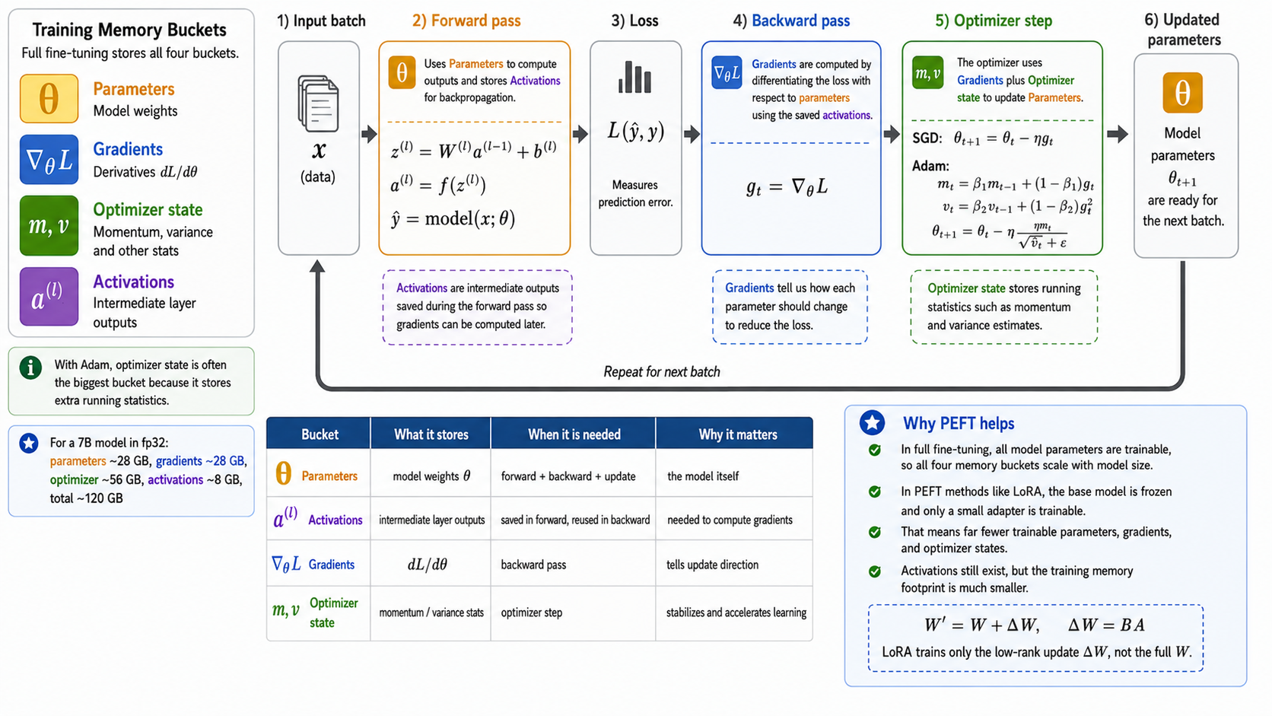
Training memory buckets across the forward and backward pass
Each bucket has a role in the training loop; gradients and optimizer state exist only because we are training.
4
Notes:
Opening (90 sec): 'You just saw 38 GB spread across four colored buckets. This slide is why those buckets exist. Follow the training loop from left to right: input batch, forward pass, loss, backward pass, optimizer step, updated parameters. Each stage creates or consumes a specific bucket.'
Walk through:
1. Parameters (yellow, theta) - the model weights. Present at every stage. For Nemotron-4B in bf16, that is 7.5 GB.
2. Activations (purple, a^(l)) - intermediate outputs of each layer. Saved during the forward pass because backward needs them for the chain rule. About 7.6 GB at batch 8 x 256 tokens on Nemotron-4B; gradient checkpointing cuts it to 1.6 GB.
3. Gradients (blue, nabla_theta L) - produced by the backward pass. One derivative per parameter. Another 7.5 GB for Nemotron-4B in bf16.
4. Optimizer state (green, m and v) - momentum and variance under Adam. Read and updated during the optimizer step. 15 GB for Nemotron-4B with bf16 AdamW states.
Key point (bridge to Background): three of the four buckets exist ONLY because we are training (Gradients, Activations, Optimizer). Only Parameters would survive an inference-only pass. That is the training tax we come back to on the LoRA-gradients slide.
'Why PEFT helps' panel on the right: in LoRA, the base is frozen and only a small adapter is trainable. Fewer trainable parameters means far fewer gradients, much smaller optimizer state, and only the adapter path adds activation memory.
Time budget: 90 sec.

Slide 5
Background
5
Notes:
OPENING LINE:
"The core idea of the last five years of PEFT is one hypothesis and one trick."
TALKING POINTS:
- Hypothesis: the weight update during adaptation lives in a low-dimensional subspace.
- Trick: freeze the base, parameterize the update as a product of two small matrices.
- Everything in this section builds from that one bet.
Q&A ANTICIPATED: None on dividers.
TIME BUDGET: 10 sec.

Slide 6
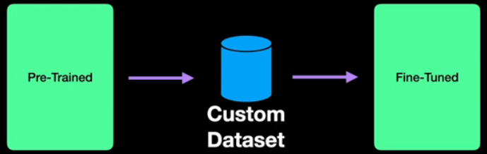
Why fine-tune a base LLM
Adapt one base to a task, domain, or tenant.
Purpose. Base LLMs are general-purpose.
Adaptation. Fine-tuning adapts vocabulary, style, judgment.
Concrete example (finance)
Fine-tune RoBERTa and Nemotron 3 Nano 4B on FOMC sentences to classify tone as hawkish, dovish, or neutral.
Fine-tuning = base model + custom dataset -> specialized model
Figure: AI Bites, YouTube.
6
Notes:
Setup (60 sec): 'Before we dive into the memory problem, a quick word on WHY teams fine-tune at all. Modern base LLMs are already very capable, but they are trained to be general-purpose. In practice you almost always want the model to behave in a way that is specific to your task, your domain, or your tenant.'
Talking points:
1. Base LLM is a strong starting point. General-purpose. Broad but not specialized.
2. Fine-tuning adapts vocabulary, format, style, judgment. Not just facts - behavior.
3. Concrete examples that resonate with an industry audience: contract review, medical Q&A, code review, customer-support voice, in-house translation glossary.
4. The figure is the canonical mental picture: base model + your custom data -> specialized model. This slide sets up WHY the memory cost on the next slide matters.
Bridge to next slide (§1 divider): 'That is the payoff. Now: what does it actually COST to do this the naive way?'
Time budget: 60 sec.

Slide 7
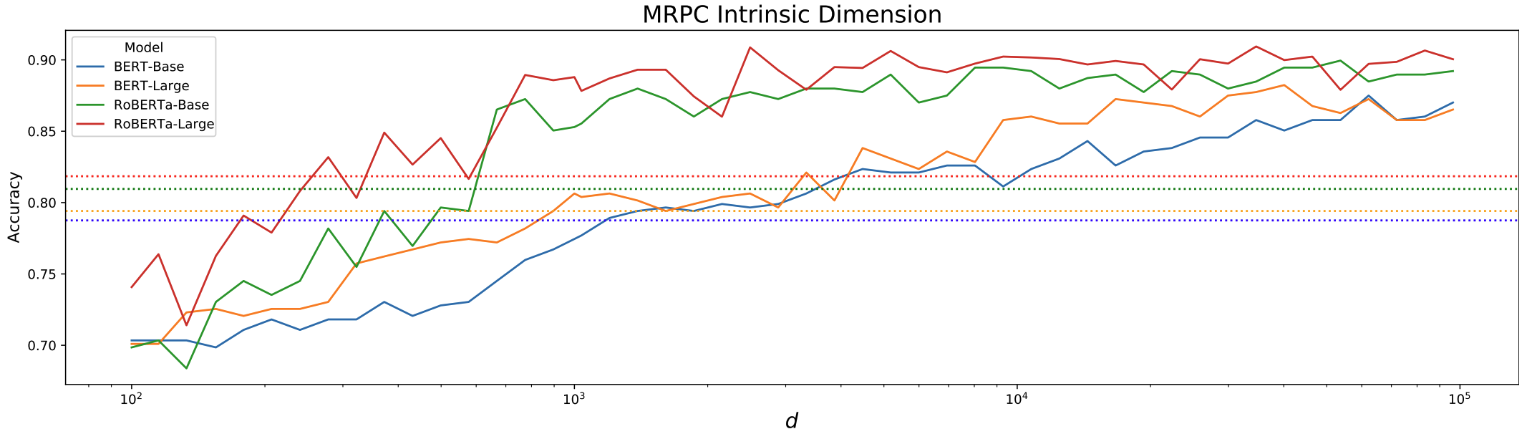
Pretrained models already know most of what you need
Pretrained language models live in a much lower-dimensional subspace than their parameter count suggests.
MRPC accuracy for BERT / RoBERTa vs. intrinsic dimension d. Near-full accuracy at d far below the parameter count.
Aghajanyan, Gupta, Zettlemoyer 2020
7
Notes:
Opening (~75 sec): 'Before LoRA existed, Aghajanyan showed something surprising, you can project a pretrained model's parameters into a much smaller subspace and still fine-tune it effectively. That says the updates live on a low-dimensional manifold.'
Talking points:
• Over-parametrized models have a low intrinsic dimension d90: the smallest subspace where you can hit 90% of full-FT performance.
• For pretrained BERT-base, d90 is in the thousands, not millions. For larger models, the ratio shrinks.
• LoRA's hypothesis: if the model itself is low-intrinsic-dim, the *updates* (ΔW) are also low-rank.
• That's the theoretical launch pad: the next slide turns the hypothesis into a method.
Q&A anticipated: 'Is low intrinsic dim provable or empirical?': Empirical. The projection trick measures it; theory catching up in 2022–2024 (NTK regime results).
Time budget: 75 sec.

Slide 8
What matrix rank means
Rank = number of independent directions in a matrix. Low-rank ⇒ redundancy ⇒ can be stored smaller.
Concrete example: 3 × 3 matrix
Low-rank factorization
1
2
3
M =
2
4
6
M
≈
U
·
V
1
1
2
r × d
col 1
col 2
col 3
d × d
d × r
Observation: col 3 = col 1 + col 2.
Only 2 independent columns.
rank(M) = 2
d = 4096, r = 8
(4096 × 4096) → (4096 × 8) + (8 × 4096)
16.7M → 65K, 256× smaller
8
Notes:
Opening (45 sec): 'Before we get to LoRA, one linear-algebra reminder. Rank is the number of independent directions a matrix carries.'
Walk the concrete example:
1. Show the 3×3 matrix [[1,2,3],[2,4,6],[1,1,2]].
2. Look at the columns: col 1 = (1,2,1)ᵀ, col 2 = (2,4,1)ᵀ, col 3 = (3,6,2)ᵀ.
3. Notice: col 3 = col 1 + col 2. So col 3 is not adding new information.
4. Rank = 2 because only 2 of the 3 columns are independent.
Then the general factorization: any rank-r matrix M can be written as U·V where U is d×r (holds the r independent columns) and V is r×d (holds the recipe for combining them). Storage drops from d² to 2·d·r.
History: this is Frobenius, 1878. Nothing about neural networks. That comes next.
Anticipated Q: 'What if the matrix is only APPROXIMATELY low-rank?' → Then M ≈ U·V and the error depends on the trailing singular values you drop. SVD gives the best low-rank approximation of a given rank.
Time budget: 60 sec.

Slide 9
Low-Rank Adaptation (LoRA)
9

Slide 10
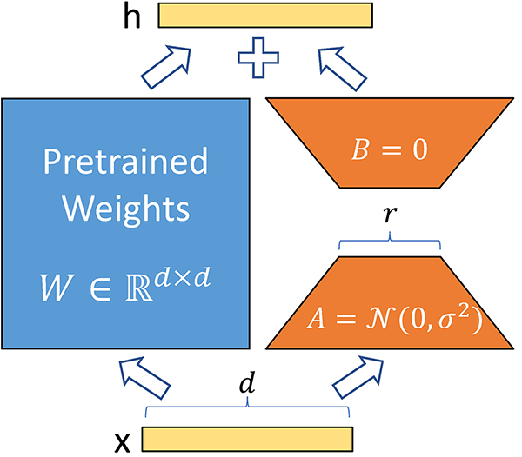
LoRA: constrain the update to be low-rank
Same training objective as full fine-tuning, but only two small matrices change.
Objective (same as full fine-tuning).
max_{Θ} Σ log P_{Φ₀+ΔΦ(Θ)} (y_{t} | x, y_{<t})
with |Θ| ≪ |Φ₀| (typically 0.01 to 1%).
Hypothesis.
If pretrained weights already live in a low-rank subspace, then the updates ΔW during fine-tuning should be low-rank too.
Parameterization.
Freeze W₀. Learn a low-rank ΔW = B · A with rank r ≪ d.
Trainable: B and A only. Frozen: W₀.
Hu et al. 2021 (eq. 1-2).
10
Notes:
Opening (30 sec): 'LoRA in one sentence: instead of updating W directly, keep W frozen and learn a low-rank correction ΔW = B·A.'
Definition: LoRA = Low-Rank Adaptation. The name is literal.
The hypothesis (Hu et al. 2021): the fine-tuning update ΔW is empirically low-rank, because pretrained models already live in a low-dimensional subspace (Aghajanyan et al., which we just showed). So it's OK to constrain ΔW to be low-rank by design.
Frozen: W₀. Trainable: B ∈ ℝ^(d×r) and A ∈ ℝ^(r×k). That's it.
The next few slides unpack: how the equations work at train vs inference, what has gradients, how you pick r, and where the memory savings come from.
Anticipated Q: 'Why B·A and not just one skinny matrix?' → A matrix product is what gives you rank-r structure while keeping trainable params small. One d×r matrix would only project down; you need the B to project back up.
Time budget: 45 sec.

Slide 11
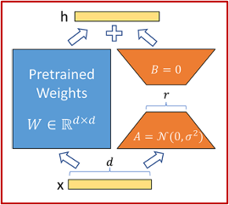
Train B and A separately. Merge them into W at serving time.
During training
Pretrained weights W₀ ∈ ℝ^(d×k) are frozen.
h = W₀ x + ΔW x = W₀ x + B A x
B ∈ ℝ^(d×r), A ∈ ℝ^(r×k), r ≪ min(d, k)
Two forward paths: the frozen one and the low-rank one.
During inference
Reparametrization: only A and B are trained.
Pre-merge: W = W₀ + B A. Store one matrix, run it once.
h = W x
No extra parameters at inference. Zero latency overhead.
Hu et al. 2021

Slide 12
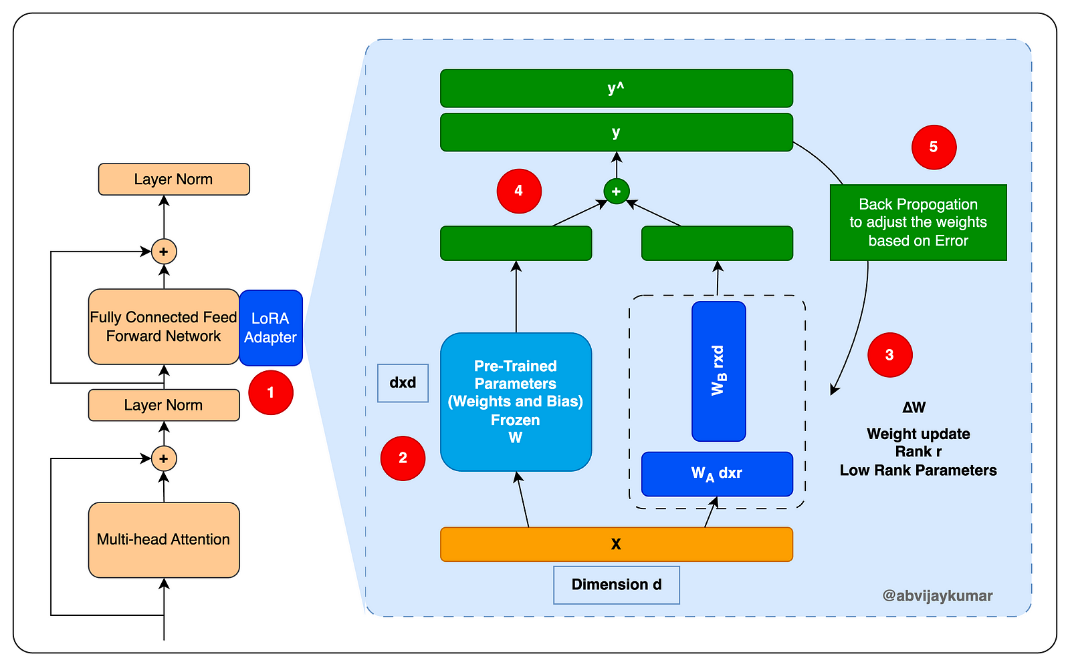
A LoRA layer, step by step
1. Add a LoRA adapter beside the linear layer.
2. Freeze the pretrained W(d×d).
3. Add trainable ΔW=W_{B}W_{A}, rank r≪d.
4. Forward: y=Wx+ ΔWx.
5. Backprop updates only W_{A} and W_{B}.
A B Vijay Kumar (DZone)
12

Slide 13
Which weights, and how large should r be?
Attention projections are usually enough. r = 8 or r = 16 is a safe default.
Which projection weights to adapt?
What rank r?
· Just W_{q} → works
· {W_{q}, W_{v}} → covers most tasks
· All-linear (Q, K, V, O + MLP) → closes the remaining gap on hard tasks
· Modern default (HF PEFT): target_modules='all-linear'
· r = 1 → already competitive on many tasks
· r = 8–16 → standard for instruction-tuning
· r = 32–64 → used for harder capability shifts
· Concrete example: W_{q} = 100 × 100 (10,000 params) vs B · A at r = 3 = 600 params → ≈17× reduction
Hu et al. 2021
13
Notes:
OPENING LINE:
"Two knobs matter when you configure LoRA: WHICH weights and HOW BIG the rank. Here's the empirical bottom line."
TALKING POINTS:
- Original Hu et al. paper adapts only W_q and W_v. That was enough for GPT-3 175B to match full FT.
- Modern practice (HF PEFT default): target_modules='all-linear': LoRA everything with a linear layer, including the MLP. Slightly more params, better on hard tasks.
- Rank: r=1 sometimes works. r=8-16 is the standard. r=32-64 for tasks that need more capacity. And critically: if you go higher, use rsLoRA scaling from §2 or you'll waste the extra capacity.
- The concrete arithmetic on the right: even at r=3, a 100×100 weight matrix drops from 10,000 params to 600: 17× reduction. At production scales (2048×2048) the reduction is orders of magnitude larger.
Q&A ANTICIPATED:
- "How do you pick r in practice?" → start r=8, add rsLoRA, sweep up if the loss plateau is high. Extras Q1 has the subspace-overlap detail.
- "Does target_modules matter more than rank?" → yes, empirically. Add modules before you add rank.
TIME BUDGET: 75 sec.

Slide 14
Quantized bases: less memory for the frozen weights
14
Notes:
OPENING LINE:
"Low-rank updates solved the adapter-size problem. They didn't solve the base-model-size problem."
TALKING POINTS:
- Beat the base slide (14) sets up this section: LoRA doesn't shrink W₀.
- QLoRA is the answer: quantize W₀ down to 4 bits, LoRA-adapt in 16-bit on top.
Q&A ANTICIPATED: None on dividers.
TIME BUDGET: 10 sec.

Slide 15
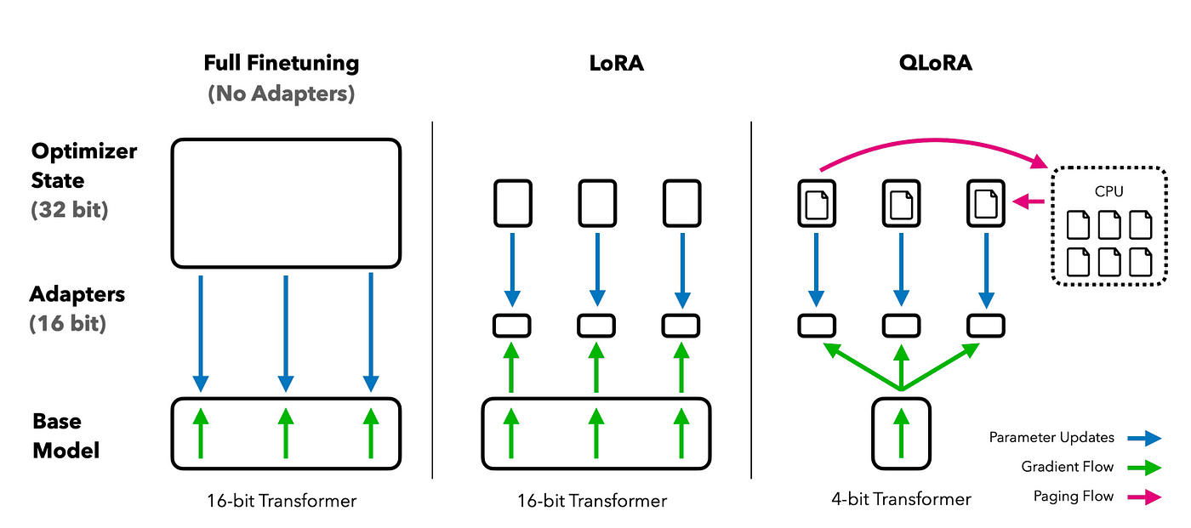
LoRA shrinks the training cost, not the base weights
On Nemotron 4B, LoRA pulls peak training memory from ~38 GB to 9 GB. QLoRA pushes it further to 5.4 GB by quantizing the base.
Dettmers et al. 2023
15
Notes:
Opening (~90 sec): 'Here's what LoRA actually saves, and what it doesn't. Three columns: full fine-tuning, LoRA, QLoRA. In all three the base model still lives on the GPU. LoRA cuts the optimizer state and gradient memory because only B and A have gradients. But the base weights themselves are still 130 GB at 16-bit for a 65B model. That’s the ceiling QLoRA breaks by quantizing the base to 4-bit.'
Talking points:
• Full FT: base + gradients + optimizer state: all 32/16-bit: that's the 780 GB.
• LoRA: base still 16-bit but gradients + optimizer only for B, A. ~30% savings on a 65B, not 90%.
• QLoRA: base at 4-bit, LoRA adapters at 16-bit. Optimizer state pages to CPU on spikes.
• This is why the field moved to QLoRA: LoRA alone still needs a rack of GPUs for the largest models.
Q&A anticipated: 'Does LoRA save NO memory then?': It saves a lot compared to full FT for a fixed base size, but the base still dominates. This diagram is the perfect setup for the QLoRA section.
Time budget: 90 sec.

Slide 16
The QLoRA recipe: four ingredients
Each attacks a specific memory cost. On this laptop (Nemotron 4B), 38 GB -> 5.4 GB with ~0.01 F1 given up.
1. NF4 quantization
4-bit weights. Data type designed for the normal distribution that pretrained weights actually follow.
2. Double Quantization
Quantize the quantization constants too. Saves another ~0.4 bits per parameter (~3 GB on a 65B model).
3. Paged Optimizers
NVIDIA unified memory + CPU spillover: absorbs memory spikes from long input sequences without OOM.
4. LoRA on top
Frozen quantized base + trainable low-rank adapters in 16-bit. All the LoRA benefits apply.
Dettmers, Pagnoni, Holtzman, Zettlemoyer 2023
16
Notes:
OPENING LINE:
"QLoRA is really four ideas stacked. Each one solves a specific problem: I'll walk through them one at a time in the next three slides."
TALKING POINTS:
- NF4: information-theoretically optimal 4-bit type for normally-distributed weights. This is where the base-weight compression comes from.
- Double Quantization: the quantization constants themselves take up ~1 GB of memory on a 65B model. Quantize THEM too. Small win but free.
- Paged Optimizers: when you have long input sequences, memory spikes. Instead of setting the batch size to survive the worst case, use NVIDIA's unified memory to spill optimizer state to CPU RAM temporarily.
- LoRA: everything from §2 sits on top. Frozen quantized base + 16-bit trainable low-rank adapters.
- Punchline: 780 GB → 48 GB. Full LLaMA-65B fine-tune on a single 48 GB GPU. And critically: no accuracy loss vs 16-bit full FT.
Q&A ANTICIPATED:
- "Why not 8-bit?" → tried in earlier work (LLM.int8()); 4-bit with NF4 recovered full accuracy with half the memory.
- "Why LoRA specifically and not other PEFT?" → orthogonal choice: quantization + any PEFT would work. LoRA was the empirical best. Extras Q3.
TIME BUDGET: 90 sec.

Slide 17
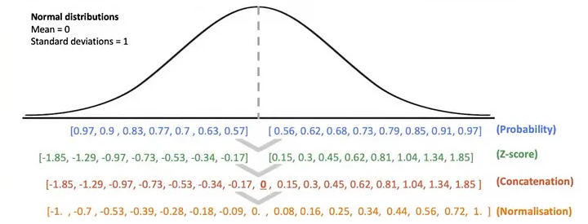
NF4: 4-bit tuned for how weights are actually distributed
Why quantile bins beat any other 16 numbers.
The idea. Equal-probability quantile bins under 𝒩(0, 1).
The shape. Dense near 0, sparse in tails.
Quantile bins: dense near 0 where weights actually live, sparse in the tails.
Dettmers et al. 2023
17
Notes:
OPENING LINE:
"The magic ingredient in QLoRA is a data type that most people had never seen before this paper."
TALKING POINTS:
- The insight: pretrained weights follow a very predictable distribution: roughly zero-centered normal. So the right 4-bit representation should be tuned to that distribution.
- NF4 stands for Normal Float 4-bit. It places the 16 quantization bins at the QUANTILES of a normal distribution: equal probability mass per bin.
- Concrete consequence: bins are DENSE near zero and SPARSE in the tails. Because that's where the weights actually are.
- Contrast with naive Int4 (uniform spacing) or FP4 (exponential spacing), they waste capacity on values that never occur in real pretrained weights.
- Extras E2 has the empirical comparison: NF4 consistently wins.
Q&A ANTICIPATED:
- "How do you compute the NF4 bin values?" → derived from the normal CDF; extras E1 walks through the procedure.
- "Does this generalize to other bit-widths?" → yes: NF3, NF6 defined analogously. NF3 works, NF2 doesn't (too few bins). Extras Q5.
TIME BUDGET: 75 sec.

Slide 18
NF4: how the 16 values are constructed
The recipe: quantiles of 𝒩(0, 1) become the 16 target values.
1. Sample 8 evenly-spaced quantiles from the negative half of 𝒩(0, 1).
2. Sample 7 evenly-spaced quantiles from the positive half of 𝒩(0, 1).
3. Compute z-scores for each quantile.
4. Concatenate: set I + {0} + set II = 16 values.
5. Normalize by the absolute maximum → range [-1, 1].
At quantize time: snap each weight to the nearest of these 16 values.
The 16 resulting values
Dense near 0 (where weights live). Sparse in the tails.
-1
0
1
← sparse tail clustered near zero sparse tail →
Each bin holds equal probability mass under 𝒩(0, 1).
Reconstruction error is minimized for normally-distributed weights.
18
Notes:
Opening (~60 sec): 'This is the construction. NF4 is picked so that each quantization bin contains the same probability mass under a standard normal. That’s the information-theoretic optimum for weights that follow a normal distribution, which pretrained weights do.'
Talking points:
• Set I: 8 quantile values above zero from N(0,1).
• Set II: 8 quantile values below zero.
• Concatenate, then rescale to [-1, 1].
• Under quantization, this minimizes L2 error for a normally-distributed weight tensor.
Q&A anticipated: 'Why not just use a lookup table?': This IS a lookup table (16 entries); the point is how the 16 values were chosen.
Time budget: 60 sec.

Slide 19
NF4 vs naive Int4 and FP4
Where each format puts its 16 bins. NF4 aligns bins with where weights actually live.
Int4
Uniform spacing. Half the bins land in tails where weights rarely go.
FP4
Denser in mid-range (magnitude scale). Closer, but still not matched to a normal.
NF4
-1
0
1
Bins land where weights live. Equal-probability quantiles under 𝒩(0, 1).
Empirically: NF4 > FP4 > Int4 on perplexity across every model size.
Dettmers et al. 2023
19
Notes:
Opening (60 sec): 'Why is NF4 better than Int4 or FP4 at the same 4 bits? Because the other two are shaped for the wrong distribution.'
Talking points:
1. Int4 spreads bins uniformly across [-max, +max]. Half the bins land in tails where there are essentially no weights. Enormous waste.
2. FP4 spreads by magnitude (scientific-notation style: sign + exponent + tiny mantissa). Better for values with wide dynamic range, but pretrained weights are not wide-range, they are normally distributed near zero.
3. NF4 spreads by probability mass under a standard normal. Every bin holds the same fraction of the distribution. Bins concentrate near zero, exactly where the actual weights live.
4. Empirically Dettmers et al. tested NF4 vs FP4 vs Int4 across every model size in the paper. NF4 wins on perplexity in every configuration. E2 in the appendix has the curves.
5. Implementation detail: the 16 NF4 values are picked once PER BLOCK from that block's absolute maximum, then reused for every weight in the block.
Q&A anticipated: 'Why not use a learned codebook instead of NF4?' Learned codebooks (like vector quantization) exist but require training + compute for the codebook, and the gain over NF4 for pretrained-model weights is small because the normal-distribution assumption is already very close to reality.
Time budget: 60 sec.

Slide 20
Two more memory tricks in QLoRA
Two smaller wins that keep single-GPU fine-tuning stable through memory spikes.
Double Quantization
Paged Optimizers
Problem. 32-bit constants per block = 0.5 bits/param on 65B.
Fix. Quantize the constants too: 8-bit, blocked by 256.
Result. ~0.37 bits/param saved ≈ ~3 GB on 65B.
Problem. Long sequences cause transient memory spikes, then OOM.
Fix. Unified memory spills optimizer state to CPU RAM during spikes.
Result. No batch-size cut, no user code change.
Dettmers et al. 2023
20
Notes:
OPENING LINE:
"NF4 is the star of QLoRA. These next two ideas are the supporting cast that made the whole thing actually work in practice."
TALKING POINTS:
- Double Quantization (left): a small but honest saving. The quantization constants themselves, one per block of 64 params, in 32-bit float: add up to 0.5 bits per parameter. That's ~3 GB on a 65B model. Quantize THEM to 8-bit with a larger block size, and you save most of that back.
- Paged Optimizers (right): more of an engineering fix. The problem: long input sequences create transient memory spikes. Without paging, you'd have to lower batch size for every step to survive the worst step. With paging, you handle spikes gracefully: spill to CPU, pull back.
- Together, these are what turned "QLoRA works in benchmarks" into "QLoRA works reliably on my machine."
Q&A ANTICIPATED:
- "Do you actually need paged optimizers?" → depends on your sequence-length distribution. If it's uniform, no. If it has long-tail outliers (legal documents!), yes.
- "How much of QLoRA's memory savings come from DQ vs NF4?" → NF4 is ~90% of the story. DQ is worth the complexity anyway because it's free performance.
TIME BUDGET: 75 sec.

Slide 21
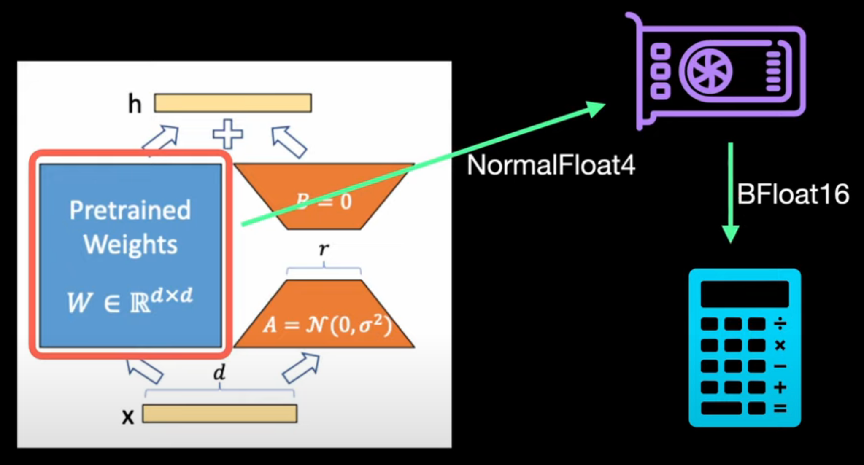
QLoRA is a training-memory tool, not an inference-latency tool
The cost. Every matmul dequantizes NF4 to BF16, computes, then discards. Memory wins; compute suffers.
The fix. Blackwell runs NVFP4 matmul natively: 4-bit in, 4-bit out, no dequant round-trip.
Effect. QLoRA-at-inference has hardware built for its data type.
AI Bites YouTube
21
Notes:
Opening (~60 sec): 'QLoRA is a training-time win. At inference it pays for the win: every forward pass has to dequantize the NF4 base weights back to BFloat16 before the matmul. That's compute overhead your serving stack does not want.'
Talking points:
• Training memory: huge win (65B on 48 GB).
• Training compute: neutral (dequant overhead ~ optimizer savings).
• Inference compute: LOSS. The dequant is on the critical path.
• This is the exact bottleneck NVFP4 (next slide) removes: E2M1 float with per-block scaling that Blackwell tensor cores execute natively, no dequant needed.
Time budget: 60 sec.

Slide 22
Honest limits: "LoRA learns less and forgets less"
LoRA wins where the target task stays close to the base. Full FT still wins for big capability shifts.
Where full FT still wins
Where LoRA wins
· Continued pretraining
· Large capability shifts
· Long-form retraining
· Instruction-tuning
· Domain adaptation
· Multi-tenant serving
· Preserving base behavior
Rule of thumb: LoRA by default; reach for full FT only when the target is genuinely a new capability.
Biderman et al. 2024
22
Notes:
OPENING LINE:
"For a long time LoRA was pitched as a free lunch. This 2024 paper is the honest correction."
TALKING POINTS:
- Biderman et al. did a careful head-to-head: LoRA vs full FT across code, math, and instruction tuning.
- Finding 1: LoRA underperforms full FT on tasks that require learning a lot of NEW knowledge (code, math): the low-rank constraint really does limit capacity.
- Finding 2: But LoRA also forgets the base task less: the constraint acts as regularization.
- So the right frame isn't "LoRA vs full FT": it's "which of these two failure modes do you care about?"
- For a domain like contract review, where the base already speaks English and you're aligning it to specific patterns, LoRA usually wins.
Q&A ANTICIPATED:
- "What about DoRA?" → next slide: DoRA closes most of the LoRA↔full-FT gap for the "learns less" side.
- "Rank r=256+? Does that fix 'learns less'?" → helps but doesn't fully close it; also expensive to serve.
TIME BUDGET: 90 sec.

Slide 23
LoRA variants: one idea, many bottlenecks
Same core recipe. Each variant relaxes a different assumption.
Fix the math
Choose the subspace
rsLoRA Scaling with rank
DoRA Weight geometry
α / √r replaces α / r; high-rank finally stable
Magnitude + direction; LoRA the direction
LoRA+ Optimizer
PiSSA Init from weights
Higher learning rate for B than A
Init from top-r SVD of W₀
LoRA-GA Initialization
EVA Init from data
Init so first step matches full-FT gradient
SVD of activations; rank by variance
Shrink memory
Escape low-rank
QLoRA Base memory
MoRA / RandLoRA / GraLoRA Beyond low-rank
Freeze 4-bit NF4 backbone; backprop into LoRA
Higher or full effective rank at LoRA cost
VeRA / LoRA-XS Tiny adapters
Freeze basis; learn only tiny scales
23
Notes:
Reference table backing the branches slide. Pull in only if audience wants method-level detail. Each row corresponds to a specific arXiv paper (linked bottom-left).

Slide 24
Using PEFT
24
Notes:
OPENING LINE:
"Enough theory. What does this actually look like in code, and where would you actually use it?"
TALKING POINTS:
- Two slides: the modern stack (10 lines of Python), then the deployment story that makes per-tenant adapters practical.
Q&A ANTICIPATED: None on dividers.
TIME BUDGET: 10 sec.

Slide 25
How teams use PEFT in practice
Task- or tenant-specific adapters
One base model. Small LoRA adapters per task, domain, or customer, updated without touching the base.
Multi-LoRA serving with vLLM
One base-model deployment shared across many adapters. The right adapter is chosen per request, not per model.
PEFT across the post-training stack
The same LoRA mechanism backs both supervised fine-tuning and preference optimization (DPO).
25
Notes:
OPENING LINE:
"To close, three concrete places this stack meets a real domain."
TALKING POINTS:
- Per-tenant adapters, one base, N small BA files, one per customer. Trained on THEIR contracts, THEIR clause libraries, THEIR historical redlines. Base ships once; adapters ship continuously.
- Multi-tenant serving via S-LoRA (Sheng et al. 2023) or vLLM: thousands of adapters can share one base on a single GPU, swapped per request. This is what makes per-customer adaptation ECONOMICALLY viable: otherwise you'd need N GPUs for N customers.
- Post-training on top: LoRA-adapt the base for domain, then DPO on top for reviewer preferences. Which suggested redlines the reviewer accepted becomes the preference signal.
- End with the topic-list bridges: quantization neighbors, post-training, attention variants: all things I can dive into.
- OPTIONAL if time: mention I have a small companion demo ready if there's interest.
Q&A ANTICIPATED:
- "How does data isolation work between tenants?" → adapters trained separately; base has no per-tenant data.
- "What about privacy / on-prem?" → 4-bit base + LoRA adapters fits on a single H100; can run entirely on-prem for regulated industries.
- "Which adapter method for legal specifically?" → LoRA + rsLoRA + DoRA for capability; VeRA if adapter storage becomes the bottleneck.
TIME BUDGET: 90 sec. Leave the last 15 sec open for the transition to Q&A.
Presenter cue: end on the conviction sentence above. If audience asks, you can go deeper on quantization neighbors (PolarQuant, TurboQuant, NVFP4), post-training stacks (SFT / DPO / RFT), or attention variants (MLA, GQA, FA3). See appendix Q&A and N-slides.

Slide 26
What a real fine-tune looks like today
Hugging Face PEFT + bitsandbytes: the QLoRA setup we ran on Nemotron 3 Nano 4B.
from peft import LoraConfig, get_peft_model
from transformers import AutoModelForCausalLM, BitsAndBytesConfig
# 4-bit NF4 base. Plain LoRA: drop quantization_config, load in bf16.
bnb = BitsAndBytesConfig(load_in_4bit=True, bnb_4bit_quant_type="nf4",
bnb_4bit_use_double_quant=True,
bnb_4bit_compute_dtype="bfloat16",
llm_int8_skip_modules=["lm_head", "out_proj"])
base = AutoModelForCausalLM.from_pretrained(
"nvidia/NVIDIA-Nemotron-3-Nano-4B-BF16", quantization_config=bnb)
model = get_peft_model(base, LoraConfig(r=64, lora_alpha=128,
target_modules=["q_proj", "k_proj", "v_proj", "o_proj",
"up_proj", "down_proj", "in_proj"]))
26
Notes:
OPENING LINE:
"Here's the actual setup behind the results I'm about to show."
TALKING POINTS:
- BitsAndBytesConfig is the QLoRA recipe from §4: NF4 + double quantization, bf16 compute.
- llm_int8_skip_modules: lm_head stays bf16 because it scores the label words; Mamba out_proj stays bf16 because the fused Mamba-2 kernel reads it directly.
- LoRA rank 64, alpha 128, on attention + MLP projections and the Mamba in_proj.
- Plain LoRA is the same code without quantization_config.
- On Blackwell, NVFP4 (torchao) is the hardware-native 4-bit alternative.
- The real training script (train_run.py) swaps in bnb LinearNF4 by hand; this is the equivalent.
TIME BUDGET: 60 sec.

Slide 27
Worked example: hawkish or dovish?
Classify Fed (FOMC) sentences by policy tone. Data, splits, and metric from Shah et al. 2023.
The task
Label each sentence hawkish (toward raising rates), dovish (toward cutting), or neutral. ~2,400 labeled sentences, scored by weighted F1.
Three models
RoBERTa-base (125M) and RoBERTa-large (355M) from the paper, plus Nemotron 3 Nano 4B, an LLM scored on the label words.
33 runs
No fine-tuning, full fine-tuning, LoRA, QLoRA, three seeds each. Nemotron full fine-tuning does not fit in 24 GB (slide 3).
One laptop GPU
Dell Pro Max 16 Plus with an NVIDIA RTX PRO 5000 Blackwell laptop GPU (24 GB).
Task and data: Shah et al. 2023 (Combined-S split, seeds 5768, 78516, 944601).
27
Notes:
OPENING LINE:
"Let's make this concrete with one task, three models, and one laptop."
TALKING POINTS:
- The FOMC sets interest rates. Hawkish = leaning toward raising rates, dovish = leaning toward cutting. No finance background needed.
- Shah et al. (ACL 2023) labeled ~2,400 FOMC sentences and fine-tuned RoBERTa. We reuse their data, splits, seeds, and weighted F1 so our numbers line up with their Table 5.
- RoBERTa gets a classification head. Nemotron reads a prompt and we compare its logits for the words dovish / hawkish / neutral.
- 2 RoBERTa sizes x 4 methods x 3 seeds = 24 runs, plus Nemotron x 3 methods x 3 seeds = 9. Total 33.
- Everything on one 24 GB laptop GPU.
TIME BUDGET: 60 sec.

Slide 28
Did the fine-tune actually help?
Test weighted F1 (0 to 1, higher is better), mean of three seeds.
Model
No fine-tuning
Full FT
LoRA
QLoRA
RoBERTa-base (125M)
0.188
0.667
0.684
0.685
RoBERTa-large (355M)
0.173
0.716
0.720
0.705
Nemotron 3 Nano 4B
0.622
does not fit
0.727
0.716
All runs ours, RTX PRO 5000 Blackwell laptop GPU. Data and splits: Shah et al. 2023 (Combined-S).
28
Notes:
OPENING LINE:
"So did fine-tuning actually help? Three things jump out."
TALKING POINTS:
- Without fine-tuning RoBERTa is near useless (~0.18): an encoder isn't a classifier until you train its head.
- Nemotron is different: 0.622 from a prompt alone. LLMs get part of the way on their own.
- QLoRA lifts Nemotron to 0.716, the same as our fully fine-tuned RoBERTa-large, training only a small adapter on a 4-bit base.
- Plain LoRA on Nemotron scores 0.727, our best run.
- If asked about the paper: our RoBERTa numbers land within about 0.03 of the paper's published full fine-tunes (0.698 / 0.711), so the setup is sound.
- Std across seeds is 0.01 to 0.03, so differences under ~0.01 are noise.
TIME BUDGET: 90 sec.

Slide 29
The QLoRA tradeoff on one laptop GPU
Peak training memory, Nemotron 3 Nano 4B. QLoRA gives up ~0.01 F1 for 40% less memory.
RTX PRO 5000 laptop GPU: 24 GB
Full fine-tuning
~38 GB · does not fit
LoRA (bf16 base)
9.0 GB · F1 0.727
QLoRA (NF4 base)
5.4 GB · F1 0.716
Plain LoRA already fits on a laptop GPU. QLoRA buys headroom for a bigger model or longer sequences.
Measured peak GPU memory during training (3-seed runs). Full fine-tuning: bf16 estimate from slide 3.
29
Notes:
OPENING LINE:
"Here's the QLoRA tradeoff in one picture."
TALKING POINTS:
- Full fine-tuning Nemotron 4B needs ~38 GB (slide 3): it doesn't fit on this 24 GB GPU.
- LoRA freezes the base: no gradients or Adam state for it. Peak 9.0 GB, F1 0.727.
- QLoRA also stores the frozen base in 4-bit NF4. Peak 5.4 GB, F1 0.716.
- So QLoRA costs about 0.01 F1 for 40% less training memory. Within seed noise, but consistent.
- On this model LoRA already fits; QLoRA matters when the base is bigger or sequences are longer.
TIME BUDGET: 60 sec.

Slide 30
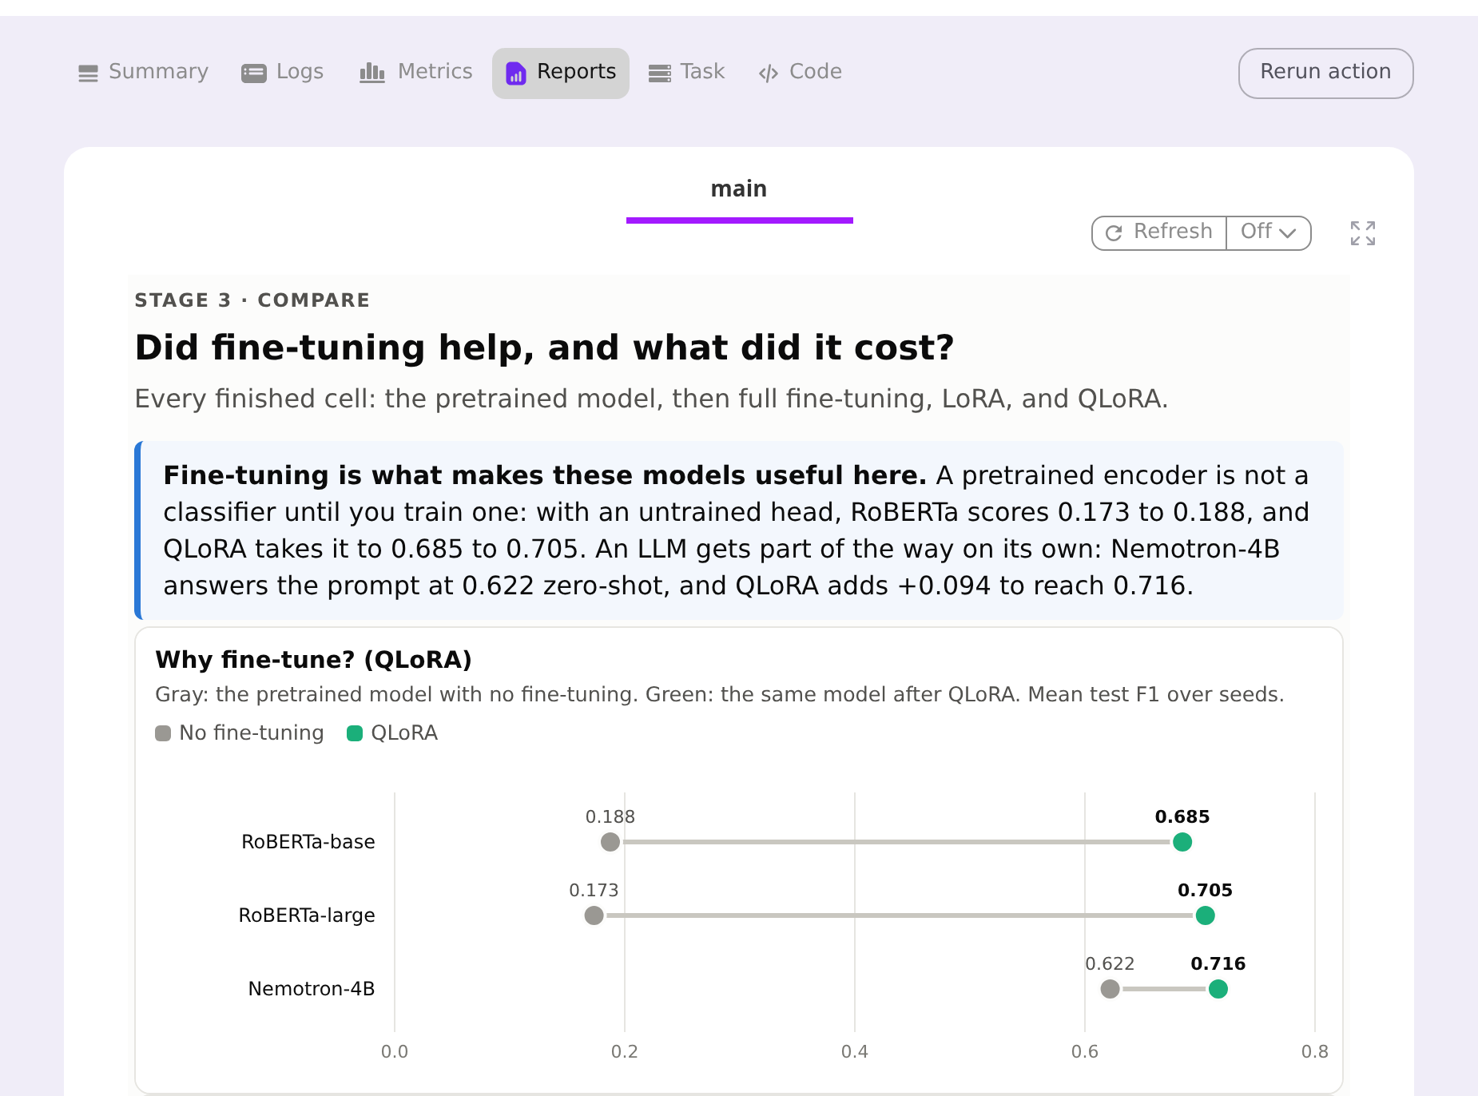
Flyte: 33 runs as one pipeline
One workflow runs unchanged on a MacBook, a laptop GPU, and a Flyte cluster.
Cheap reruns
Data prep is cached. A failed GPU task retries from its last epoch, not from scratch.
Every stage explains itself
Each step writes a report: label mix, training curves, the model's most confident mistakes.
Results side by side
The compare stage puts every model and method on one page (right).
Flyte Reports tab: the compare stage, QLoRA vs no fine-tuning.
Flyte: github.com/flyteorg/flyte
30
Notes:
OPENING LINE:
"33 runs by hand turns into a pile of scripts and half-remembered settings. So I ran them as one pipeline."
TALKING POINTS:
- One Flyte workflow: prepare data -> train each (model, method, seed) -> compare -> report.
- Same code ran on a MacBook (flyte run --local), on this laptop GPU, and on a Flyte cluster.
- Data prep is cached, so reruns skip it. GPU tasks checkpoint, and a failed task retries from its last epoch.
- Every stage has its own report in the UI. The screenshot is the compare stage; the results table two slides back came from it.
TIME BUDGET: 75 sec.

Slide 31
Serving the adapter with vLLM
The adapter trained on the laptop works unchanged on NVIDIA's FP8 release of the base model.
ACCURACY HOLDS
WEIGHTS IN GPU MEMORY
THROUGHPUT
0.725
weighted F1 (0.727 in training)
5.2 GB
FP8 base + LoRA adapter
~100
sentences per second
Flyte's vLLM plugin deploys the model as a service from the same project.
OpenAI-compatible API: existing clients work unchanged.
Multi-LoRA: several adapters share one base; the adapter is picked per request.
vLLM on an RTX PRO 5000 Blackwell laptop GPU, 496 test sentences, 3 seeds. Base: nvidia/NVIDIA-Nemotron-3-Nano-4B-FP8. vLLM
31
Notes:
OPENING LINE:
"A fine-tuned model still has to answer requests."
TALKING POINTS:
- Nemotron 3 Nano 4B was built for on-device use, and NVIDIA also ships an FP8 version.
- The LoRA adapter trained on the bf16 base loads onto the FP8 base unchanged: 0.725 F1 vs 0.727 in training.
- Weights take 5.2 GB of GPU memory; ~100 sentences/s, ~25 ms p50 latency on the laptop GPU.
- vLLM batches requests and manages KV-cache memory, so one GPU handles far more traffic than a Python loop.
- OpenAI-compatible API, and multi-LoRA: one base deployment, adapter chosen per request (ties back to the previous section).
CLOSE:
"Fine-tuning a useful model no longer requires a cluster."
TIME BUDGET: 75 sec.

Slide 32
Appendix
Anticipated questions, depth material, precision + memory accounting.
32
Notes:
Beat (5 sec): 'That is the main talk. The rest of the deck is appendix: anticipated Q&A slides, depth material on NF4 and QLoRA numbers, and a full memory-accounting appendix from LLM-training first principles that ends with the 16 GB QLoRA-on-Llama2-7B breakdown.'

Slide 33
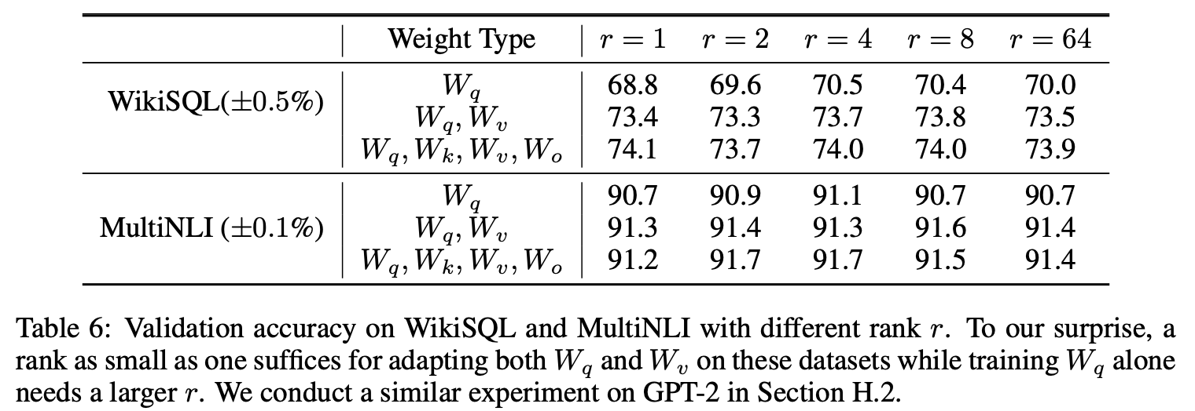
Q: How do you pick the rank r in practice?
What is the optimal rank for the factorized matrices? I was wondering to know if you have findings on choosing the optimal rank in the experiment.
33
Notes:
Answer to hit:
1. Start at r=8 with all-linear target modules and rsLoRA scaling.
2. Sweep upward: r in {8, 16, 32, 64}. Plateau appears fast on most tasks.
3. Hu et al. §7.1: the top-r subspace learned at r=8 is approximately the same as the top-r subspace at r=64. Bigger r does not discover a bigger update, it just gives more capacity to overfit.
4. For capability-shift tasks (Biderman): reach for DoRA or full FT before adding rank.
Source diagram: TD94 discussion in the LoRA OpenReview thread.

Slide 34
Q: The VRAM savings claim looks too good. Where does it come from?
What does VRAM stand for? If it is GPU memory, then the 2/3 saving of training memory is quite surprising to me:LoRA still needs to build the forward and backward computation graphs for the whole model. Could the authors clarify?
“VRAM” refers to “Video RAM” or “GPU memory.”
We do not need to store the adaptive optimizer states (e.g., momentum and second order moment for Adam) for the pretrained parameters
For smaller models where VRAM is dominated by activations, the savings will be less
34
Notes:
Answer to hit:
1. Almost all of the savings comes from optimizer state, not parameter count.
2. Adam stores momentum (m) and variance (v) for every trainable param: 2x the parameter count in extra memory.
3. Full FT of a 65B model with Adam: 65B params + 65B gradients + 130B optimizer state = 260B floats of state.
4. LoRA freezes the base -> no gradients, no optimizer state for W_0. Only B, A get all that.
5. Corollary: for SGD-with-momentum (1x extra state), savings are smaller. For Adafactor, similar to LoRA already.
6. Corollary: activations still grow with sequence length. LoRA does not help there. That is gradient checkpointing's job.
Source: Vqdv discussion in the LoRA OpenReview thread.

Slide 35
Q: Does NF4 generalize to other bit-widths?
Can the structure of NF4 data type be directly plugged into 8-bit and higher precision data-types for improved performance, if yes is there any experiment to show the prowess of the NFX data types?
NormalFloats can easily be defined for any bit-width.
NF3 > FP3, but not stable
35
Notes:
Answer to hit:
1. Yes: the recipe (quantiles of a normal distribution) defines NF_k for any k.
2. Dettmers et al. reported NF3 > FP3 but noted training instability at 3 bits.
3. NF2 does not work: too few bins to represent even a rough normal.
4. 5-bit and 6-bit variants appeared in 2024 (SmoothQuant-style hybrids), but 4-bit remains the sweet spot for LLM fine-tuning.
Source: uL2c discussion in the QLoRA OpenReview thread.

Slide 36
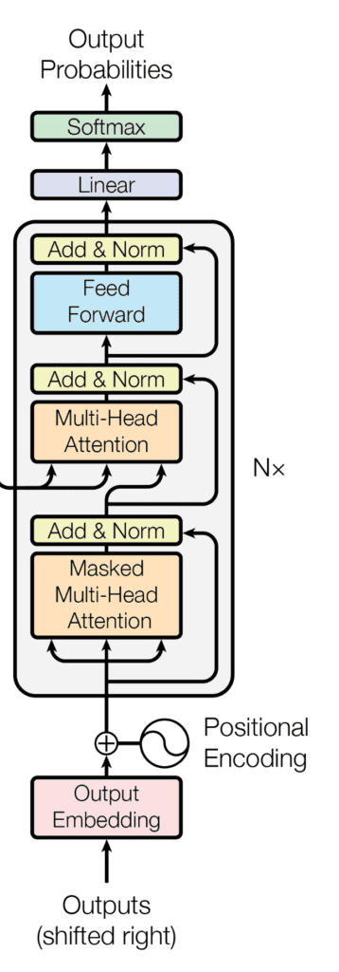






LoRA: freeze the model, train two small matrices
Only Update Weights of LoRA Matrices
Freeze Model No Weight Updates
Hu et al. 2021
36
Notes:
Opening (90 sec): 'This is the whole idea of LoRA in one slide. Take a pretrained transformer. Freeze every weight, that is the snowflake. Then wrap the frozen weight matrix W with two small matrices B and A. During fine-tuning, ONLY B and A get updated. Every gradient, every optimizer state, every trainable parameter lives in those two tiny matrices.'
Talking points:
1. The transformer on the left is your base model, frozen. Any pretrained LLM works.
2. The red arrow points to where the LoRA update is injected: the feed-forward projections (and typically the attention Q, K, V, O projections as well).
3. On the right: pretrained W is d x d, frozen. B is d x r, A is r x d, both trainable. The rank r is much smaller than d: often r = 8, 16, or 64 for a d in the thousands.
4. Initialization: A is Gaussian, B is zero. So the initial ΔW = B·A = 0. Training starts from the exact pretrained function.
5. At inference you can merge: W_final = W + BA. Zero latency overhead vs the base model.
6. Parameter savings: for d=4096, r=16, one LoRA-adapted matrix goes from 4096x4096 = 16.8M params to 2 x 4096 x 16 = 131k params. About 128x fewer trainable weights per matrix.
Q&A anticipated: 'Why B=0 not both random?' Symmetric random init would immediately push the model off the pretrained function. B=0 preserves it as the starting point and lets the training decide how much to move.
Source: Hu, Shen, Wallis et al. 2021, 'LoRA: Low-Rank Adaptation of Large Language Models,' arXiv:2106.09685.
Time budget: 90 sec.

Slide 37
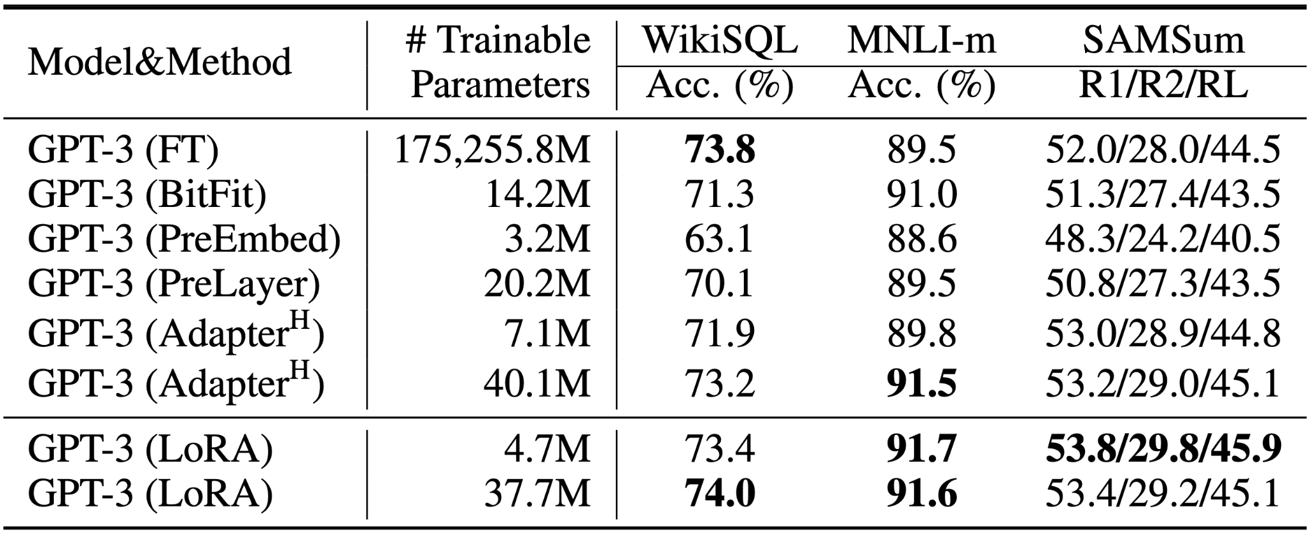
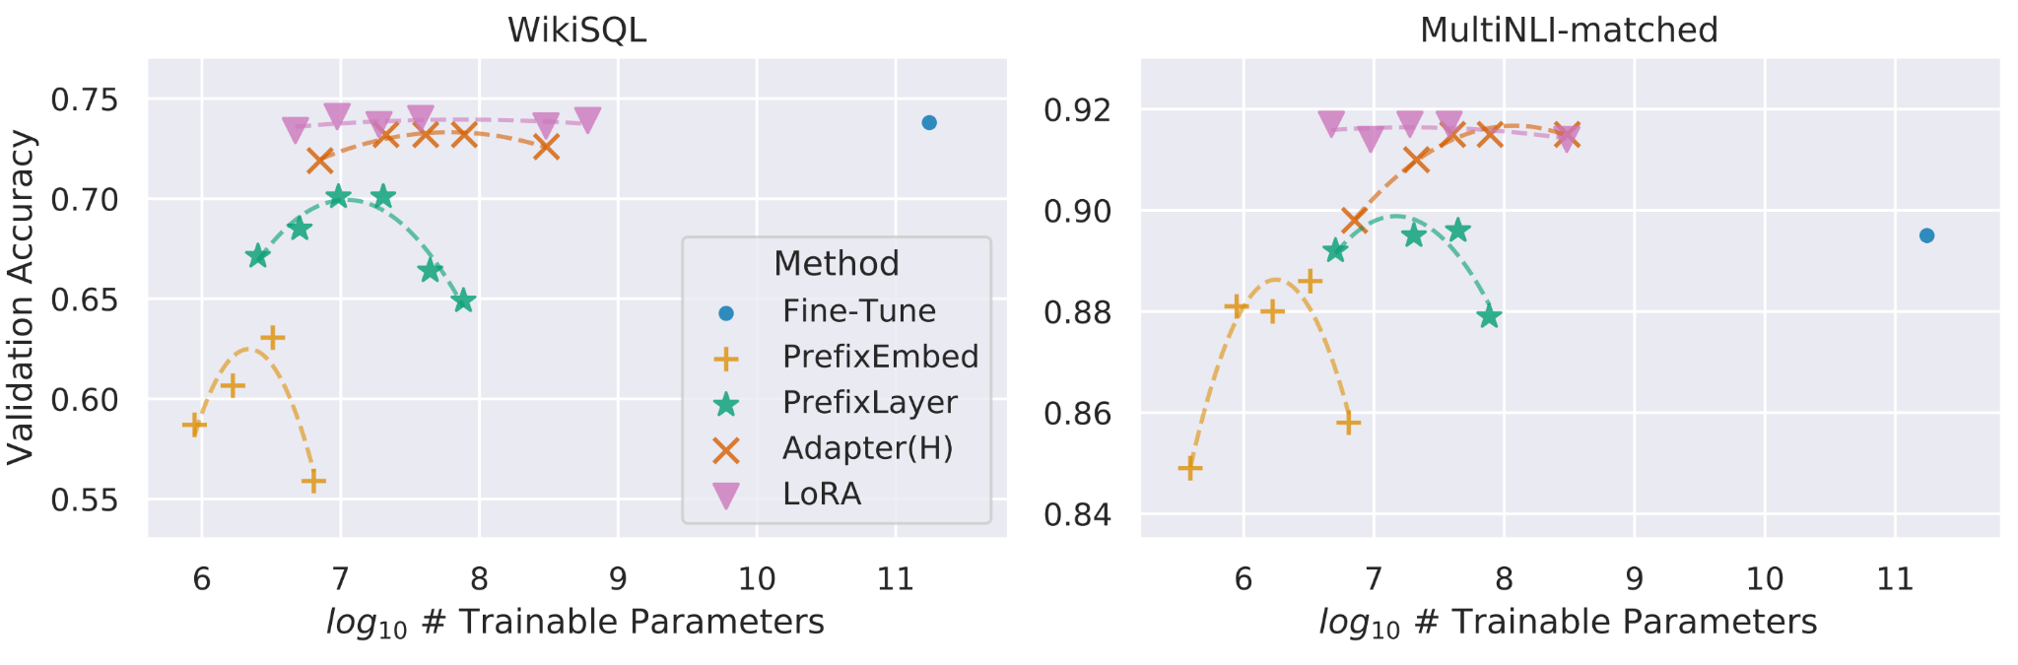
Evidence: LoRA matches full FT on GPT-3 175B
~4.7M trainable params reaching or exceeding full 175B fine-tune performance.
LoRA matches or exceeds full FT across WikiSQL, MNLI, SAMSum.
Scalability: LoRA vs prefix-tuning and adapters, GPT-3.
Hu et al. 2021
37
Notes:
OPENING LINE:
"This is the slide that made LoRA the default."
TALKING POINTS:
- Left (Table 4): three datasets (WikiSQL, MNLI, SAMSum), GPT-3 175B. LoRA meets or beats full fine-tuning on all three, with 4.7 million trainable parameters instead of 175 billion.
- Right (Figure 2): scalability curves. As trainable parameter count grows, LoRA's performance grows smoothly. Prefix-tuning saturates. Adapters underperform LoRA at every parameter count.
- The big picture: LoRA doesn't just save memory, it doesn't sacrifice quality. That's the reason it became the default rather than a niche method.
Q&A ANTICIPATED:
- "This is 2021 GPT-3: does it hold for LLaMA / Mistral / GPT-4-class?" → yes; the finding has been replicated many times on Llama-2, Llama-3, Mistral, Qwen bases in 2023-2025.
- "What's the loss on the 'hard' tasks?" → this is where Biderman's paper comes in (slide 20). Instruction-tuning like these tasks: LoRA wins. Learning new capabilities: full FT still has an edge.
TIME BUDGET: 75 sec.

Slide 38
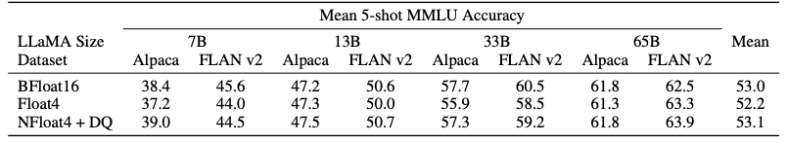
Evidence: 4-bit QLoRA matches 16-bit full fine-tuning
MMLU 5-shot across LLaMA 7B–65B. 4-bit NF4 with DQ ≈ BFloat16 full FT.
65B model. 48 GB single GPU. No accuracy loss vs 16-bit full fine-tune.
Dettmers et al. 2023
38
Notes:
OPENING LINE:
"This is the plot that ends the QLoRA argument."
TALKING POINTS:
- MMLU 5-shot accuracy. Four model sizes (7B, 13B, 33B, 65B). Multiple data types tested.
- The NF4-with-DQ column matches: within noise: the BFloat16 full-FT column at every model size.
- No accuracy loss. Half the bit-width. 17× the memory reduction. Single-GPU 65B fine-tuning.
- This is the result that made QLoRA the default fine-tuning path in HuggingFace's PEFT library.
Q&A ANTICIPATED:
- "Is MMLU representative?" → the authors also tested Alpaca and FLAN-v2 tasks; results replicate.
- "What about tasks that need MORE precision?" → for pure fine-tuning (adaptation to a task), 4-bit is enough. For CONTINUED PRETRAINING or capability shifts, this is where Biderman's caveats apply, but that's not the QLoRA setting.
TIME BUDGET: 60 sec.

Slide 39
Prompt-based PEFT: prefix tuning, P-tuning v2
· Prompt engineering: hand-crafted natural-language instructions. Zero training. Brittle.
· Prefix tuning (Li & Liang '21): learn a small set of continuous 'prefix' vectors prepended to inputs.
· P-Tuning v2: learnable prompts at every layer, not just the input. Closer to full FT in capacity.
· Downside vs LoRA: eats input-token budget; usually plateaus below LoRA on hard tasks.
· Upside: can be composed with LoRA (prefix + LoRA together: increasingly common).
Li & Liang 2021
39
Notes:
Depth extra. Pull in if asked to compare LoRA to prompt-based methods. TIME BUDGET: 45 sec.

Slide 40
Modern quantization neighbors: GPTQ, AWQ, EXL2, PolarQuant, NVFP4
The quantization stack around QLoRA in 2026.
· GPTQ (Frantar '22): post-training weight quantization for INFERENCE. Different tool from QLoRA.
· AWQ (Lin '23): activation-aware weight quantization: protects the ~1% of weights that matter most for activations. Standard for serving.
· EXL2 (2024): variable-bit-per-weight quantization tuned per-model. Popular in llama.cpp world.
· PolarQuant (2025): rotates weight distributions before quantization: better for outliers than NF4.
· TurboQuant (2025): hardware-aware quantization for specific accelerator layouts.
· NVFP4 (NVIDIA, 2024): 4-bit float (E2M1) with per-block scaling, native to Blackwell tensor cores. NF4's hardware-accelerated cousin: designed for serving, not training.
· How QLoRA fits: QLoRA quantizes the base for TRAINING. GPTQ / AWQ / EXL2 / NVFP4 quantize a trained model for SERVING. Different pipelines, same math family.
GPTQ
40
Notes:
Modern neighbor. HIGH probability of being asked given the interviewer's topic list explicitly names PolarQuant and TurboQuant. TIME BUDGET: 90 sec.
NVFP4 note (added 2026-08-31): NVIDIA's Blackwell-era 4-bit float format (E2M1 with per-block FP8 scale factors). It's the hardware-accelerated analog of NF4, where NF4 was chosen because pretrained weights are normally distributed, NVFP4 is chosen because it runs at line rate on Blackwell tensor cores. Positioned for INFERENCE, not training; the QLoRA of the next generation would likely pair LoRA adapters with an NVFP4-quantized base for serving. Ref: developer.nvidia.com/blog/introducing-nvfp4-for-efficient-and-accurate-low-precision-inference/

Slide 41
LoRA under post-training: SFT, DPO, RFT stack on top
PEFT and post-training are orthogonal axes, they stack.
· SFT (Supervised Fine-Tuning): the default target for QLoRA. Cross-entropy on instruction-response pairs. 10 lines of code shown earlier.
· DPO (Direct Preference Optimization): train on (chosen, rejected) preference pairs. Skips the RLHF reward model. Works over a LoRA-adapted base cleanly.
· RFT (Reinforcement Fine-Tuning, GRPO/RLOO/etc.): online RL from rewards. Usually done with LoRA to keep the RL loop cheap. Only trainable params get updated.
· Typical production pipeline: base → QLoRA SFT for domain → DPO on top for preference alignment → merge or serve unmerged.
· For legal-review workloads: DPO is where reviewer-accepted-vs-rejected redlines become the alignment signal.
DPO (Rafailov et al. 2023)
41
Notes:
Modern neighbor. HIGH probability of being asked given topic 5 (post-training) is on the interviewer's list. TIME BUDGET: 90 sec.

Slide 42
Attention variants (MLA, GQA, FA3) and target_modules
Attention architecture changes what "LoRA the attention" even means.
· GQA (Grouped-Query Attention): fewer K, V heads than Q heads. Fewer projections → fewer LoRA target modules to think about.
· MLA (Multi-head Latent Attention, DeepSeek): compresses K and V into a shared low-rank latent. Now "LoRA the K projection" doesn't mean the same thing: there IS no separate K projection.
· FlashAttention-3: kernel-level fusion. Doesn't change PEFT semantics but changes the memory profile you're optimizing against.
· Practical PEFT implication: for modern architectures (Llama-3, DeepSeek-V3, Qwen-2.5), target_modules='all-linear' is the safe default because you can't easily reason about individual attention projections anymore.
GQA (Ainslie et al. 2023)
42
Notes:
Modern neighbor. Bridges to topic 6 on the interviewer's list. TIME BUDGET: 75 sec.

Slide 43
LongLoRA: extending context length under LoRA
Fine-tune a short-context base into a long-context model with a LoRA-shaped budget.
· Problem: attention memory scales O(n²) with context length. Fine-tuning a 4K-context base to 32K context in full FT is prohibitive.
· LongLoRA: LoRA-adapt attention + shifted-sparse attention (S²-Attn) → fine-tune 7B to 100K context on a single 8×A100 node.
· S²-Attn: compute attention within groups + overlap groups by shifting. Approximate but effective during training; merged back at inference.
· Why relevant here: legal documents are LONG. If domain adaptation includes a context-length extension, LongLoRA is the standard tool.
Chen et al. 2023
43
Notes:
Modern neighbor. Pull in if long-document use case comes up. TIME BUDGET: 60 sec.

Slide 44
The broader PEFT taxonomy: AdaLoRA, IA³, BitFit
LoRA-family is not the only PEFT-family.
· AdaLoRA (Zhang '23): allocate rank adaptively per weight matrix instead of using a single r everywhere.
· IA³ (Liu '22): learn per-channel scaling vectors instead of low-rank matrices: extremely few params, less capacity.
· BitFit (Zaken '22): fine-tune ONLY the bias terms. Nearly-zero param count, surprisingly competitive baseline.
· (IA)³ and BitFit are the honest "how few params can you get away with?" experiments.
· AdaLoRA is the honest "do you need the same rank everywhere?" experiment (answer: no).
· When to reach for these: extreme storage/serving-count constraints (thousands of tenants), or as sanity-check baselines against LoRA.
AdaLoRA (Zhang et al. 2023)
44
Notes:
Modern neighbor. Pull in if asked 'what else is out there besides LoRA?' TIME BUDGET: 60 sec.

Slide 45
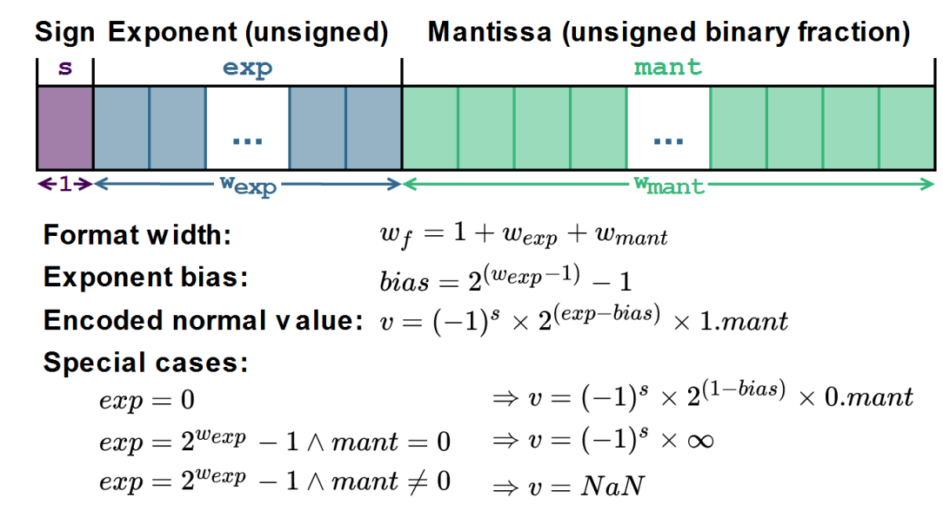
Floating Point (IEEE 754): sign, exponent, mantissa
45
Notes:
On-screen framing (say this while the slide comes up): Sign, exponent, mantissa. This is what a floating-point number IS.
Source: Diagram: Glenn Matlin, FinAI Conference public deck.
Opening (60 sec): 'Every quantization discussion assumes you know what fp16, fp32, bf16 actually mean. Here is the anatomy. Sign bit, exponent, mantissa. The exponent gives dynamic range, the mantissa gives precision, the sign gives you negatives.'
Talking points:
1. Format width = 1 (sign) + w_exp + w_mant. fp32 = 1+8+23, fp16 = 1+5+10, bf16 = 1+8+7.
2. Exponent bias shifts the raw exponent to allow negative exponents (very small numbers).
3. Special cases: subnormals near zero (exp=0), infinity (exp=all-1s, mant=0), NaN (exp=all-1s, mant nonzero).
4. NF4 does not follow this layout at all, it is 16 lookup values chosen by quantile.
Time budget: 60 sec.

Slide 46
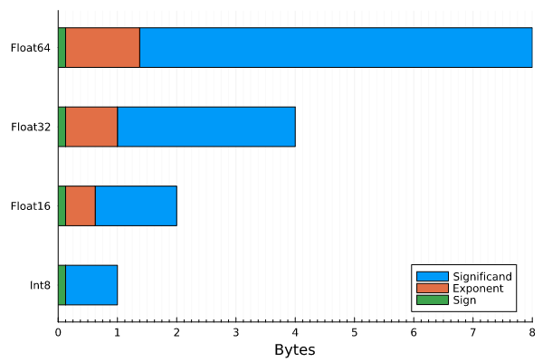
Mixed-Precision Floating Point: fp64 vs fp32 vs fp16 vs int8
blog.eleuther.ai/transformer-math/
46
Notes:
On-screen framing (say this while the slide comes up): fp16 keeps range but loses precision. bf16 keeps range and loses more precision. int8 loses both.
Source: Chart: Glenn Matlin, FinAI Conference public deck. See blog.eleuther.ai/transformer-math/.
Opening (60 sec): 'This chart compares the four numeric formats you actually see in a modern training stack. fp32 for master weights, bf16 or fp16 for compute, int8 for quantized inference, NF4 as the QLoRA base.'
Talking points:
1. fp32 range is ~1.7e-38 to 3.4e+38. That is the reference.
2. fp16 range collapses to ~5e-8 to ~65504. Numbers underflow / overflow easily.
3. bf16 keeps fp32's exponent (~1.2e-38 to 3.4e+38) but drops precision to 7 bits.
4. int8 is a completely different beast: -128 to 127, no exponent.
5. Modern PEFT stacks USE mixed precision: fp32 master + bf16 compute + int8 or NF4 storage.
Time budget: 60 sec.

Slide 47
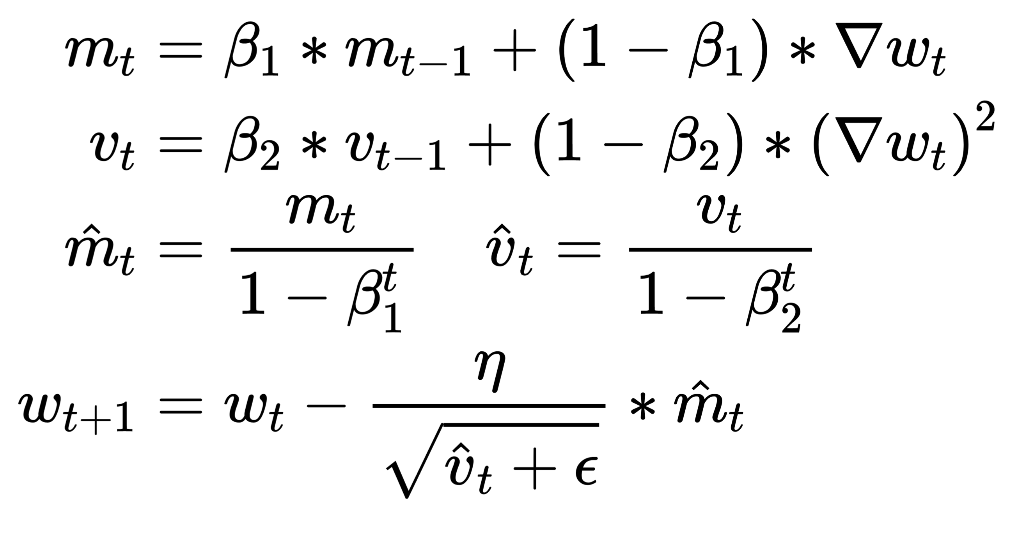
Why AdamW is so expensive: momentum + variance = 2x weights
AdamW is an Optimizer.
Per weight, it stores momentum (m) and variance (v).
7B weights → 14B extra numbers = the Optimizer bucket.
Loshchilov & Hutter 2019 (Decoupled Weight Decay Regularization, ICLR 2019).
47
Notes:
On-screen framing (say this while the slide comes up): For every weight, AdamW tracks first-moment m_t and second-moment v_t. 2x the parameters, always.
Source: Loshchilov & Hutter 2017, “Decoupled Weight Decay Regularization” (arXiv:1711.05101).
Opening (75 sec): 'Here is why the optimizer state is 2x the weights. AdamW is the default optimizer for LLM training. For every parameter, it maintains an exponential moving average of the gradient (momentum m_t) AND an exponential moving average of the squared gradient (variance v_t). Two extra buffers per weight, every step.'
Talking points:
1. m_t = β1 * m_{t-1} + (1 - β1) * grad: the momentum, one buffer per param.
2. v_t = β2 * v_{t-1} + (1 - β2) * grad^2: the variance, one buffer per param.
3. Bias correction (m_hat, v_hat) is free (just divide by 1 - β^t).
4. Weight update uses BOTH: w_{t+1} = w_t - η * m_hat / sqrt(v_hat + ε).
5. So 7B weights literally means 14B optimizer entries. This is why the memory grid in slide 4 has so much green.
6. LoRA sidesteps this: only B and A have gradients, so only B and A have m_t and v_t. The frozen base contributes ZERO to optimizer memory.
Q&A anticipated: 'Can you use 8-bit optimizer states?' Yes: bitsandbytes 8-bit Adam. Cuts optimizer memory 4x. Often combined with QLoRA.
Time budget: 75 sec.

Slide 48
Large Language Model on 16 GB VRAM: full QLoRA accounting
Llama2 7B
(nf4) 3.5GB
Activations (fp16) 4GB
Gradients
(int8) 1GB
Optimizer
(fp16) 4GB
LoRA
(fp16) 1GB
48
Notes:
On-screen framing (say this while the slide comes up): Full accounting for QLoRA. NF4 base 3.5 GB + INT8 grads 1 GB + fp16 optimizer 4 GB + LoRA 1 GB + activations 4 GB. Fits.
Source: Diagram: Glenn Matlin, FinAI Conference public deck.
Opening (75 sec): 'This is the payoff. Llama2 7B with QLoRA: base weights quantized to NF4 = 3.5 GB. Gradients on the LoRA adapters at INT8 = 1 GB. Optimizer state on the adapters at fp16 = 4 GB. LoRA parameters themselves = 1 GB. Activations for the forward pass = 4 GB. Total: ~13.5 GB, fits comfortably in 16 GB VRAM.'
Talking points:
1. Compare to slide 4: the same 7B model in full FT wanted 112+ GB. QLoRA gets it to 14.
2. The activations are still the biggest single cost after NF4 quantization. That is why gradient checkpointing is a common companion technique.
3. Once the model fits, the training loop is the same as full FT. The user does not have to think about the quantization at the training-loop level; bitsandbytes + PEFT handle it.
4. This is why the whole open-weight fine-tuning stack in 2026 defaults to QLoRA, it moves 7B-class training from 'need a data center' to 'need a 4090 or an A6000'.
Time budget: 75 sec.

