Slide 1

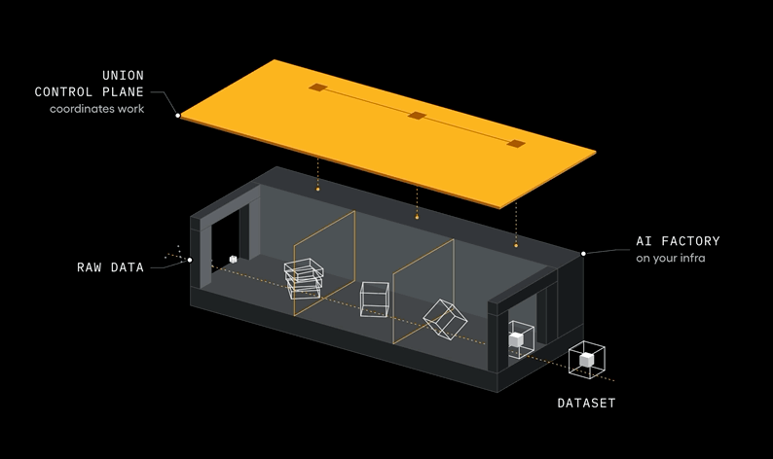
Prompt, fine-tune,
and RL
Customizing NVIDIA Nemotron with Union on AWS
Michael Galarnyk, Developer Relations, Union.ai · November 10, 2026

Slide 2
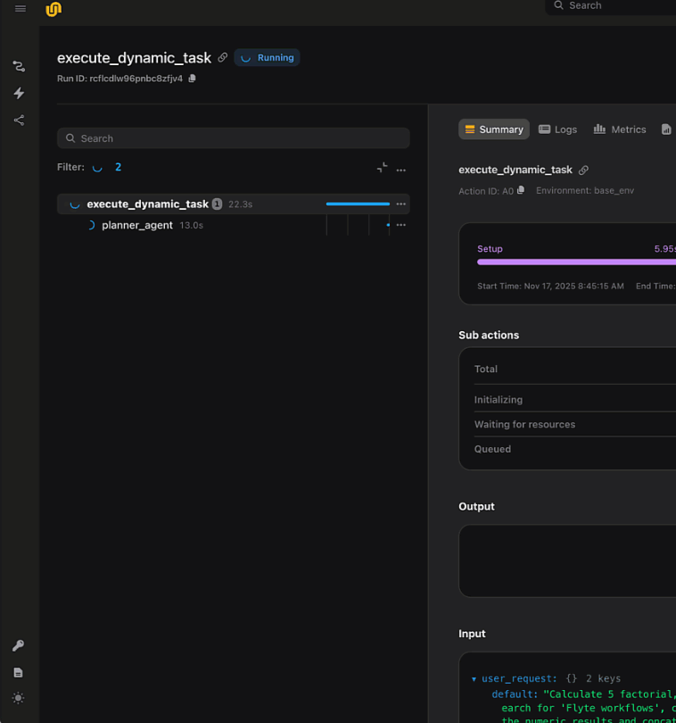
Union in one minute
What: The runtime that orchestrates AI pipelines, models, and agents.
How: Pure Python workloads heal themselves when the infrastructure fails.
Who: Toyota, Prima Mente, Artera, Lockheed Martin, Mistral. 4,000+ companies on Union or open-source Flyte.
Where: In the customer's own cloud (AWS) or on-prem.

Slide 3
Use case: will the US Fed raise interest rates?
One 8-minute Fed speech wiped ~$3 trillion off US stocks in a day.
1 Label every sentence
2 Score each Fed release
(hawkish − dovish) ÷ all sentences
hawkish
toward raising rates
“Market-based measures of inflation compensation have also picked up.”
→
dovish
toward cutting rates
“I think that keeping interest rates low is still appropriate for our economy.”
3 Use the score
Tracks inflation and Treasury yields. Trading on it beat buy-and-hold, 2011–2022.
neutral
no lean
“Our current framework for implementing monetary policy is working very well.”
Speech: Powell, Jackson Hole, Aug 26, 2022 · Sentences from Fed minutes, press conferences, speeches · Shah et al. 2023

Slide 4
Ways to customize Nemotron 3 Nano 4B
MANUAL by a person
AUTOMATED learned from data
Manual prompt engineering
Prompt optimization (GEPA)
Fine-tuning (LoRA)
Reinforcement learning (GRPO)
What changes
The prompt
The prompt
The weights
The weights
Learns from
A person’s domain knowledge
Its own mistakes
The right answers, shown to it
A score on its own tries
Each can build on the one before

Slide 5
Our workflow: one Flyte pipeline
Off-the-shelf
Better prompt
Fine-tune (LoRA)
RL (GRPO)
Evaluate
The paper’s prompt, nothing changed
By hand
paper’s guide + examples
Shown the right label for each sentence
Tries 8 answers, each scored right or wrong
Same test sentences, 3 seeds
→
→
→
→
Automated
GEPA search
Each step is a Flyte task: a failed step retries and resumes where it stopped.

Slide 6
Off-the-shelf: the paper’s prompt
STARTING POINT · Shah et al. 2023’s prompt, verbatim
System prompt
Discard all the previous instructions. Behave like you are an expert sentence classifier. Classify the following sentence from FOMC into 'HAWKISH', 'DOVISH', or 'NEUTRAL' class. Label 'HAWKISH' if it is corresponding to tightening of the monetary policy, 'DOVISH' if it is corresponding to easing of the monetary policy, or 'NEUTRAL' if the stance is neutral. Provide the label in the first line and provide a short explanation in the second line.

Slide 7
Manual prompt engineering with domain knowledge
Classify the following sentence from FOMC into 'HAWKISH', 'DOVISH', or 'NEUTRAL' class.
← task description
Labeling guide (Shah et al. 2023, Table 10):
Economic Status. Dovish: when inflation decreases, when unemployment increases, … Hawkish: when inflation increases, when unemployment decreases, …
Labor. Dovish: when productivity increases. Hawkish: when productivity decreases.
…
← domain knowledge
Sentence: The persistence of underutilized resources was expected to foster some moderation in core price inflation.
Label: NEUTRAL
Sentence: So unemployment has tended to go up much faster for minorities and for others who are—tend to be at the low end of the income spectrum.
Label: DOVISH
← few-shot examples
chosen by prompt optimization
Sentence: <new sentence>
Label: ______
← new input
Few-shot prompting: Brown et al. 2020, Language Models are Few-Shot Learners · Labeling guide: Shah et al. 2023, Table 10

Slide 8
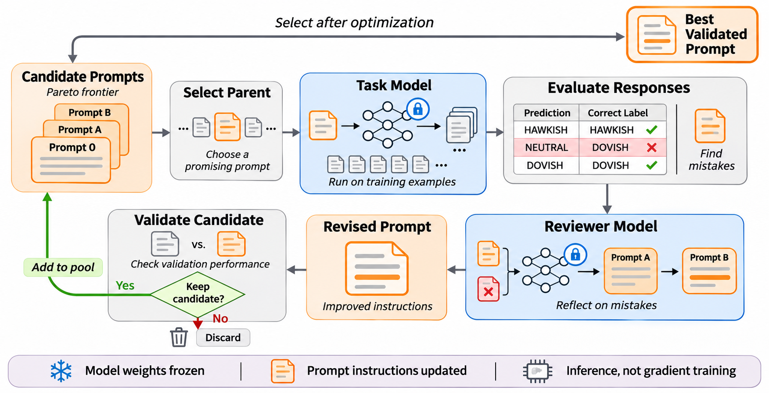
Prompt optimization (GEPA)

Slide 9
GEPA’s prompt, before and after
Before · the paper’s prompt, 71 words
After GEPA · 576 words, excerpt
Discard all the previous instructions. Behave like you are an expert sentence classifier. Classify the following sentence from FOMC into 'HAWKISH', 'DOVISH', or 'NEUTRAL' class. Label 'HAWKISH' if it is corresponding to tightening of the monetary policy, 'DOVISH' if it is corresponding to easing of the monetary policy, or 'NEUTRAL' if the stance is neutral. Provide the label in the first line and provide a short explanation in the second line.
You are an expert sentence classifier for FOMC statements.
HAWKISH – the sentence signals tightening of monetary policy:
• Inflation is expected to rise or is rising.
• Unemployment is falling or is expected to fall.
• Economic growth is strong or projected to be high. …
DOVISH – the sentence signals easing of monetary policy:
• Inflation is expected to fall or is falling. …
NEUTRAL – the sentence is descriptive or mixed, with no clear tightening or easing signal: …
If the sentence contains both dovish and hawkish cues, default to NEUTRAL unless one side dominates.
+ 6 labeled examples

Slide 10
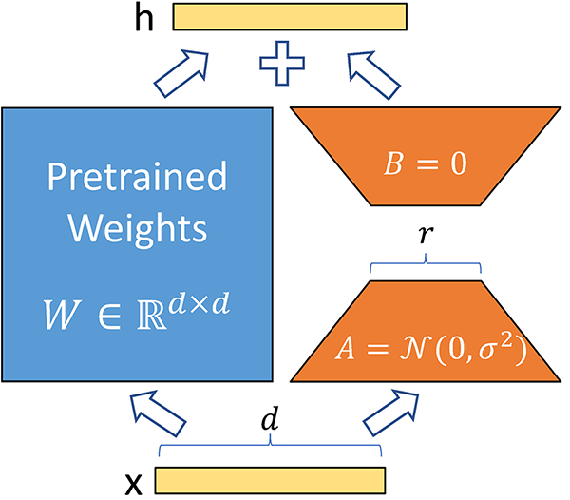
Fine-tuning (LoRA)
Freeze the pretrained weights
W doesn’t change.
Train two small matrices
B × A is the update, with a small rank r.
Full update, d = 4096: 4096 × 4096 = 16.7M numbers
LoRA, r = 8: (4096 × 8) + (8 × 4096) = 65K, 256× fewer
Learn from labeled examples
Same objective as full fine-tuning.
Hu et al. 2021, Figure 1

Slide 11
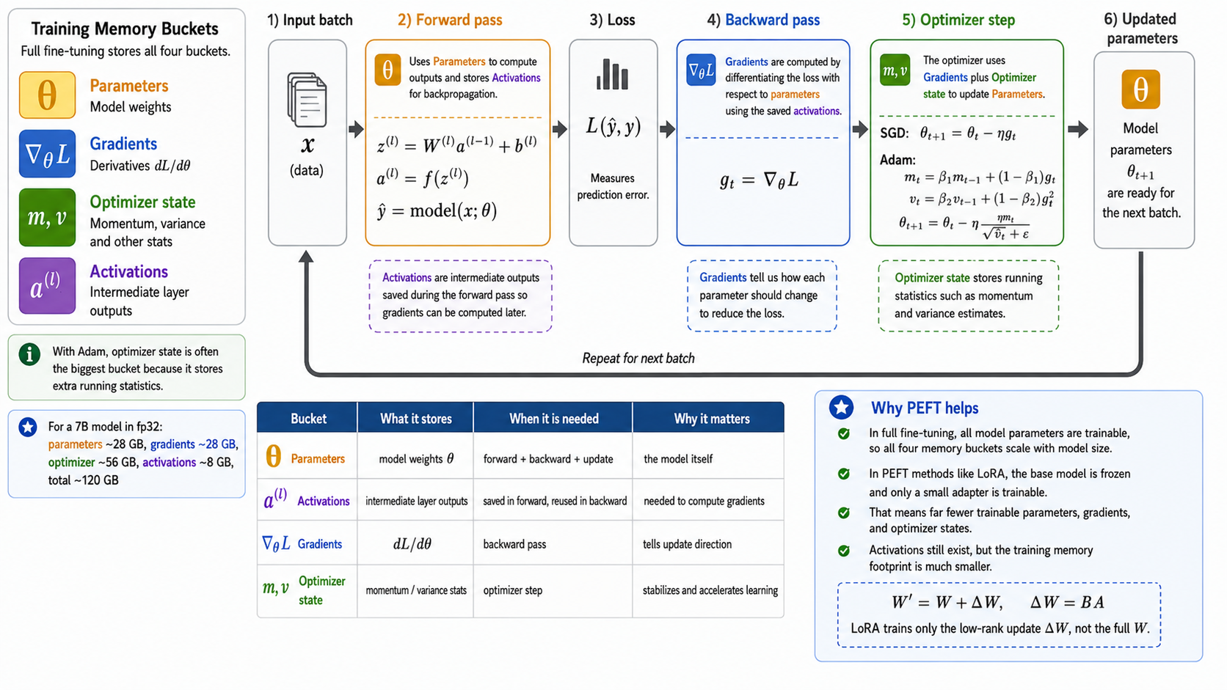
Where training memory goes
Off-the-shelf and GEPA train nothing: parameters only, ~7.5 GB.
Nemotron 3 Nano 4B in bf16: 4.04B weights × 2 bytes

Slide 12
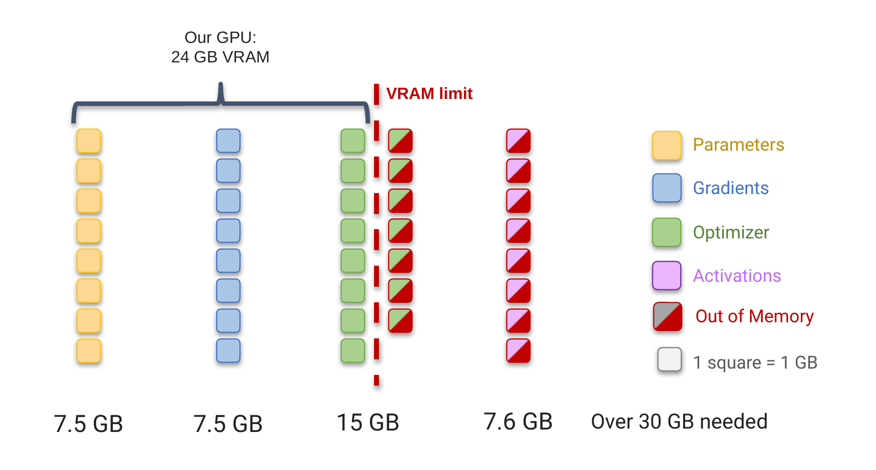
Why LoRA: memory efficiency on Nemotron 3 Nano 4B
Full fine-tuning: ~38 GB. LoRA: 9.0 GB. QLoRA: 5.4 GB.
bf16. LoRA and QLoRA measured; full fine-tuning estimated. · QLoRA in depth: PEFT talk (ODSC AI West 2026)

Slide 13
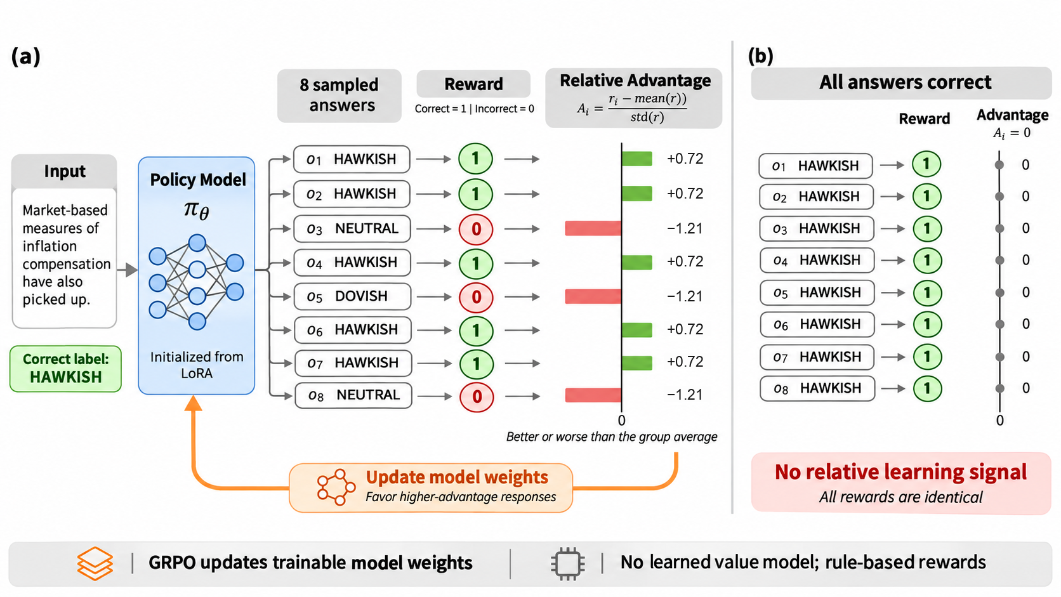
GRPO: Learning from Relative Rewards
GRPO compares multiple responses to the same input and updates model weights to favor better-performing answers.

Slide 14
Results: a better prompt, then fine-tuning
FED INTEREST RATES · Nemotron 3 Nano 4B · test weighted F1, mean of 3 seeds
0.748
0.637
+11
0.588
0.516
+5
+7
Off-the-shelf
paper’s prompt
+ domain knowledge
the paper’s labeling guide
+ 6 examples
chosen by prompt optimization
+ LoRA*
fine-tuned on the best prompt
*RL (GRPO) on top added little: after fine-tuning, most groups of 8 tries all score the same, which gives RL no signal.

Slide 15
Where prompt optimization shines
WHEN TO REACH FOR IT · reported results from teams using GEPA
You can’t touch the weights
Multi-step agents
Rich text feedback
Few labels, costly rollouts
Models behind an API, e.g. on Amazon Bedrock. The prompt is the only knob.
Tunes every prompt in the pipeline together.
Compiler errors, test output, a judge’s reasons.
Works from 20–100 examples. Far fewer rollouts than RL.
Nubank LLM judges: 69% → 89%
Instacart assistant: 77% → 85%
GPU code compiles: 67% → 93%
vs GRPO: up to 35x fewer rollouts
Sources: GEPA use-case showcase (gepa-ai.github.io); Decagon engineering blog, 2026; Agrawal et al., ICLR 2026.

Slide 16
From one laptop GPU to production on AWS
On one laptop GPU
On AWS
GEPA’s reviewer was the same 4B model
Amazon Bedrock
A larger model reviews the prompt
→
Every seed and method ran one at a time
Union on Amazon EKS
Steps run side by side, each sized to fit: CPU, an NVIDIA GPU slice (MIG), or a full GPU
→
24 GB: no full fine-tuning, no larger Nemotron
Amazon EC2 GPU instances, Spot
Bigger GPUs only for the steps that need them, scaled up and down automatically
→
Laptop standby stopped a training run
Union
Interrupted runs recover without repeating completed work
→

Slide 17

Try Union on AWS Marketplace
Union, in your own AWS account
Prompt optimization, fine-tuning and RL as one pipeline
Interrupted runs resume without repeating finished work
Self-serve on AWS Marketplace · 30-day free trial
Thank you. Questions?
Union on AWS Marketplace

