Slide 1
Care - o - Bots
Project_Goal:
Two robots to be programmed to take care of a person on a bed by assisting them to drink water.
Project_Milestone:
A home environment with a fixed and a mobile robot in it. The mobile robot must be able to move within this environment.
Final_Demonstration:
The robot must be able to move from one room to the elder person, perform a selected task and roll back. The task here is to transport a glass to the elder’s bed and hold them the drink while drinking.

Slide 2
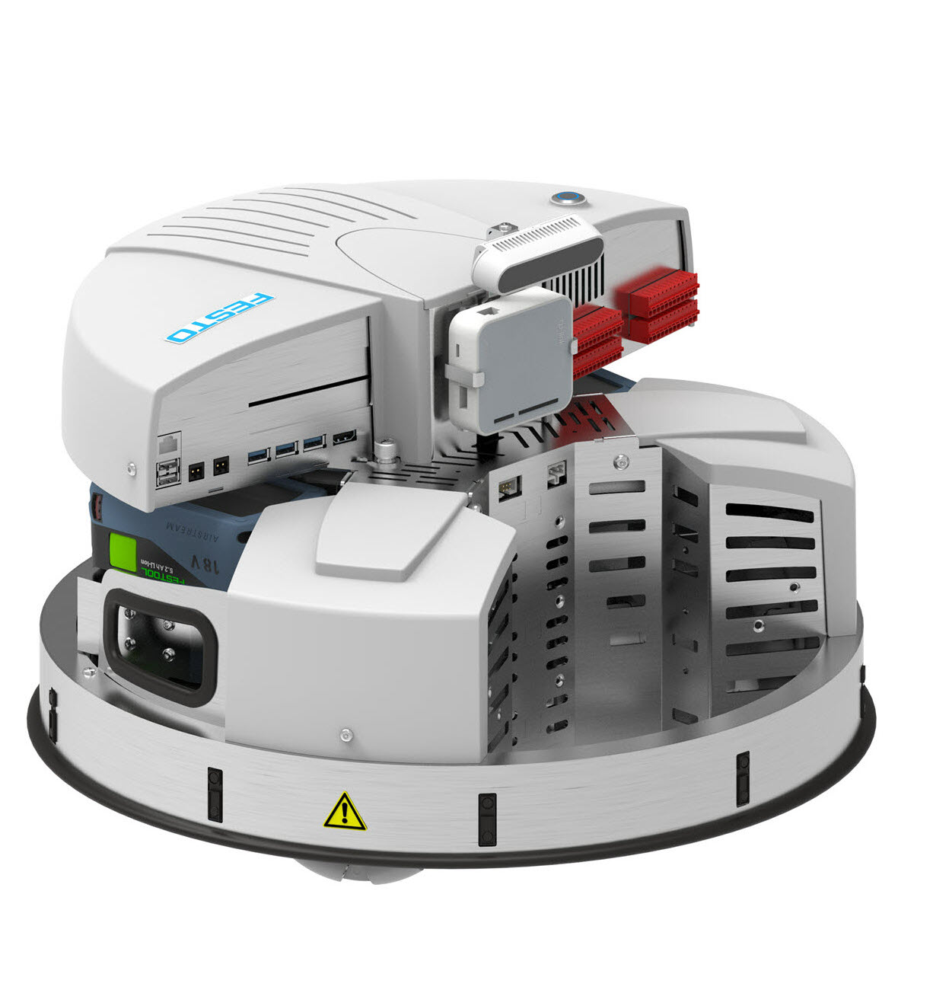
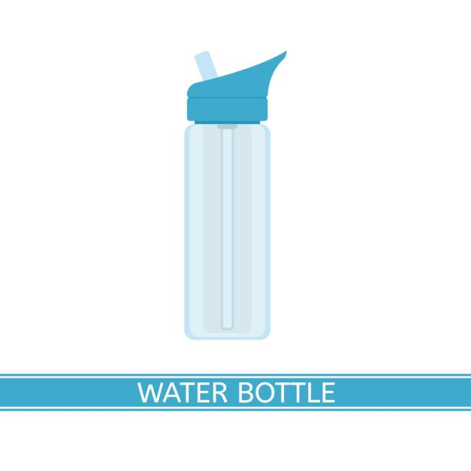

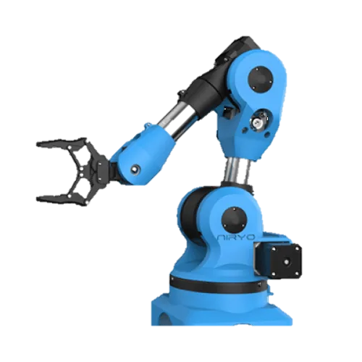
Robotino:
Mobile robot powered with 3 Mecanum Wheels
9 IR Sensors
1 Bump Sensor
Accelerometer
Compass
Ned:
6DOV Robotic Arm

Slide 3
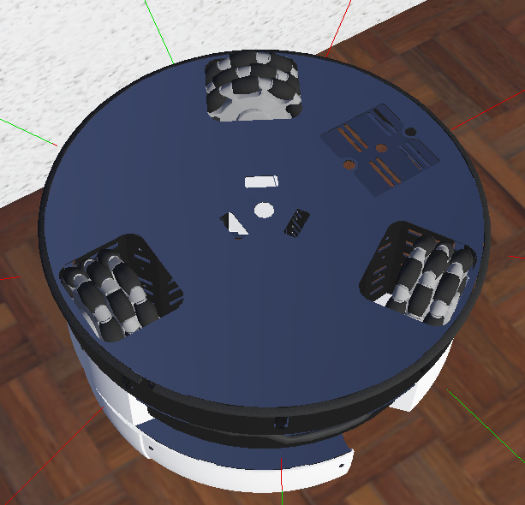
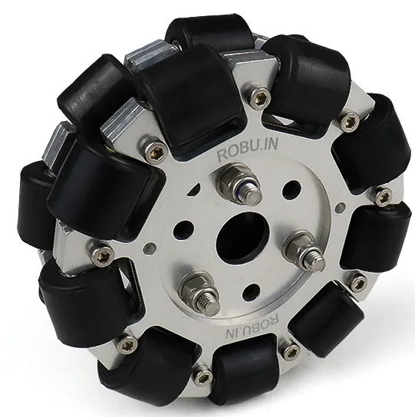
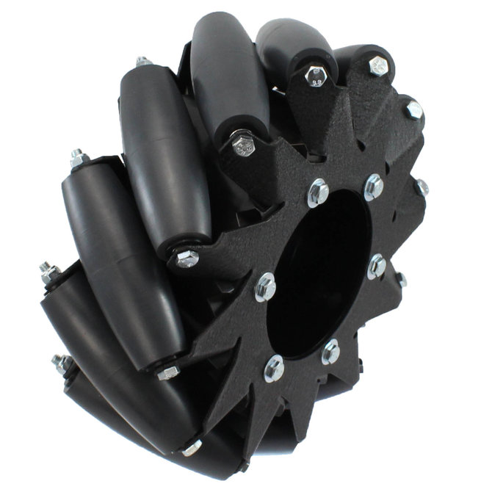
Kinematics of Omni-Directional Wheels
_{y}
V_{A}
+ V_{C} cos(30˚)
V_{C}
x
− V_{B} cos(60˚)
V_{B}
V_{X} = V_{A} − V_{B} cos(60˚) + V_{C} cos(30˚)
Omni-Directional
Mecanum
V_{Y} = −V_{B} sin(60˚) + V_{C} cos(30˚)
r . ω = V_{A} + V_{B} + V_{C}

Slide 4
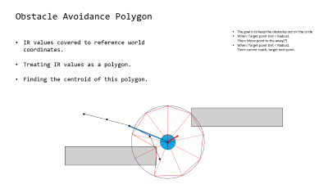
Obstacle Avoidance Polygon
The goal is to keep the obstacles out oV the circle
When: Target point Dist < Radius1 Then: Move point to the away(?)
When: Target point Dist < Radius1 Then: cannot reach, target next point.
IR values covered to reference world coordinates.
Treating IR values as a polygon.
Finding the centroid of this polygon.
c

Slide 5
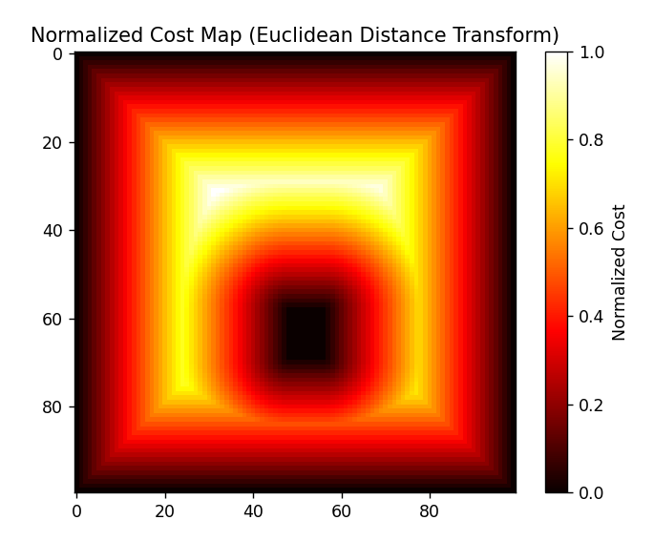
Grid Cost Mapping
Lower costs further away from the walls
The path algorithm will prefer the lower costs.
Normalizes at the end.
Euclidean Distance Transform

Slide 6

Path Finding
A* Search Algorithm
Uses the cost map generated by edt.
Diagonal Search enabled
Pure Pursuit
Look Ahead at bit
Start from the nearest path point

Slide 7
The goal is to keep the obstacles out oV the circle
When: Target point Dist < Radius1 Then: Move point to the away(?)
When: Target point Dist < Radius1 Then: cannot reach, target next point.
c
c

Slide 9
1m = 0.90436 gps
1m = (600/10) pxl

