Slide 1
Emotion Recognition from Text
Classical ML · RNN · Transformers · XAI
Anger · Joy · Sadness · Fear — 3 Datasets Comparison
Project Report · May 2026

Slide 2
Project Goals
Build and compare emotion classification models across 3 approaches: classical ML, RNN, Transformers
4 target emotions: anger, joy, sadness, fear
Evaluate on 3 datasets: Combined (60k balanced), ISEAR (4.3k), GoEmotions (11k)
Analyze model generalization on out-of-domain data
Apply XAI techniques (LIME, Integrated Gradients) for model interpretability
Identify best model considering accuracy, generalization, and explainability

Slide 3
Datasets
Dataset | Total Samples | Anger | Joy | Sadness | Fear | Source
Combined | 60,000 | 15,000 | 15,000 | 15,000 | 15,000 | kushagra3204/sentiment-and-emotion-analysis-dataset
ISEAR | 4,284 | 1,078 | 1,080 | 1,054 | 1,072 | faisalsanto007/isear-dataset
GoEmotions | 11,092 | 3,833 | 3,317 | 2,757 | 1,185 | debarshichanda/goemotions
Combined: 6-emotion dataset (422k sentences), filtered to 4 emotions, balanced to 60k (15k/class)
ISEAR: psychological questionnaire dataset, naturally balanced
GoEmotions: Reddit comments, imbalanced — fear underrepresented (1,185), anger dominant (3,833)

Slide 4
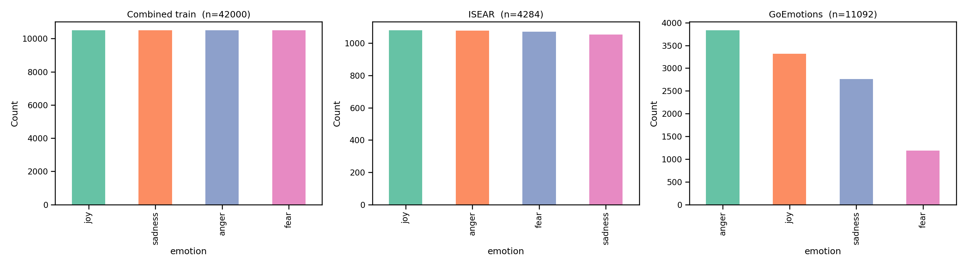
Data Distribution
Combined train set: perfectly balanced (42k total after split)
ISEAR: nearly balanced (1,054–1,080 per class)
GoEmotions: imbalanced — fear has only 1,185 samples vs 3,833 anger
Train/val/test split: 70/15/15% stratified by class

Slide 5
Methodology & Models
Classical ML (TF-IDF + Classifier):
• SVM (LinearSVC, class_weight='balanced')
• Decision Tree (max_depth=50)
• Naive Bayes (MultinomialNB)
Recurrent Neural Networks (BiRNN):
• BiLSTM — 2-layer bidirectional LSTM
• BiGRU — 2-layer bidirectional GRU
• Embedding dim=128, Hidden dim=128
Fine-tuned Transformers (HuggingFace Trainer):
• Own-DistilBERT (distilbert-base-uncased)
• Own-DistilRoBERTa (distilroberta-base)
Pretrained Emotion Transformers:
• Emotion-BERT (bhadresh-savani/bert-base-uncased-emotion)
• Emotion-RoBERTa (SamLowe/roberta-base-go_emotions)
XAI: LIME (classical + transformers), Integrated Gradients (RNN)

Slide 6
Results — Macro F1 Score Comparison
Model | Combined_test | ISEAR | GoEmotions | Avg
Own-DistilBERT | 0.9810 | 0.7409 | 0.5937 | 0.7719
Own-DistilRoBERTa | 0.9808 | 0.6941 | 0.5479 | 0.7409
BiLSTM | 0.9766 | 0.4065 | 0.3714 | 0.5848
BiGRU | 0.9758 | 0.5230 | 0.3750 | 0.6246
Emotion-BERT | 0.9730 | 0.7089 | 0.5799 | 0.7539
SVM | 0.9513 | 0.6132 | 0.4156 | 0.6600
NaiveBayes | 0.9138 | 0.5998 | 0.4563 | 0.6566
Emotion-RoBERTa | 0.5804 | 0.6421 | 0.7814 | 0.6680
DecisionTree | 0.5157 | 0.2839 | 0.1980 | 0.3325
Green cells = high performance. Own-DistilBERT is the best overall model (avg macro F1 = 0.7719)

Slide 7
Best Model: Own-DistilBERT — Detailed Breakdown
Dataset | Anger | Fear | Joy | Sadness | Avg F1
Combined_test | 0.9718 | 0.9761 | 0.9929 | 0.9832 | 0.9810
ISEAR | 0.7169 | 0.8006 | 0.7648 | 0.6816 | 0.7409
GoEmotions | 0.6631 | 0.4422 | 0.7168 | 0.5528 | 0.5937
Own-DistilBERT: fine-tuned distilbert-base-uncased (67M params) on 42k Combined training samples
Best in-domain (Combined_test): 0.9810 macro F1 — near-perfect classification
Good generalization on ISEAR (0.7409) — more formal, psychological language
Moderate on GoEmotions (0.5937) — informal Reddit text, different distribution
Fear is hardest class on GoEmotions (0.4422) — due to class imbalance in training
Training configuration: 3 epochs, batch_size=16, lr=2e-5, max_len=64, fp16

Slide 8
Model Comparison Insights
In-Domain (Combined_test):
• All Transformers + RNNs score >0.97 macro F1 — saturation on in-distribution data
• SVM and NaiveBayes also strong (0.95, 0.91) with much lower training cost
• DecisionTree severely limited (0.52) — insufficient depth for text classification
Cross-Domain — ISEAR (psychological text):
• Own-DistilBERT (0.74) and Emotion-BERT (0.71) generalize best
• BiLSTM collapses to 0.41 — overfits to Combined distribution
• DecisionTree and RNNs suffer most: linguistic patterns don't transfer
Cross-Domain — GoEmotions (Reddit):
• Emotion-RoBERTa (0.78) is best — it was pretrained on GoEmotions itself!
• Own-DistilBERT (0.59) and Emotion-BERT (0.58) follow
• Classical models and RNNs drop below 0.46 — vocabulary mismatch hurts TF-IDF

Slide 9
Training Curves — Transformers
Training curves not available (checkpoints/ must contain trainer_state.json)
Both models converged well within 3 epochs with validation macro F1 ~0.98

Slide 10
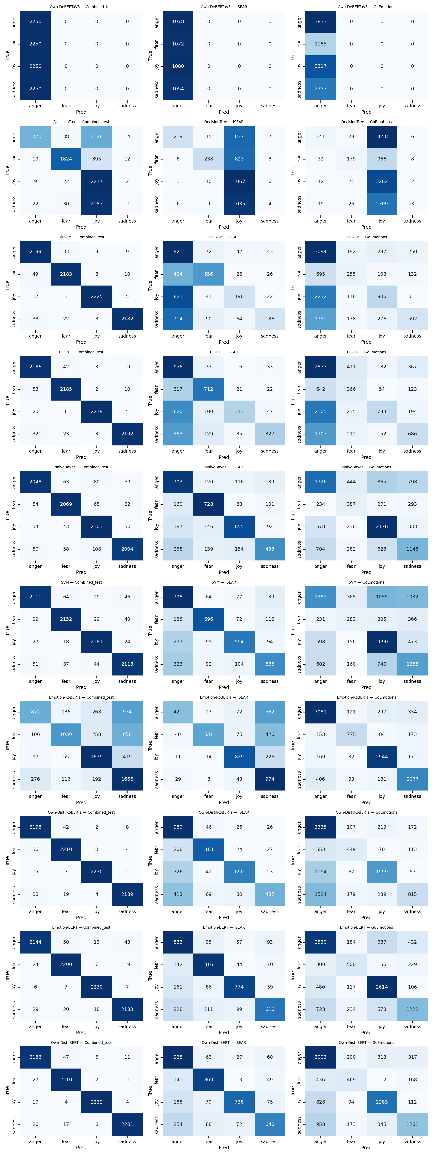
Confusion Matrices — Best Model

Slide 11
XAI — Model Explainability Analysis
LIME (Local Interpretable Model-agnostic Explanations):
• Applied to classical ML (NaiveBayes, DecisionTree) and transformers
• Highlights individual tokens contributing to each prediction
• Computes feature importance by perturbing input text
Integrated Gradients (Captum):
• Applied to BiLSTM and BiGRU via embedding layer attribution
• Attribute importance scores to each input token
• Gradient-based method with baseline comparison
XAI Similarity Analysis (Jaccard, Spearman, Cosine):
• BiGRU vs BiLSTM: highest agreement (cosine=0.86, jaccard=0.69) — similar RNN architecture
• LIME_Own-DistilBERT vs LIME_Own-DistilRoBERTa: high agreement (cosine=0.93) — similar transformer attention
• DecisionTree vs all others: lowest agreement — fundamentally different decision process
• RNN and Transformer explanations show moderate correlation: both capture similar linguistic patterns

Slide 12
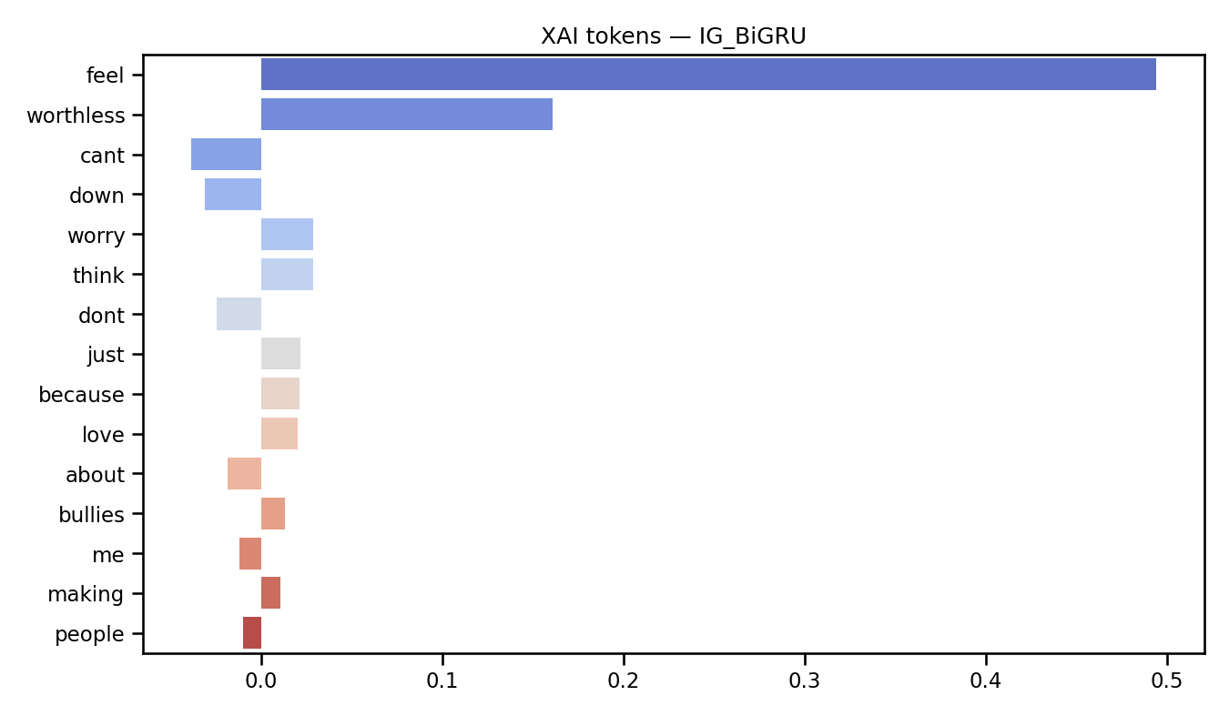
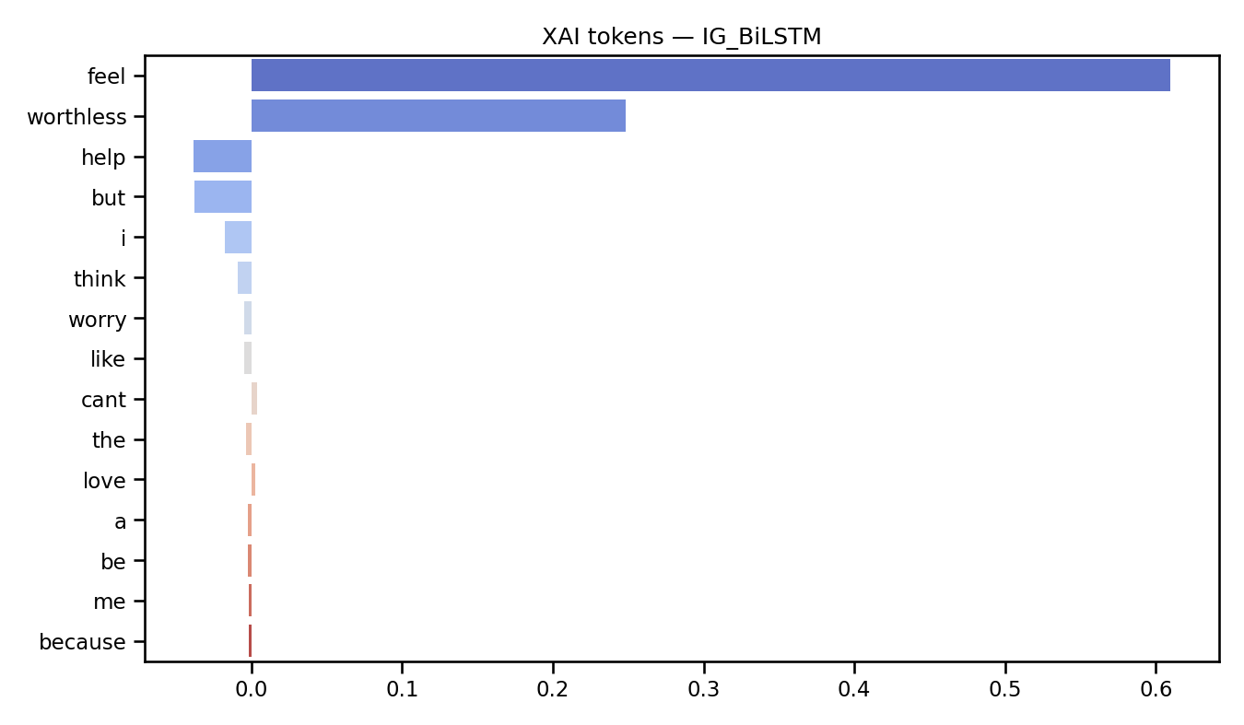
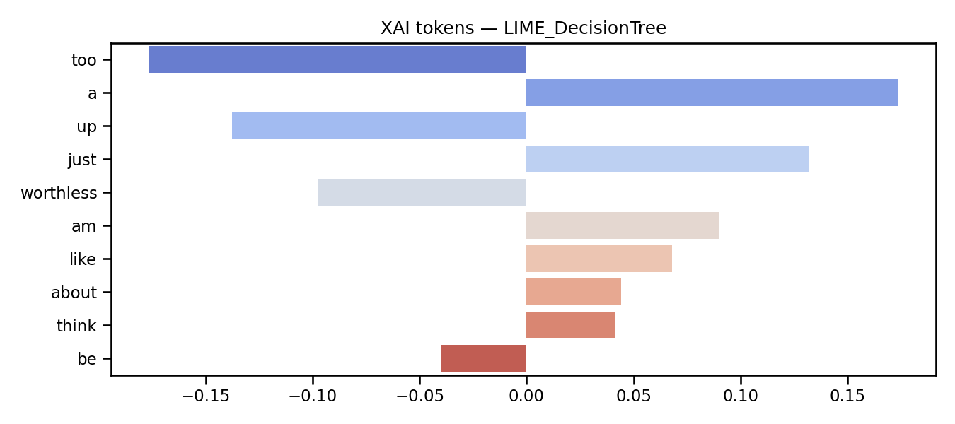
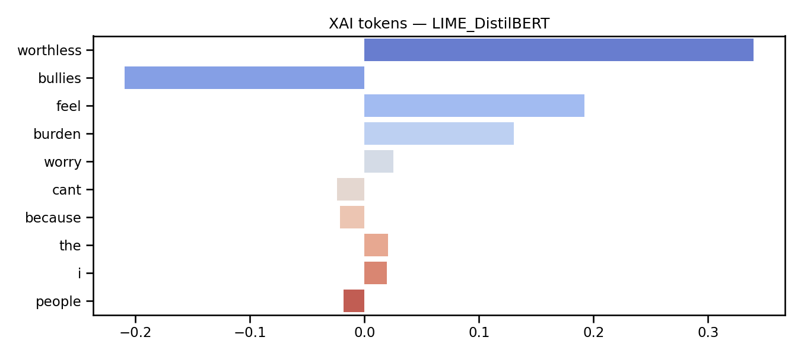
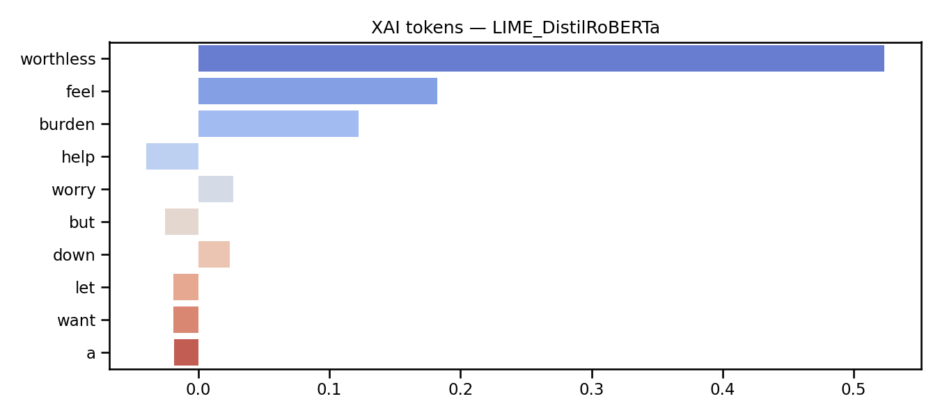
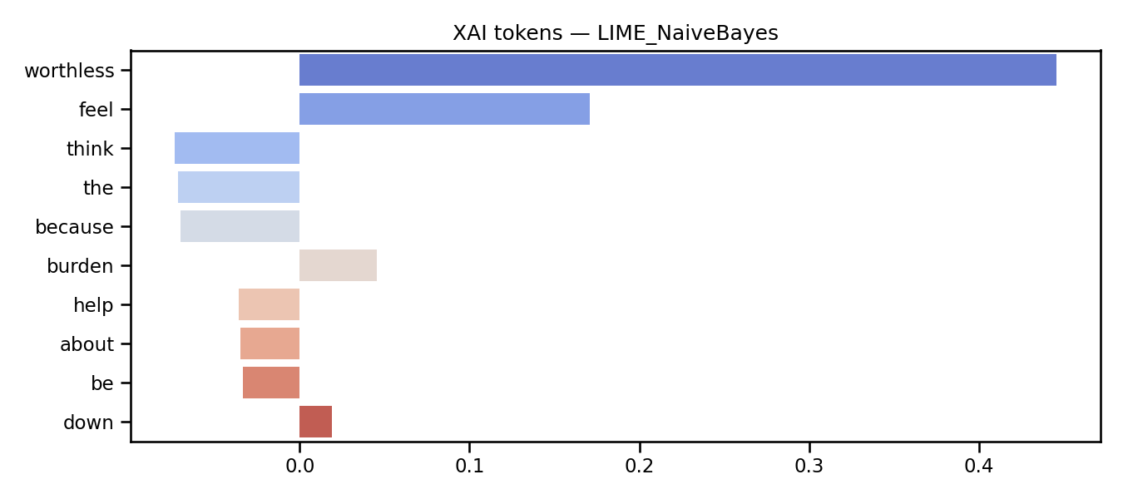
XAI — Top Token Attributions (Sample)
IG_BiGRU_sample0
IG_BiLSTM_sample0
LIME_DecisionTree_sample0
LIME: top tokens usually sentiment-bearing words (e.g., 'love', 'hate', 'cried', 'scared')
Integrated Gradients: focuses on emotional keywords and negations
Transformers show more distributed attention across tokens than classical models
Different models highlight similar key tokens for same emotion classes
LIME_DistilBERT_sample0
LIME_DistilRoBERTa_sample0
LIME_NaiveBayes_sample0

Slide 13
Conclusions
Model | Combined_test | ISEAR | GoEmotions | Best For
Own-DistilBERT | 0.9810 | 0.7409 | 0.5937 | Overall best generalization
Emotion-BERT | 0.9730 | 0.7089 | 0.5799 | Zero-shot transfer
Emotion-RoBERTa | 0.5804 | 0.6421 | 0.7814 | GoEmotions specialist
SVM + TF-IDF | 0.9513 | 0.6132 | 0.4156 | Fast, interpretable baseline
BiGRU | 0.9758 | 0.5230 | 0.3750 | Good in-domain only
Own-DistilBERT (fine-tuned) provides the best balance of accuracy and generalization across domains
Pretrained Emotion-BERT works well zero-shot without fine-tuning on target data
Classical ML (SVM) is surprisingly competitive in-domain and on formal text (ISEAR) at minimal cost
Cross-domain generalization remains the key challenge — especially from curated to social media text
RNNs (BiLSTM, BiGRU) perform well in-domain but overfit and don't transfer to different domains
XAI reveals that different model families focus on similar emotional keywords, but with different decision boundaries

Slide 14
References
Datasets:
• Combined: kaggle.com/datasets/kushagra3204/sentiment-and-emotion-analysis-dataset
• ISEAR: kaggle.com/datasets/faisalsanto007/isear-dataset
• GoEmotions: kaggle.com/datasets/debarshichanda/goemotions
Pretrained Models (HuggingFace):
• Emotion-RoBERTa: SamLowe/roberta-base-go_emotions
• Emotion-BERT: bhadresh-savani/bert-base-uncased-emotion
• DistilBERT: distilbert-base-uncased
• DistilRoBERTa: distilroberta-base
Libraries: scikit-learn, PyTorch, HuggingFace Transformers, Captum, LIME, matplotlib, seaborn

