Slide 1




supporting
#NokiaRSA

Slide 2
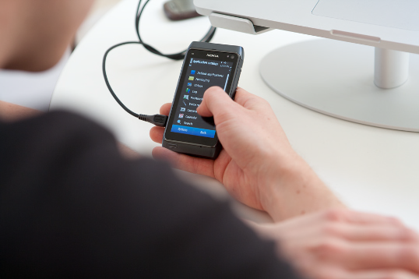
Testing and Certification
Nokia testing devices for mLab companies
Access to remote testing services
Physical testing environment for Nokia
(testing suite, flashing station etc.)
Access to private API’s and SDK’s for top developers
Ensuring access to proto devices for the
mLab top companies
Application certification
#NokiaRSA
Notes:
mLab market devices available for testing purposes; Latest Nokia offering showcased to developers
Improved quality of developed apps through
remote testing
Free remote testing vouchers available for mLabs

Slide 3





Training and Accreditation
Training on Nokia platforms as part of the
mLab curriculum
Certifications of mLab
developers
Accreditation of training partners
#NokiaRSA

Slide 4

Business mentoring and intelligence
Mentorship model for mLab
Link mentorship to competitions and membership programs
Sharing of business intelligence
#NokiaRSA

Slide 5
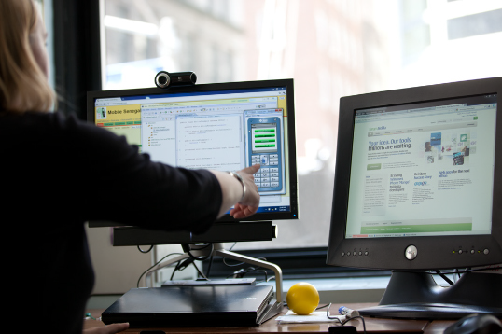
Outreach Activities
Events
Messaging
Competitions
#NokiaRSA

Slide 6
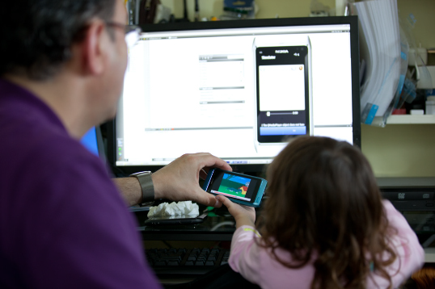
Research Programs
Market research
Consumer behavior
Research capabilities
#NokiaRSA

Slide 7

Outsourcing
Development outsourcing
Prototyping
R&D
#NokiaRSA

Slide 8
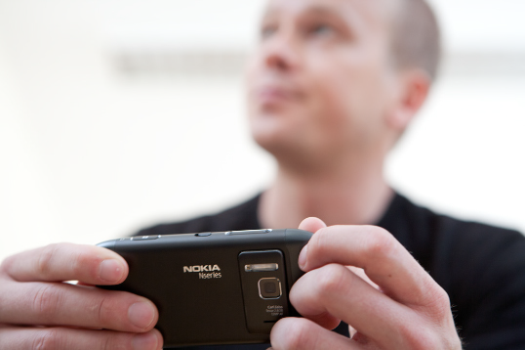
Funding
Link mLab companies to funding instruments
VC partnerships
Incubate companies out of mLab
#NokiaRSA

Slide 9

Derrick Kotze
Developer Outreach and Marketing
derrick.kotze@nokia.com
+27 82 567 6817
#NokiaRSA

